Slide 1

OpenStreetMap: An example for Open Technology, Open Source and Citizen Science
History, Data Structure, License and Ecosystem
Prof. Dr. Franz-Josef Behr
Partially based on a a presentation of Min Qian, Virasith Phomsouvanh (2008): The OpenStreetMap (OSM) Project. Stuttgart University of Applied Sciences
Moscow State University of Geodesy and Cartography – MIIGAiK, 2017-10-12
The content is licensed under a Creative Commons-Lizenz CC BY-NC-SA.

Slide 2
Introduction

Slide 3
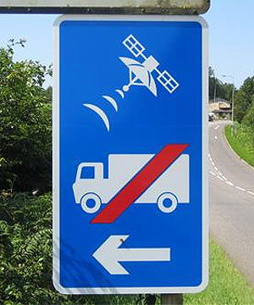
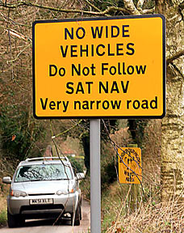
Problems of „traditional“ navigation data
Source:Mikel Maron 2008: FreeMap West Bank. Bethlehem

Slide 4
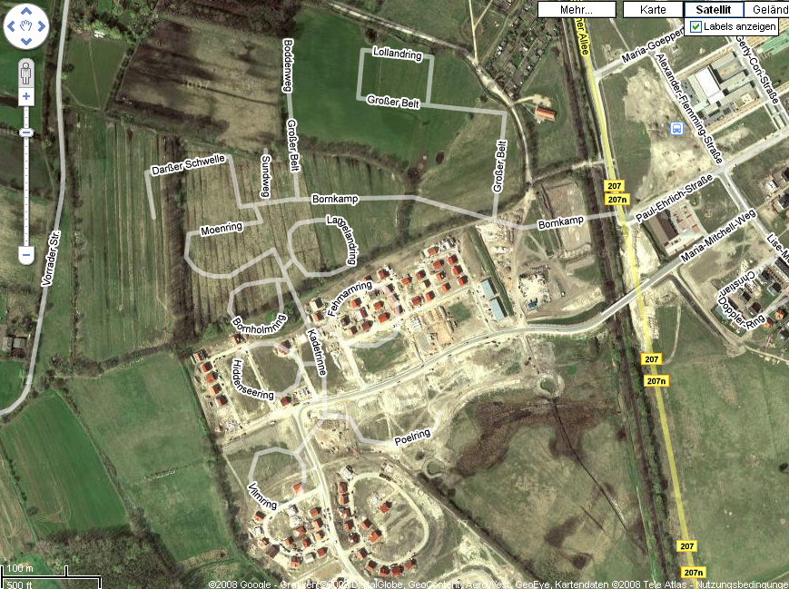
http://maps.google.de/maps?q=l%C3%BCbeck&ie=UTF8&oe=utf-8&client=firefox-a&ll=53.829294,10.684354&spn=0.009308,0.027895&t=h&z=16

Slide 5
OpenStreetMap however…
Offers its data for free
Grows dynamically
Is updated quite regularly
Is user driven, not profit driven

Slide 6
Ideas and Background

Slide 7
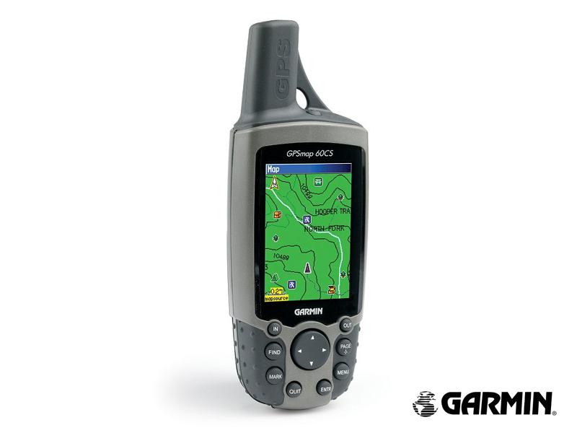

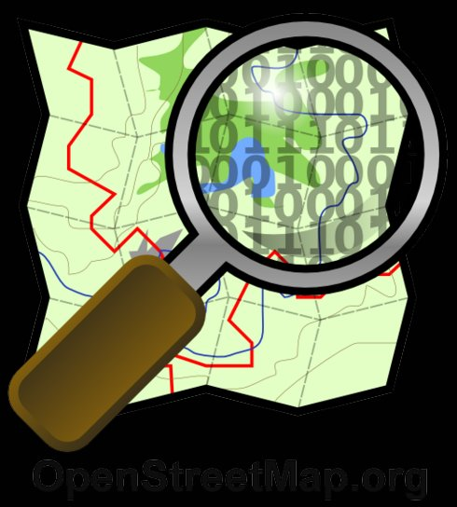
The OpenStreetMap Equation
+
=
Something like a Wiki…
GNSS measurements
Open Geodata Repository
Source:Mikel Maron 2008: FreeMap West Bank. Bethlehem

Slide 8
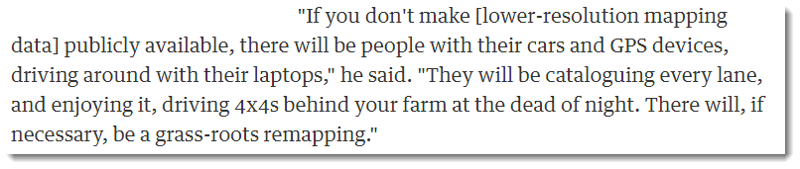
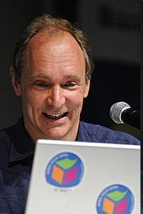

Some motivating ideas…
Tim Berners-Lee, 2006 [1]
Tim Berners-Lee, one of the "inventors" of the WWW and the Semantic Web
[1] http://www.guardian.co.uk/society/2006/mar/23/epublic.technology#article_continue [2017-10-30]
[2] http://www.flickr.com/photos/89142790@N00/3212369167

Slide 9

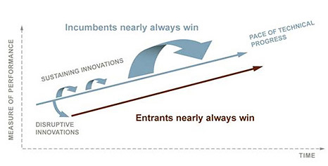
“…in almost every case, a disruptive technology enables a larger population of less skilled people to do things that historically only an expert could do. And to do it in a more convenient settings.
… One of the […] mechanisms through which our lives have improved”
Clayton Christensen (2010): How Will You Measure Your Life. Harper Collins Publ. USA

Slide 10
“You could have a community capability
where you took the GPS data of people driving around and started to see,
oh, there’s a new road that we don’t have, a new route .. And so that data eventually should just
come from the community
with the right software infrastructure.” -- Bill Gates
Cited based on https://news.microsoft.com/speeches/bill-gates-microsoft-mix06-conference/#OVu0wkJzjoZKyycJ.97 [2017-06-22]

Slide 11
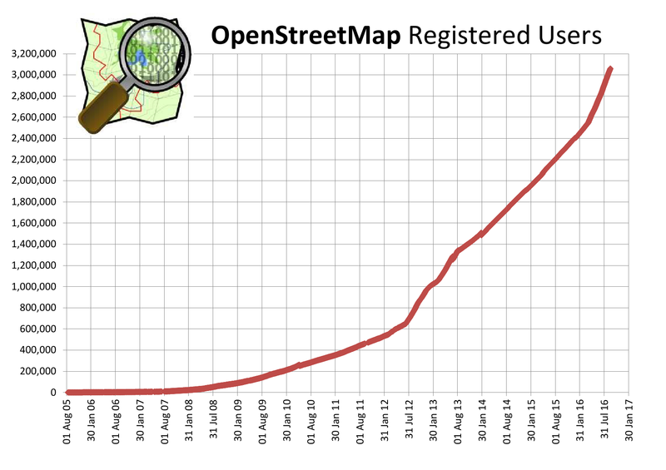
http://wiki.openstreetmap.org/wiki/Stats [2017-06-22]

Slide 12
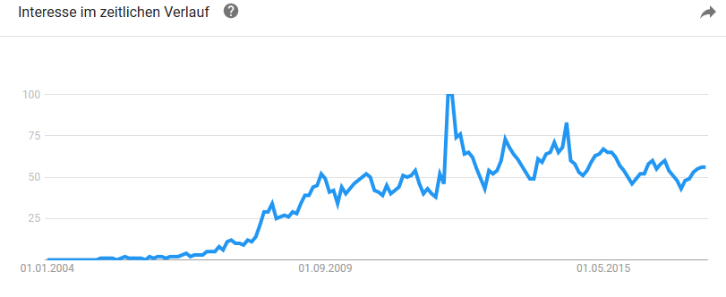
Trends, observed by Google
http://www.google.de/trends?q=OpenStreetMap&ctab=0&geo=all&date=all&sort=2 [2017-06-22]

Slide 13
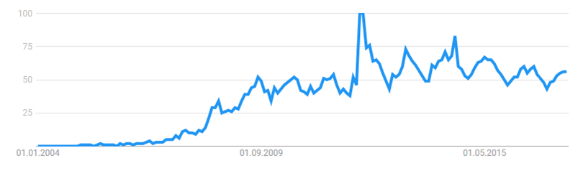
The OpenStreetMap Project - History
Aug 2004: founded by Steve Coast (since that time working for different companies)
Dec 2005: 1000 User
March 2006: Osmarender
May 2006: Isle of Wight Mapping Party
Aug 2006: OpenStreetMap Foundation: fundraising,
promotion and legal representation
Nov 2006: Slippy Map, significantly increasing number of data
Feb 2007: City of Cambridge completely mapped
since 2008: several German cities completely mapped
2010: OSM integrated in Bing Maps and MapQuest

Slide 14
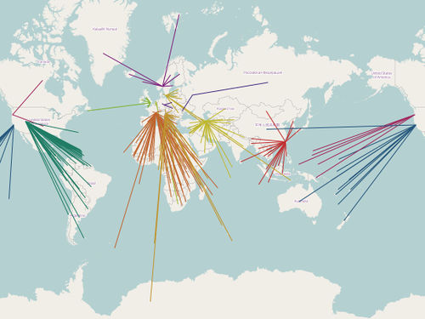
How does it work?
Decentral data collection and updating primarily by volunteered work (Volunteered Geographic Information, VGI) Goodchild, M.F. (2007). "Citizens as sensors: the world of volunteered geography". GeoJournal. 69 (4): 211–221
Central database
stored in PostgreSQL with PostGIS
Data processing
by Ruby on Rails
Rendering
by MapNik
Presentation of Tiles
by Leaflet
Data export
Content Delivery Network of Tile Servers, http://wiki.openstreetmap.org/wiki/File:OSM-tileserver_worldwide_Jan2015.jpg [2017-06-22]

Slide 15
Motivation for crowd-sourcing success
Trust
Non-monetary motivation
Give people ownership
Create a short feedback loop -
Allow especially talented people to do amazing things
Discrete multi-size pieces
Low-cost integration
Fun
Short time needs
Fun

Slide 16
A closer look

Slide 17
Resources to learn
http://wiki.openstreetmap.org/wiki/Main_Page
http://learnosm.org/en/
http://www.weeklyosm.eu/

Slide 18

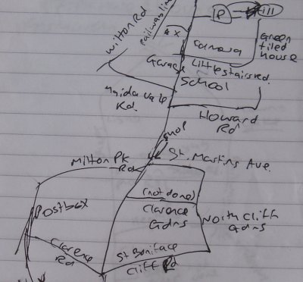
Where do the data come from?
Data donations – mind the license
GNSS enabled devices – basically free
  At the beginning: Explicit GNSS devices (GNSS rover)
  Nowadays: Smart phones
Digitization over backdrop imagery, donated by Remote Sensing corporations or Mcrosoft etc. and NMA (using WMS services)
Private notes, sketches, photographs or maps (rarely), basically free

Slide 19
Data donations: Openly-licensed data from national mapping agencies and other sources
Austria: data from Stadt Wien (under CC BY), Land Vorarlberg and Land Tirol (under CC BY AT with amendments).
Canada: data from GeoBase®, GeoGratis (© Department of Natural Resources Canada), CanVec (© Department of Natural Resources Canada), and StatCan (Geography Division, Statistics Canada).
Finland: data from the National Land Survey of Finland's Topographic Database and other datasets, NLSFI License.
France: data sourced from Direction Générale des Impôts.
Netherlands: © AND data, 2007 (www.and.com)
New Zealand: data sourced from Land Information NZ. Crown Copyright reserved.
Slovenia: data from the Surveying and Mapping Authority and Ministry of Agriculture, Forestry and Food (public information of Slovenia).
South Africa: data sourced from Chief Directorate: National Geo-Spatial Information, State copyright reserved.
United Kingdom: Ordnance Survey data © Crown copyright and database right 2010-12.

Slide 20
Collaboration
Task Manager: mapping tool designed and built for the Humanitarian OSM Team collaborative mapping.
  mapping jobs are divided into smaller tasks that can be completed rapidly.
  shows which areas need to be mapped and which areas need the mapping validated.
  http://tasks.hotosm.org/

Slide 21
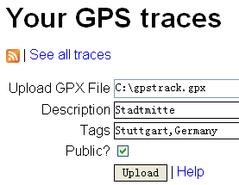
Data upload
GPX
WGS84 Datum
Field papers
GPS Traces
Database

Slide 22
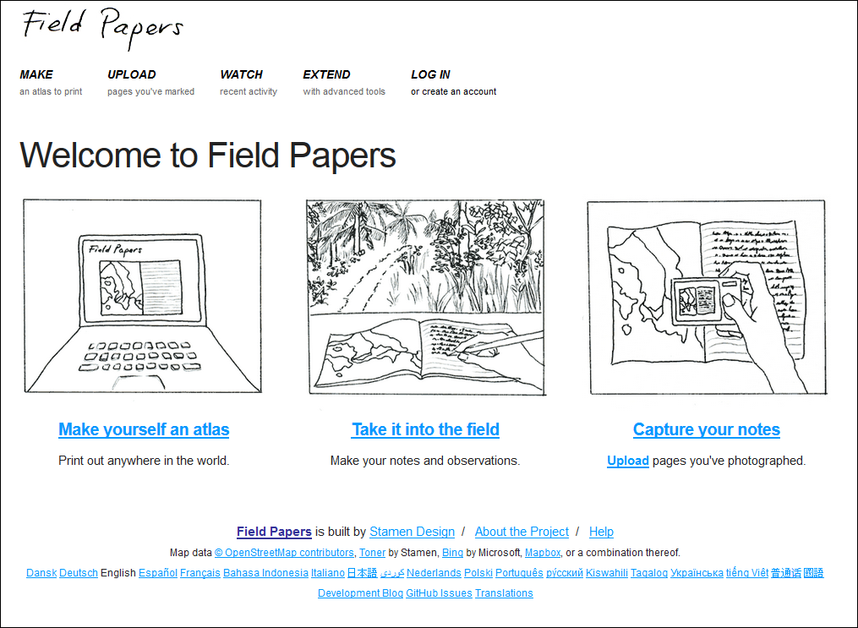
http://fieldpapers.org/?locale=en

Slide 23
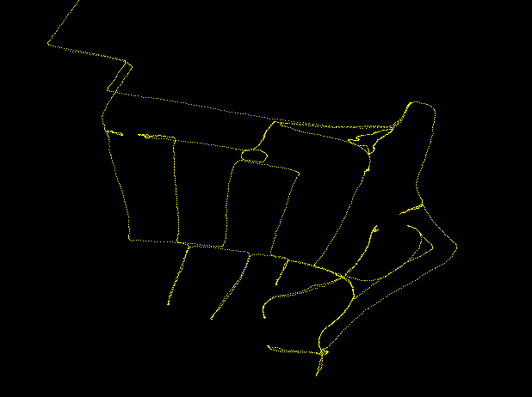
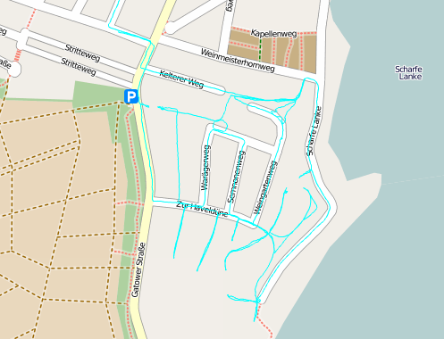
After Data upload: Feature Creation

Slide 24
The Data Model

Slide 25

Lesson to learn
"The importance of this cannot be over estimated. We use the IETF mantra – 'rough consensus and running code'.
Too many specifications are written in advance of implementations and many turn out to be too complex, both for implementers and the community. The full range of software must include authoring tools, editors, validators, in-memory data models, renderers, and conversion to and from legacy."
Peter Murray-Rust, Open access and open data activist, University of Cambridge
[1] Peter Murray-Rust (n.d.): Data-driven science - a scientist's view. http://www.ibrarian.net/-navon/paper/-Data_driven_science___a_scientist_s_view.pdf?paperid=9300672 [2017-10-05]

Slide 26
Basic OSM Objects Types
“The simplest solution which could work!”
  For Geospatial Community: Quite uncommon data model, not fitting to international standards.
XML-based objects
  Nodes (point objects)
  Ways (linestrings, linear rings, used for polygons as well)
  Relations (compound objects)
Geomtetrical
Objects
+
Tags
=
Features

Slide 27
Lesson to learn
Keep your data model simple.
Integrate the following properties:
  Unique Id (in the sense of a primary key in databse technology)
  Timestamp
  Version number, to be incremented with each update
Keep previous versions in your database

Slide 28
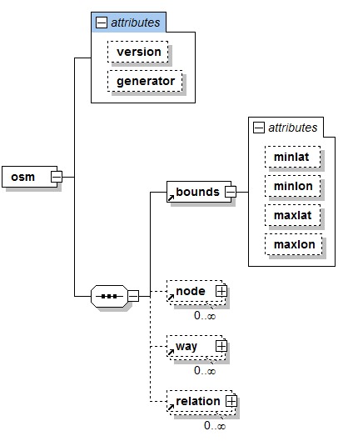
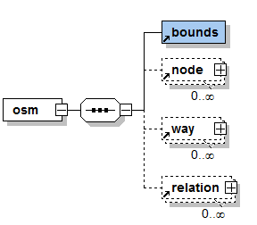
Data Types: Overview
Abstract overview
Overview, unfolded

Slide 29
<?xml version="1.0" encoding="UTF-8"?>
<osm
version="0.6"
generator="CGImap 0.6.0 (17576 thorn-03.osm.org)"
copyright="OpenStreetMap and contributors"
attribution=http://www.openstreetmap.org/copyright
license=http://opendatacommons.org/licenses/odbl/1-0/
>
<bounds minlat="40.6962400" minlon="-74.0626600" maxlat="40.7017500" maxlon="-74.0499300"/>
...
</osm>

Slide 30
Data Types: Overview, alternative representation
Way
id
visible
Timestamp
user
Way
Node
Node
id
Lat
long
visible
timestamp
Tag
Relation

Slide 31


Node
a point object, basically latitude and longitude
can represent point features, e.g. a bus station or postal address, and all of kinds of points of interesting (POI), having at least one tag
can be a vertex of a way (or of many ways)

Slide 32
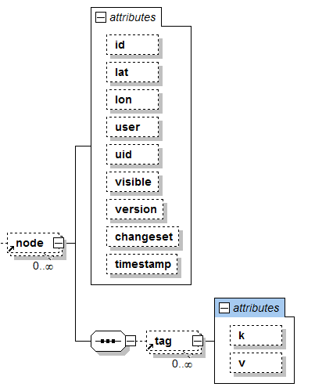
Node: XML structure and example
<node id=“874039” lat=“48.7728093” lon=“9.1771907” version="1" user="fjb">
<tag k="name" v="Oblomow" />
<tag k="created_by" v=“Potlatch” />
<tag k="amenity" v=“phonebox” />
</node>

Slide 33


Way
A linear feature characterized by uniform properties
  Example: motorway
  tagging with: highway=motorway
Ways can be split into shorter ways if different properties exist (e.g. different surface material)

Slide 34
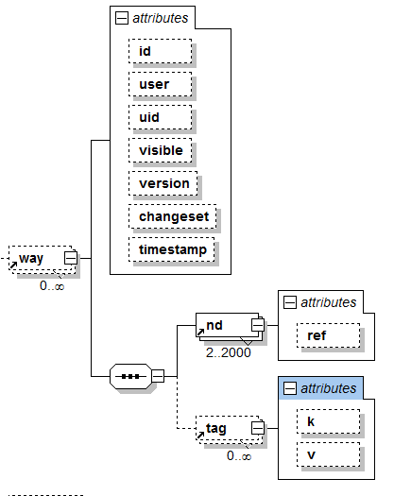
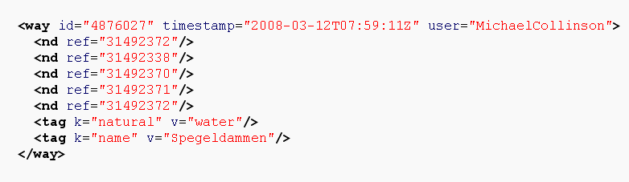

Slide 35
Closed ways: Areal Features
Should have appropriate tag, e.g. landuse
First node = last node

Slide 36
Relation
Basically: group of objects where each object may take on a specific role
specifying relationships between objects,
may also model an abstract object.

Slide 37
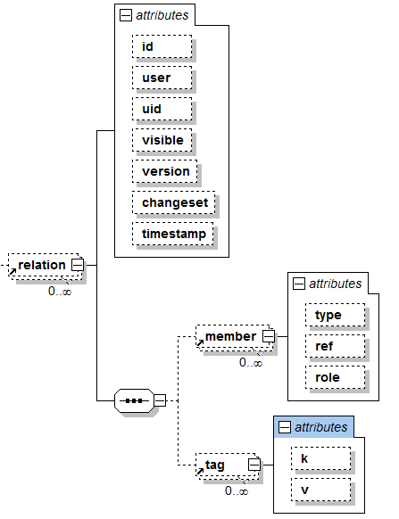
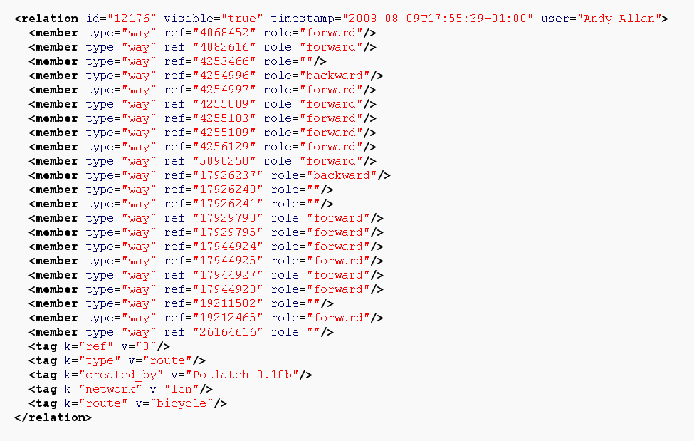

Slide 38
Tagging
Assign properties to objects with key=value
Arbitrary Tags possible
Community based process (Wiki), yielding discussions...
Very flexible
Partially unstructured → "Folksonomy"
Tags
physical
Non-physical
Naming, meta…

Slide 39
Physical Tags
highway=motorway
highway=cycleway
Highway (roads, paths, intersection features…)
Waterway (river, boatyard; mooring…)
Railway (track, stop, intersection...)
Amenity (parking, post_box, place_of_worship…)
Landuse (farm, forest, landfill, military…)
Natural (spring, wood, water, coastline…)
……
railway=subway
railway=station
railway=subway_entrance

Slide 40
Non-Physical Tags
area=yes
lane=4
layer=1
Route (bus, ferry…)
Sport (football, swimming…)
Properties (area, lane, layer, width…)
Restrictions (oneway, maxspeed, toll…)
……
oneway=yes
maxspeed=40
toll=yes
Details: http://wiki.openstreetmap.org/index.php/Map_Features

Slide 41
Further Tags
Naming tags
  Name
  References (ref…), e.g. for street numbers
  ……
Annotation
  note,
  Description
Metatags
  created_by
  version
Details: http://wiki.openstreetmap.org/index.php/Map_Features

Slide 42
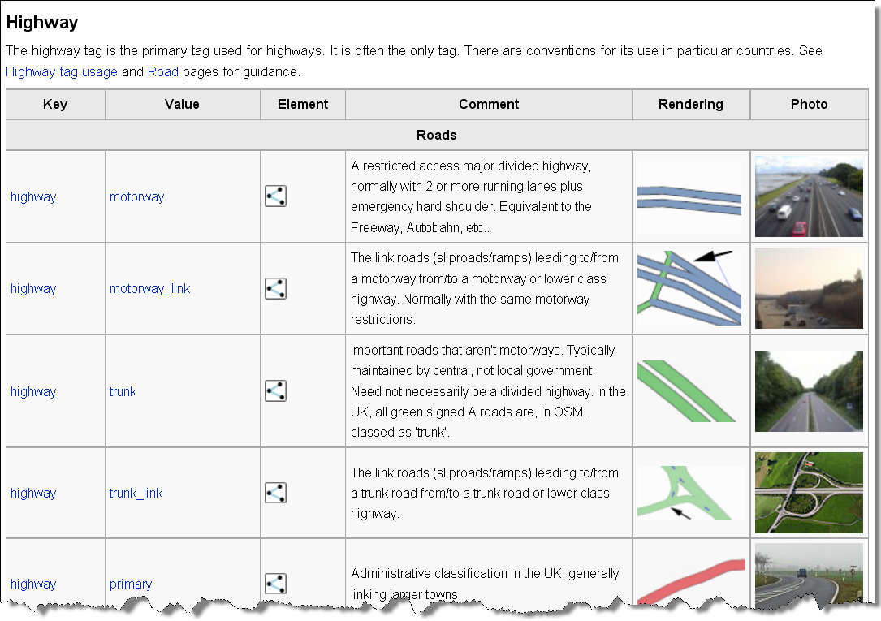
Wiki.openstreetmap.org
Details: http://wiki.openstreetmap.org/index.php/Map_Features

Slide 43
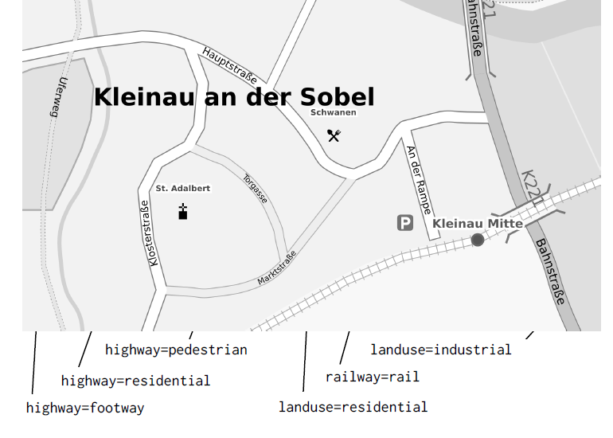
Source: Frederik Ramm, Geofabrik.de

Slide 44
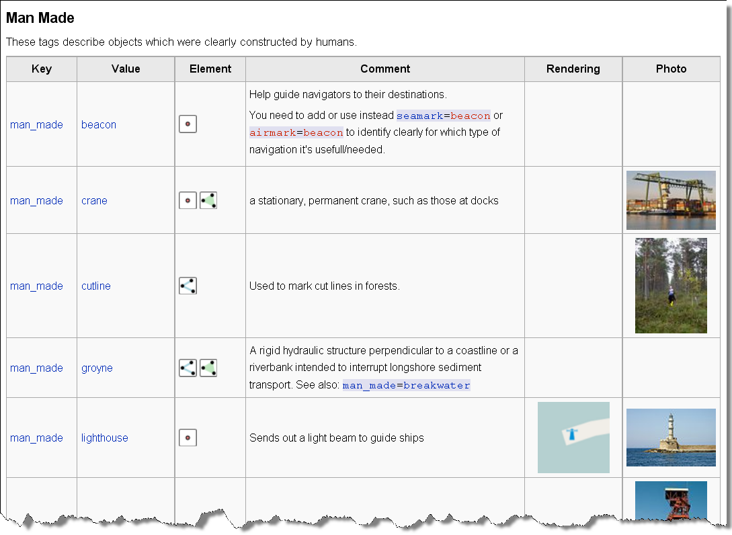

Slide 45
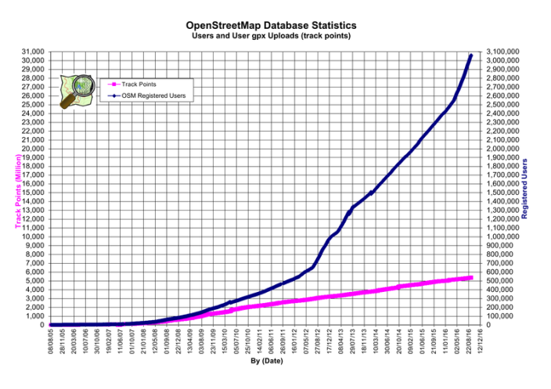
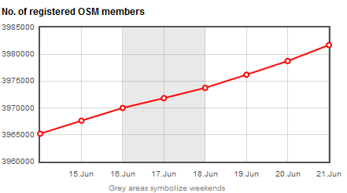
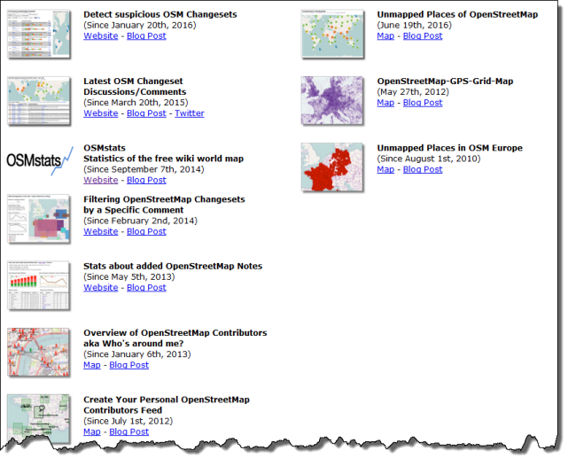
Statistics
http://wiki.openstreetmap.org/wiki/Stats
https://osmstats.neis-one.org/
http://resultmaps.neis-one.org/

Slide 46
Tools

Slide 47
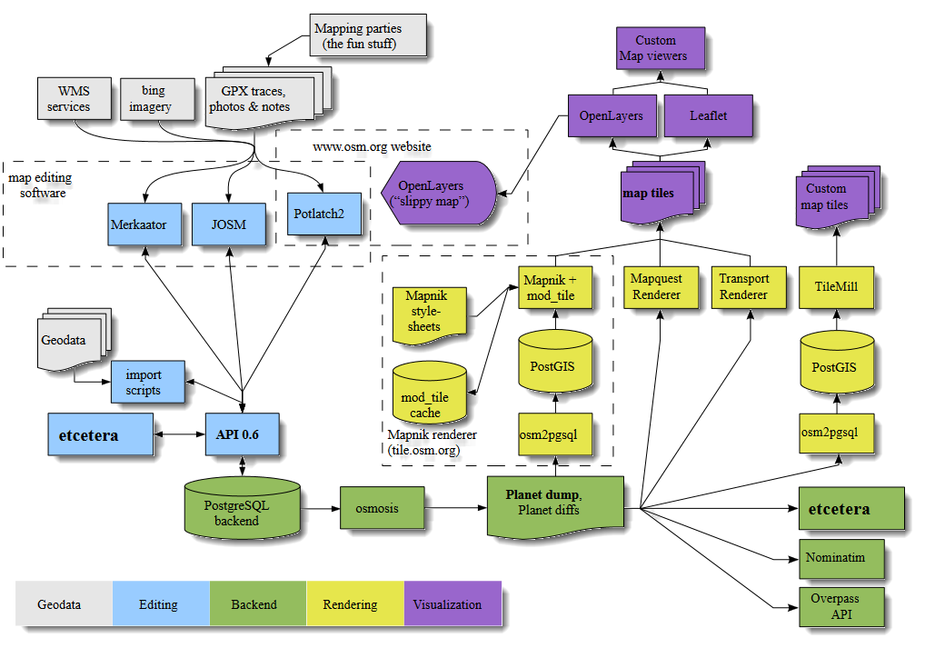
http://wiki.openstreetmap.org/wiki/File:OSM_Components.svg

Slide 48
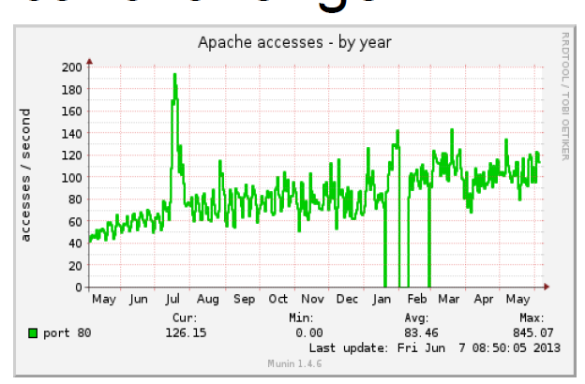



The technical challenge
>1,200,000 signed up users
> 3000 mappers a day
> 3.5 million unique visitors per month
Managed by people
  Tom Hughes, Grant Slater, Matt Amos, Jon Burgess (Tile), Sarah Hoffmann (Nominatim), Andy Allan, Emilie Laffray (Operation Work Group)
Source: Grant Slater (2013): OSM Core Architecture and DevOps. sotm.us - 8 June 2013

Slide 49
Central Database
PostgreSQL 9.1
Streaming Replication to 2 read servers
3.0TB of data
Primary DB Server
Slave DB Server Slave DB Server
High level of IO operations: Concurrent Read + Write
Source: Grant Slater (2013): OSM Core Architecture and DevOps. sotm.us - 8 June 2013

Slide 50
Core Services
openstreetmap.org Website
api.osm.org: the editing API
planet.osm.org: Raw osm data exports: weekly, daily, minutely, streaming
tile.osm.org: delivering map tiles
nominatim.osm.org: Geocoding service
wiki.osm.org

Slide 51
Secondary services
help.osm.org (Q&A, like "stackoverflow")
blog.osm.org
wiki.osmfoundation.org
otrs.osm.org (support tickets)
piwik.osm.org (site visitor analytics)
munin.osm.org (monitoring)
lists.osm.org
svn.osm.org, git.osm.org, trac.osm.org
irc.osm.org
dev.osm.org (aka toolserver)
switch2osm.org
imagery
Services run by others:
  taginfo.osm.org
  forum.osm.org
  ci.osm.org

Slide 52
Planet.osm
Planet.osm is the OpenStreetMap data in one file: all the nodes, ways and relations that make up our map.
A new version is released every week, Wednesday morning.
Big (2017-04-15):
  XML variant over 784.5GB uncompressed,
  56.3GB bz2 compressed and
  35.2GB PBF

Slide 53
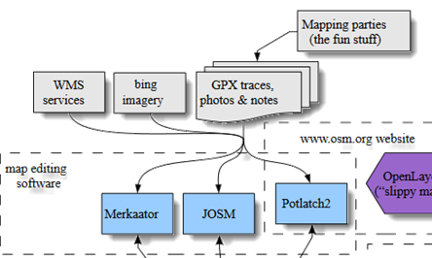
Data Editing
JOSM
Potlach 2
ID – “an overall usable tool for novice users” (Behrens 2014, http://repositum.tuwien.ac.at/download/pdf/1633966 [2017-06-22])
Merkaartor
…

Slide 54
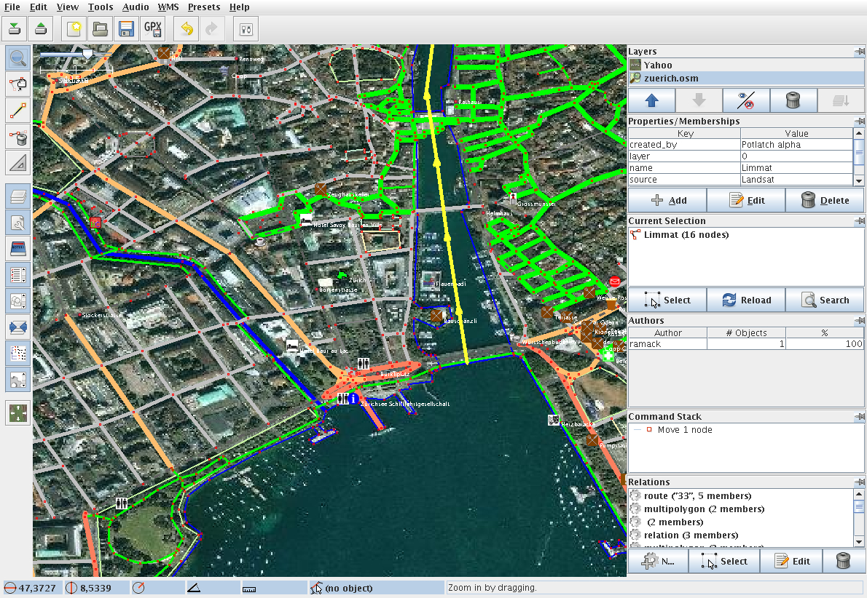
Data Editing: JOSM
Developed in Java
"power tool"
A little bit tough to start, but many options & plugins
Allows fast handling after some training

Slide 55
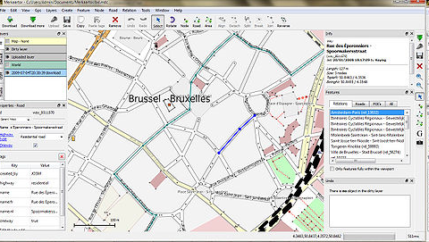
Data Editing: Mercartoor
an openstreetmap mapping program
focuses on providing a visually pleasing but performant editing environment for free geographical data
http://www.merkaartor.org/

Slide 56
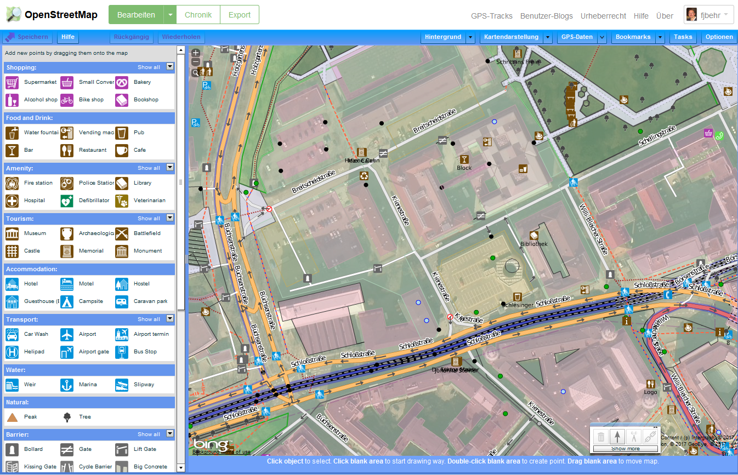
Data Editing: Using Potlach 2
Embedded in web browser
Easy to learn and to handle (IMHO)

Slide 57
Data rendering: Mapnik
Programmed in C, very efficient
Style-driven
Can be used for
  OSM,
  but also for data in Shape format
  Data from PostGIS geo database
For the Slippy Map on OSM’s main site.
For special purpose cartography

Slide 58
Rendering: Technical details
tile.openstreetmap.org (rendered map)
Live Map updates (Minute rendering): Average of 2700 tiles per second. (5400 tiles per second peak)
Average: 175Mbits/s (340Mbit/s peak)
Source: Grant Slater (2013): OSM Core Architecture and DevOps. sotm.us - 8 June 2013

Slide 59
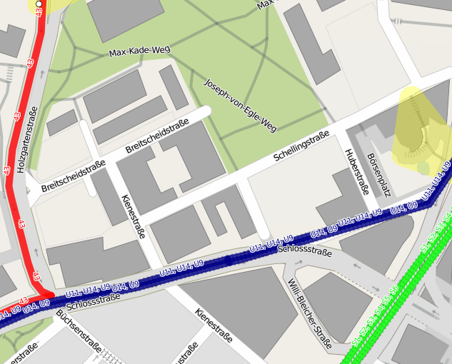
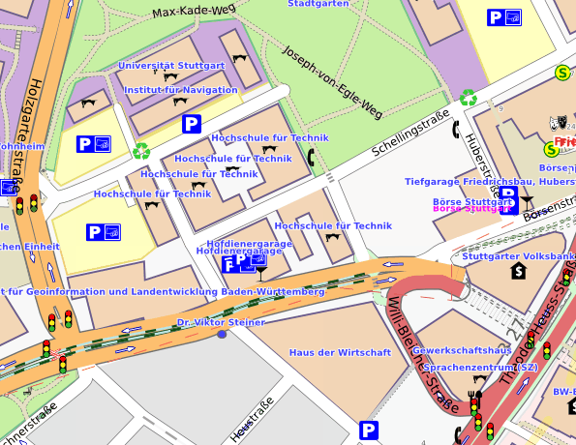
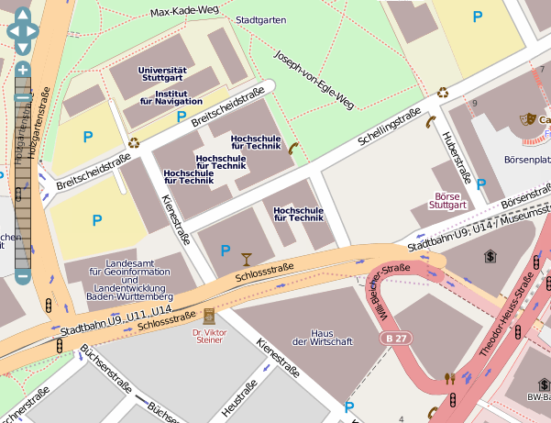
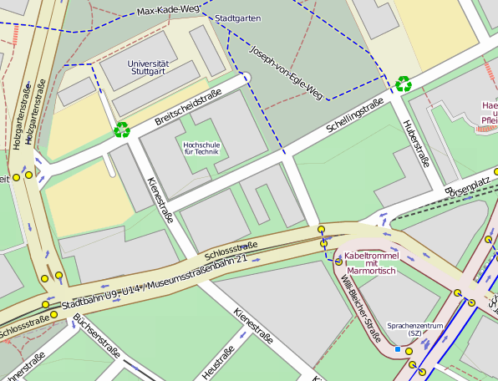
Render Styles
http://tools.geofabrik.de/mc/index.html?mt0=googlemap&mt1=mapnik&lon=76.294384&lat=9.9262423&z=12

Slide 60
APIs
http://api.openstreetmap.org/api/0.6/....
  Some restrictions related to amount of data…
Overpass API, see http://overpass-api.de/ and https://overpass-turbo.eu/
Others: see also http://wiki.openstreetmap.org/wiki/Platform_Status

Slide 61
Data presentation/visualization
OpenLayers
Leaflet
Custom Map Viewer

Slide 62

How to credit OpenStreetMap
Required: to use the credit “© OpenStreetMap contributors”.
For a browsable electronic map, the credit should appear in the corner of the map.
"You must also make it clear that the data is available under the Open Database License, and if using our map tiles, that the cartography is licensed as CC BY-SA. You may do this by linking to the copyright page. Alternatively, and as a requirement if you are distributing OSM in a data form, you can name and link directly to the license(s). In media where links are not possible (e.g. printed works), we suggest you direct your readers to openstreetmap.org (perhaps by expanding 'OpenStreetMap' to this full address), to opendatacommons.org, and if relevant, to creativecommons.org."

Slide 63
Some thoughts about the success of the OpenStreetMap project

Slide 64
1: Using Open Source Components

Slide 66
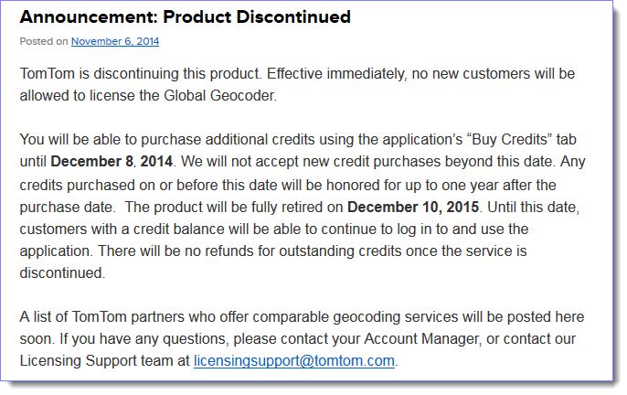
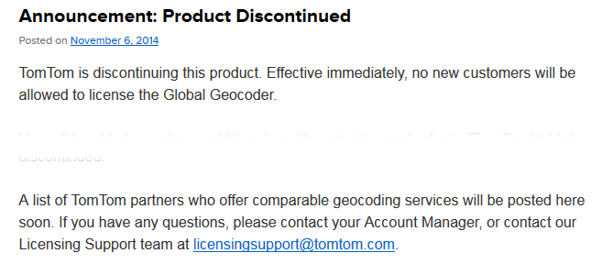
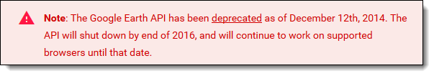
OS: You are not dependent of the decisions of companies – software may be discontinued
http://geocoderblog.tomtom.com/ [2015-04-28]
https://developers.google.com/earth/ [2016-12-06]

Slide 67
Usage of Open Source in Closed source
„an average product or application contains almost 700 MB of code, 22% of which is open source software … almost 80% of newly deployed code is Open Source” [1]
"44% of all code was Open Source„ [2]
"sampling continues to find that between 30 and 70% of code submitted as Internally Developed is identifiably from third-parties, most often in the form of Open Source components and Commercial libraries” [3]
zit. After Carlo Daffara (2012): Estimating the economic contribution of Open Source
Software to the European economy. In: Shane Coughlan (Hrsg.) (2012) The First OpenForum Academy Conference Proceedings
[1] McQuaide, B., “Distributed Multi-Source Development with Open Source:”, LinuxCon 2010
[2] Daffara, C. “The Economic Value of Open Source Software”. Submitted presentation, TransferSummit Oxford 2010
[3] Veracode, “State of Software Security Report volume 3”, 2011

Slide 68
Apache HTTP-Server: ~50% market share
Many/all of us:
Eclipse: One of the mostly used development environments
Firefox
Android
IOS

Slide 69
Open Source Development
Source Code contains all functionality (and only Source Code can be modified).
Public access to code improves the quality
Typically bugs are fixed faster
Often more secure due to multiple scrutiny
Innovation is easier – and...
Users have full control about what they get
...and many more advantages.
Read http://producingoss.org by Karl Fogel for details

Slide 70
Open Source developers
(as well as often Closed Source Developers) use Open Source.

Slide 71
Business models
Closed Source
Open Source
Often main motivation: financial incentives
Modell: Lizensing of Software products, limited ways of software distribution
main motivation :
  Solve problems
Focus:
  Professional Software development, optimal solving of problems, free csourceode
Business model:
  Openness
  Services, Support
  Sponsored development and adaption
  Training
  Distribution: Internet

Slide 72
Idea of problem solving,
Implementierung
Feed back from
the users
Open Source
Project
Release (publish)
the Source Code
Download, installation, usage

Slide 73
How it this feasable?

Slide 74
Income in IT
~ 90%: service provision
< 10%: Selling Software Licenses

Slide 75
Open Source Business
Consulting
Maintain specific distribution
Training
Implementation
Support
bug fixing
Improve Software
Service Level Agreement
Maintenance
No single representative -> economic competition!
Notes:
75

Slide 76

Source: Jody Garnett, https://farm6.staticflickr.com/5825/21298199710_23489f1f0e_z.jpg [2017-06-22]
Paul Ramsey (2013): Being an Open Source Citizen, https://vimeo.com/76365035

Slide 77


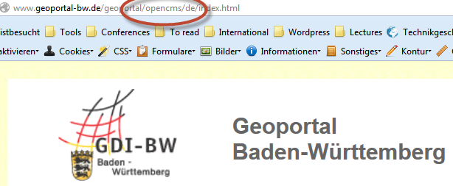
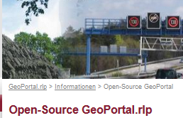
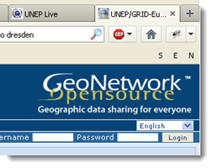
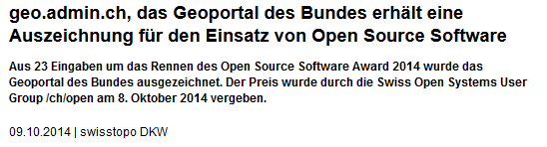

Open Source is widely used.

Slide 78
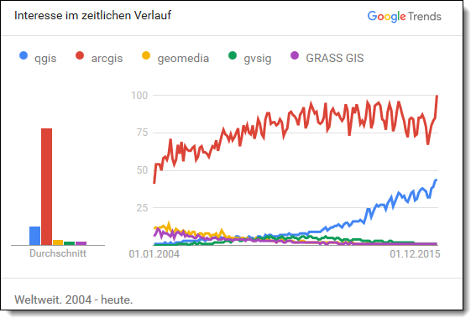
https://www.google.com/trends/explore?date=all&q=qgis,arcgis,geomedia,gvsig,GRASS%20GIS [2016-12-07]

Slide 79


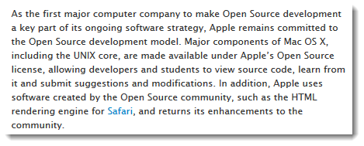
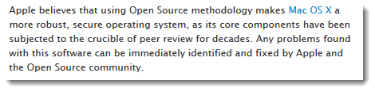
Busness model:
"Selling hardware as an add-on"?
http://www.apple.com/opensource/
http://seeklogo.com/logo.aspx?id=9834

Slide 80
2: Addressing altruistic and other human needs

Slide 81
Freedom
Contribution to the society

Slide 82


Slide 83
Allmende
Commons

Slide 84
Commons
Part of the common good.
All members of the community may use (not consume) this common, shared good. [Wikipedia]
Common good: could be used used too intensively (for example a meadow), leads to exhaustion of this resource.
Source Code: can NOT be used used too intensively, in contrary: intensive usage triggers optimisation of quality!.

Slide 85
Technical Interest
Part of a worldwide community

Slide 86
Technical Interest: The hacker
Hacker [RFC 1983]
A person who delights in having an intimate understanding of the internal workings of a system, computers and computer networks in particular.
The term is often misused in a pejorative context, where "cracker" would be the correct term.
https://tools.ietf.org/html/rfc1983
Notes:
cracker A cracker is an individual who attempts to access computer systems without authorization. These individuals are often malicious, as opposed to hackers, and have many means at their disposal for breaking into a system. See also: hacker, Computer Emergency Response Team, Trojan Horse, virus, worm.

Slide 87
“Free software foundation” and ihre vier Freiheitsgrade
The freedom to run the program as you wish, for any purpose (freedom 0).
The freedom to study how the program works, and change it so it does your computing as you wish (freedom 1). Access to the source code is a precondition for this.
The freedom to redistribute copies so you can help your neighbor (freedom 2).
The freedom to distribute copies of your modified versions to others (freedom 3). By doing this you can give the whole community a chance to benefit from your changes. Access to the source code is a precondition for this.
https://www.gnu.org/philosophy/free-sw.html.en

Slide 88

"Linux made it clear how well open source works, not just from a technical standpoint, but also from a business, commercial, and community standpoint."
Linus Torvalds, 2014
[ http://www.infoworld.com/article/2608107/linux/linus-torvalds-to-developers--to-succeed--make-it-personal.html]

Slide 89
3: Using (its own) Open Standard(s)

Slide 90
Data format: XML-based, readable
Public API to access the data

Slide 91
4: Delivering Open Data

Slide 92
Copyright and License
OpenStreetMap® is open data, licensed under the Open Data Commons Open Database License (ODbL [1]) by the OpenStreetMap Foundation (OSMF [2]).
"You are free to copy, distribute, transmit and adapt our data, as long as you credit OpenStreetMap and its contributors. If you alter or build upon our data, you may distribute the result only under the same licence. The full legal code [1] explains your rights and responsibilities. "
[1] https://opendatacommons.org/licenses/odbl/1.0/
[2] http://wiki.osmfoundation.org/wiki/Main_Page

Slide 93
Summary
Copyright not by Teleatlas, Navteq, Google, . . .
Data, NOT images,
No censoring
no restrictions on use
Encouraging people from using them in creative, productive or unexpected ways.
Fun ;-)

Slide 94
Your gain
Its your map, your project
You see very soon the results of their hard work
You have the Ownership of the data
CreativeCommons License - Trusted, inpedendent third party, Copyright assigned to the OpenStreetMap Foundation
Soemthing useful
You’r part of the community

Slide 95
References
Nick Black 2007: How OpenStreetMap is mapping the world
Mikel Maron 2008: FreeMap West Bank. Bethlehem. http://slideshare.net/mikel_maron

