Slide 1

OpenStreetMap: Its History, Data Structure, License and Ecosystem
Prof. Dr. Franz-Josef Behr
Partially based on a a presentation of Min Qian, Virasith Phomsouvanh (2008): The OpenStreetMap (OSM) Project. Stuttgart University of Applied Sciences
The content is licensed under a Creative Commons-Lizenz CC BY-NC-SA.
Notes:
Benötigte Zeit: ca. 1h

Slide 2
Ideas and Background

Slide 3
Was ist OpenStreetMap und wer ist daran beteiligt?
Wie sind OSM-Daten strukturiert, wie ist die Attributtabelle aufgebaut?
Welche Downloadmöglichkeiten gibt es?
Welche Formate gibt es und wo liegen die Vor- und Nachteile?
Wie kann ich OSM-Daten zielgerichtet herunterladen?
Wie bringe ich OSM-Daten in mein GIS?
Welche Werkzeuge gibt es noch um OSM-Daten zu verarbeiten?
Wie sind OpenStreetMap-Daten lizenziert?

Slide 4
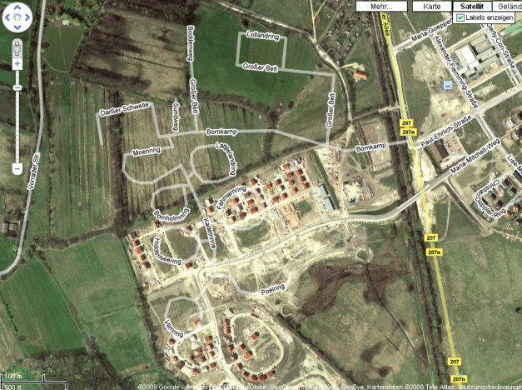
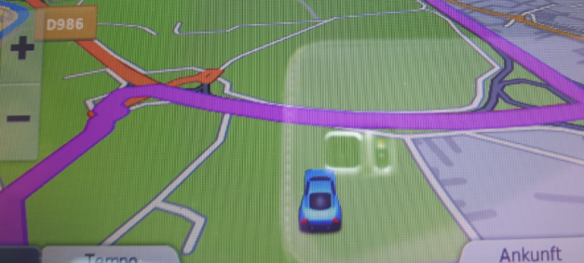
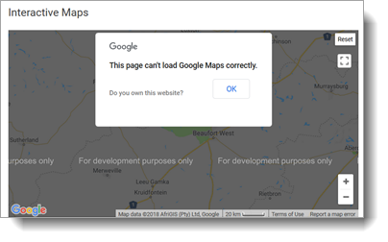
Problems of „traditional“ navigational data
Map data can be outdated
Routing data can be outdated
Vendors change their policies:
http://maps.google.de/maps?
q=l%C3%BCbeck&ie=UTF8&oe=utf-8&
ll=53.829294,10.684354&spn=0.009308,0.027895&t=h&z=16
Source: FJ Behr
https://www.sanparks.org/tourism/-
maps/default.php?p_id=11 [2018-10-10]

Slide 5
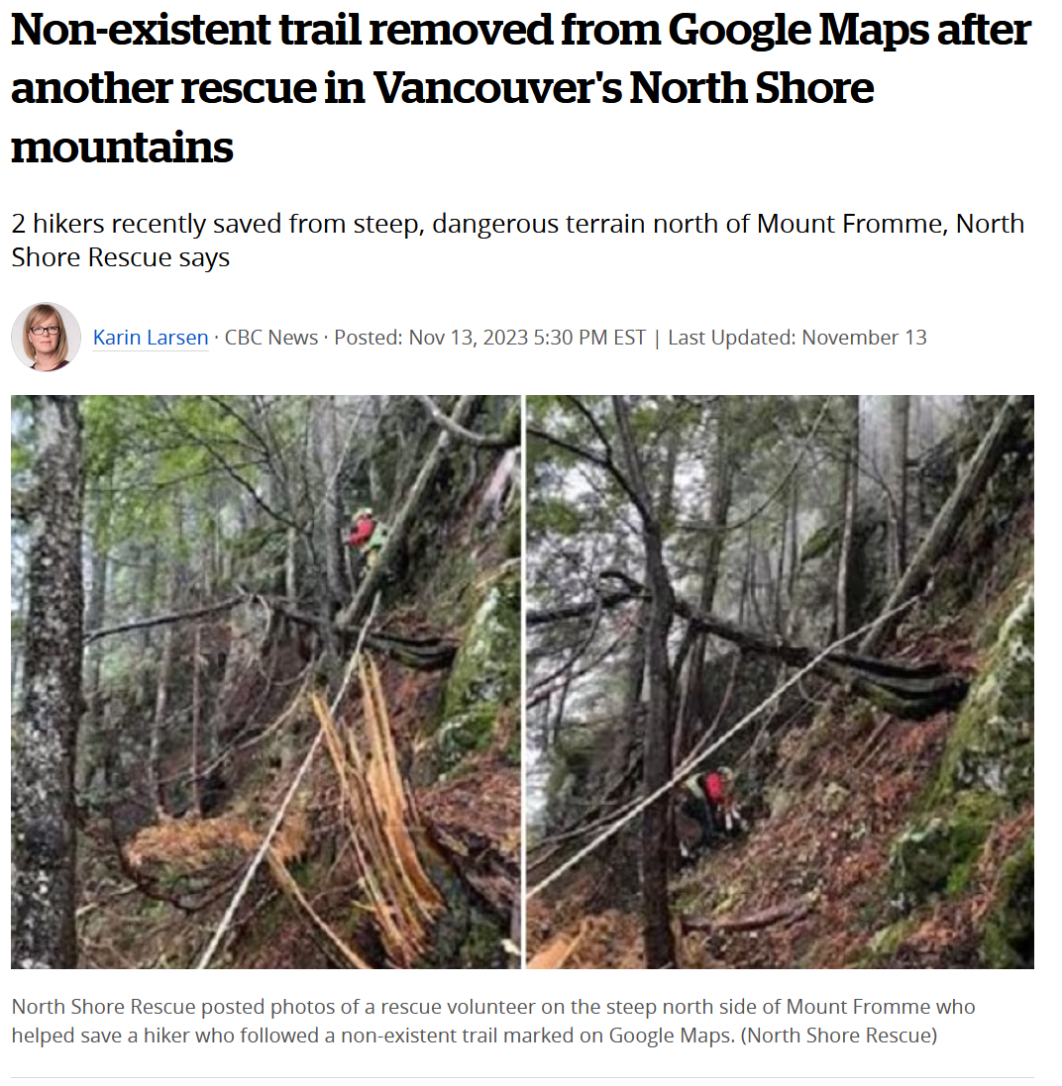
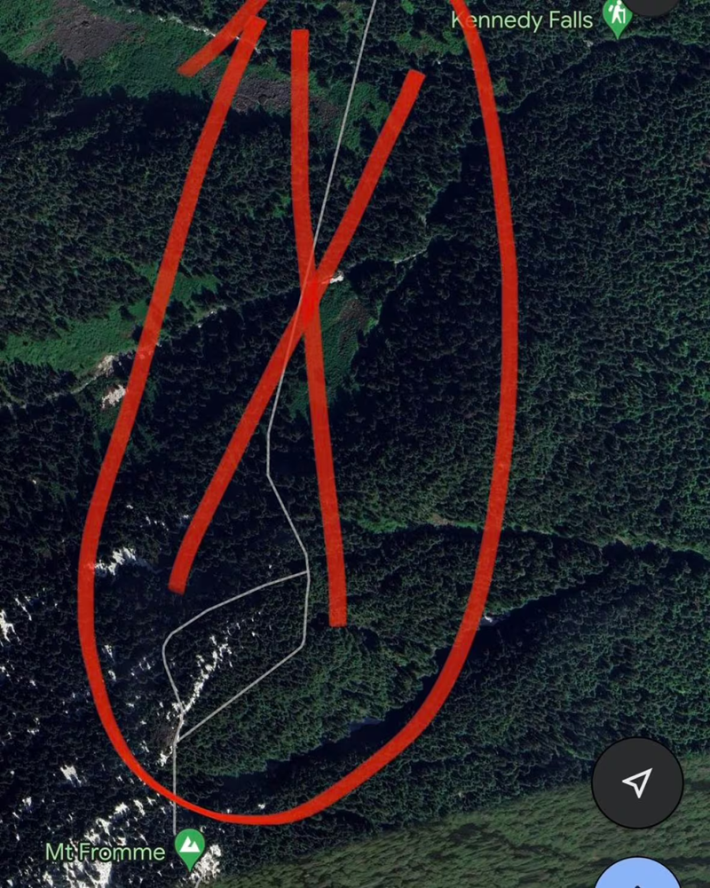
https://www.cbc.ca/news/canada/british-columbia/google-maps-non-existent-trail-removed-vancouver-north-shore-mount-fromme-1.7027120 [2023-11-15]

Slide 6


Some motivating ideas…
"If you don't make [lower-resolution mapping data] publicly available, there will be people with their cars and GPS devices, driving around with their laptops," […] "They will be cataloguing every lane, and enjoying it, driving 4x4s behind your farm at the dead of night. There will, if necessary, be a grass-roots remapping.“
Tim Berners-Lee, 2006 [1]
[1] http://www.guardian.co.uk/society/2006/mar/23/epublic.technology#article_continue [2008-10-22]
[2] http://www.flickr.com/photos/89142790@N00/3212369167

Slide 7
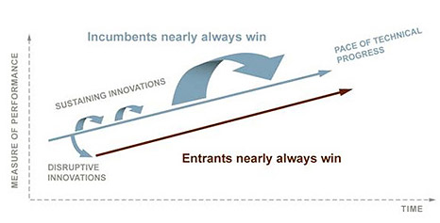
“…in almost every case, a disruptive technology enables a larger population of less skilled people to do things that historically only an expert could do.
And to do it in a more convenient settings.
… One of the […] mechanisms through which our lives have improved”
Clayton Christensen (2010): How Will You Measure Your Life

Slide 8
“You could have a community capability
where you took the GPS data of people driving around and started to see,
oh, there’s a new road that we don’t have, a new route .. And so that data eventually should just
come from the community
with the right software infrastructure.” -- Bill Gates
Cited based on https://news.microsoft.com/speeches/bill-gates-microsoft-mix06-conference/#OVu0wkJzjoZKyycJ.97 [2017-06-22]

Slide 9


“Imagine looking at your computer screen and seeing reality – an image of your city, for instance, complete with moving traffic patterns, or a picture that sketches the state of an entire corporation at this second…. These will soon be available to anyone.”
David Gelernter, 1991: “Mirror Worlds”
http://www.cs.yale.edu/people/gelernter.html

Slide 10
“increasing interest in the potential of crowdsourced geographic data to supplement authoritative data where they are not available, outdated or incomplete.”
[Papapesios et al. (2019)]

Slide 11
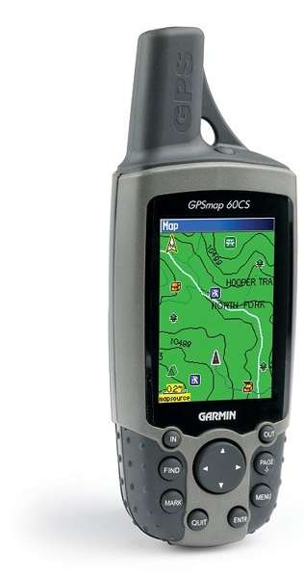

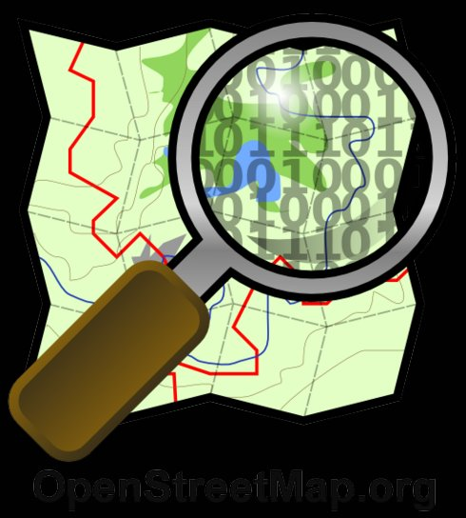
The OpenStreetMap Equation
+
=
GPS/GNSS measurements
Something like a Wiki…
Open Geodata Repository
Source: Maron 2008

Slide 12
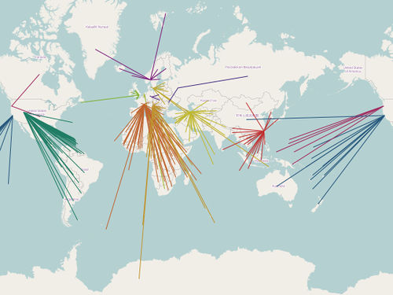
How does it work? An overview
Decentral data collection and updating primarily by volunteered work (Volunteered Geographic Information, VGI) Goodchild, M.F. (2007). "Citizens as sensors: the world of volunteered geography". GeoJournal. 69 (4): 211–221
Central database
stored in PostgreSQL with PostGIS
Data processing
by Ruby on Rails
Rendering
by MapNik
Content delivery
https://hardware.openstreetmap.org/
Presentation of Tiles
by Leaflet and others
Data export
Content Delivery Network of Tile Servers, http://wiki.openstreetmap.org/wiki/File:OSM-tileserver_worldwide_Jan2015.jpg [2017-06-22]

Slide 13
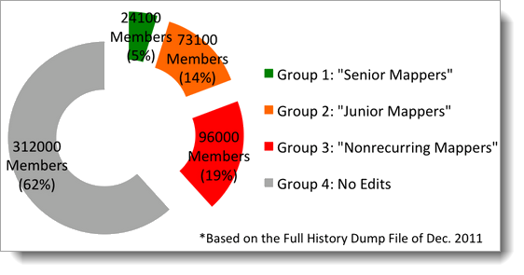
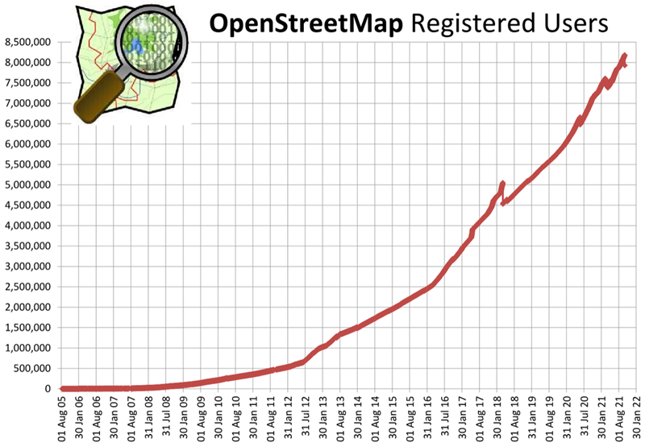
Neis & Zipf (2o12)
https://wiki.openstreetmap.org/wiki/Stats [2022-01-19]

Slide 14
The OpenStreetMap Project - History
Aug 2004: founded by Steve Coast (since that time working for different companies)
Dec 2005: 1000 User
March 2006: Osmarender
May 2006: Isle of Wight Mapping Party
Aug 2006: OpenStreetMap Foundation: fundraising,
promotion and legal representation
Nov 2006: Slippy Map, significantly increasing number of data
Feb 2007: City of Cambridge completely mapped
since 2008: several German cities completely mapped
2010: OSM integrated in Bing Maps and MapQuest
2012: ODBl –Lizenz, OSM integrated in iOS maps
https://www.theverge.com/2012/6/11/3078987/apple-tomtom-openstreemap-ios-6-maps-app
2013: 1,000,000 registered users
2019: „State of the Map“-Konferenz in Heidelberg

Slide 15
A closer look

Slide 16
VGI - Motivation for crowd-sourcing success
Non-monetary motivation, like
  Trust
  Give people ownership
  Create a short feedback loop -
  Allow especially talented people to do amazing things
  Discrete multi-size pieces
  Low-cost integration
  Fun
  Short time needs
  Fun
[Nick Black 2007]

Slide 17
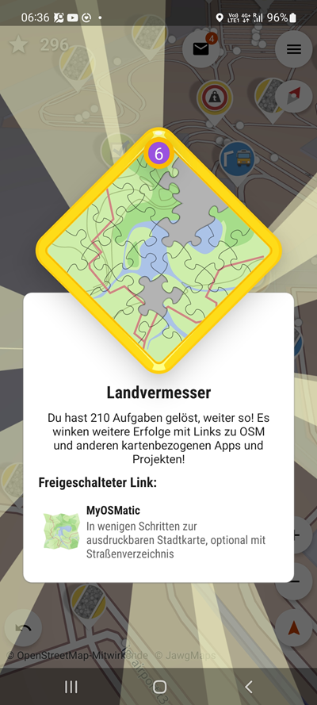
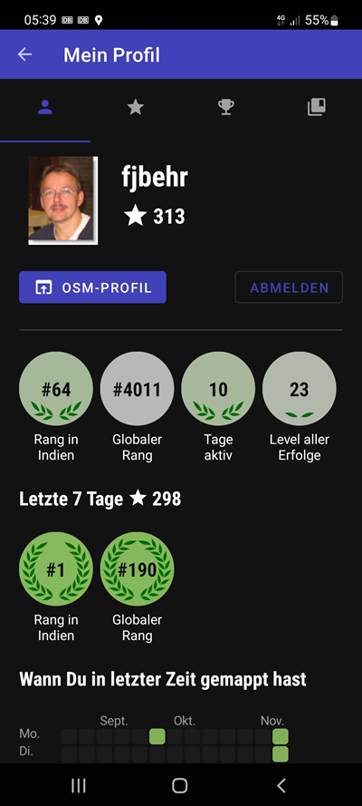
Direct, personal Feedback
Source: Street Complete App

Slide 18
Openly-licensed data from national mapping agencies and other sources, like
Austria: data from Stadt Wien (under CC BY), Land Vorarlberg and Land Tirol (under CC BY AT with amendments).
Canada: data from GeoBase®, GeoGratis (© Department of Natural Resources Canada), CanVec (© Department of Natural Resources Canada), and StatCan (Geography Division, Statistics Canada).
Finland: data from the National Land Survey of Finland's Topographic Database and other datasets, under the NLSFI License.
France: data sourced from Direction Générale des Impôts.
Netherlands: © AND data, 2007 (www.and.com)
New Zealand: data sourced from Land Information New Zealand. Crown Copyright reserved.
Slovenia: data from the Surveying and Mapping Authority and Ministry of Agriculture, Forestry and Food (public information of Slovenia).
South Africa: data sourced from Chief Directorate: National Geo-Spatial Information, State copyright reserved.
United Kingdom: Ordnance Survey data © Crown copyright and database right 2010-12.

Slide 19
Collaboration
Task Manager: mapping tool designed and built for the Humanitarian OSM Team collaborative mapping.
  mapping jobs are divided into smaller tasks that can be completed rapidly.
  shows which areas need to be mapped and which areas need the mapping validated.
  http://tasks.hotosm.org/

Slide 20

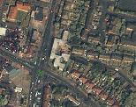
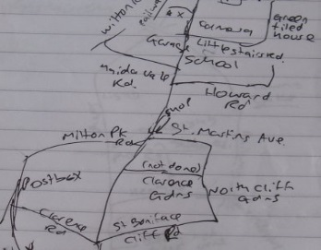
GPS, the most common way
Street names, amenities…
With recording additional details
Potlatch,
YWMS plug-in for JOSM
Yahoo! And Bing Aerial Imagery
Digitizing over the imagery and
then more complete surveying
Private photography or maps
Completely free to copy and use
Data donations

Slide 21
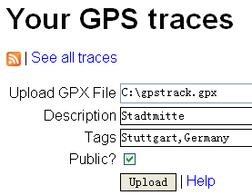
Data upload
GPS
Device
GPX
WGS84 Datum
Field papers
GPS Traces
Database

Slide 22
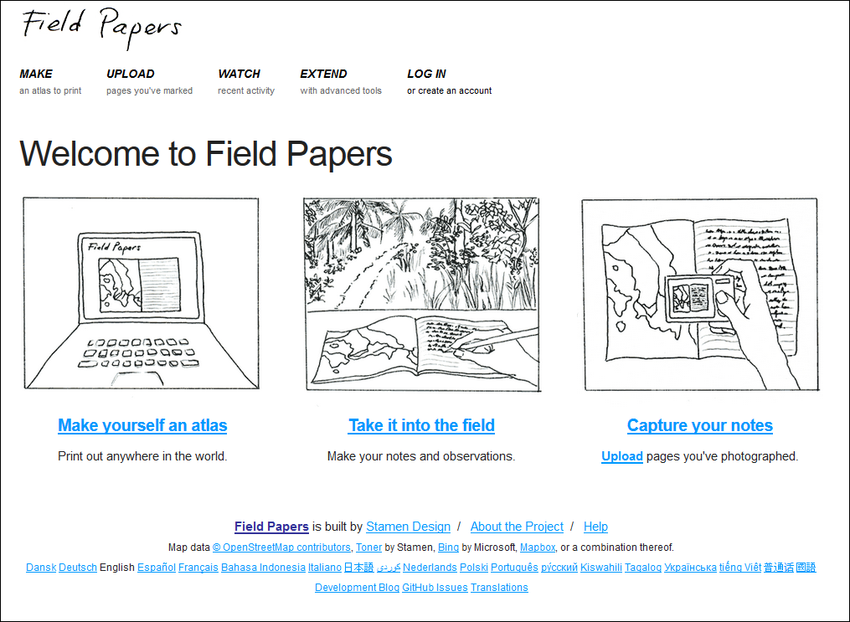
http://fieldpapers.org/?locale=en

Slide 23
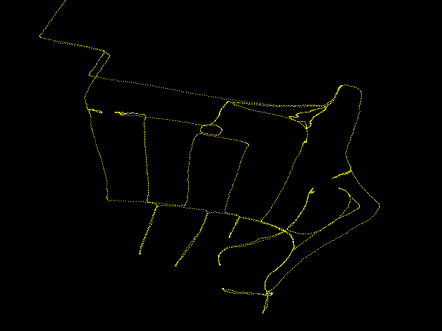
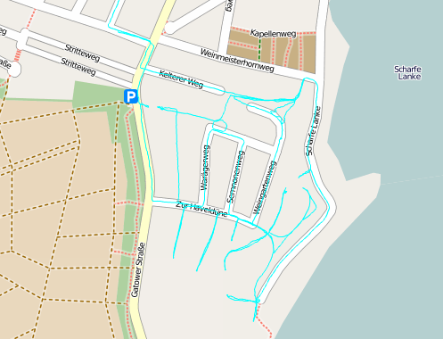
Feature Creation

Slide 24
Basic Objects Types
“The simplest solution which could work!”
Nodes (point objects)
Ways (linestrings, linear rings, used for polygons as well)
Relations (compound objects)
For Geospatial Community: Uncommon data model, not fitting to standards.
Geomtetrical
Objects
+
Tags
=
Features

Slide 25
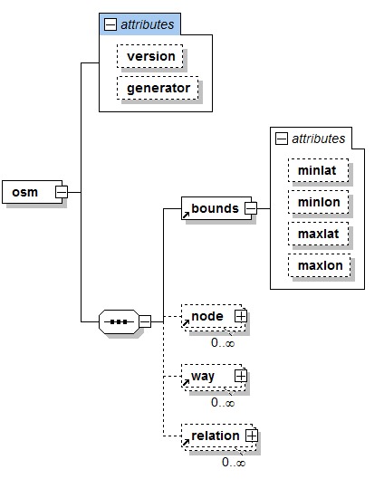

Slide 26


Node
a point that consists of latitude and longitude
can be a vertex of a way (or of many ways)
can represent point features, e.g. a bus station or postal address, and all of kinds of points of interesting (POI), having at least one tag
Notes:
Nodes are points with a geographic position, stored as coordinates (pairs of a latitude and a longitude) according to WGS 84.[90] Outside of their usage in ways, they are used to represent map features without a size, such as points of interest or mountain peaks. [https://en.wikipedia.org/wiki/OpenStreetMap]

Slide 27
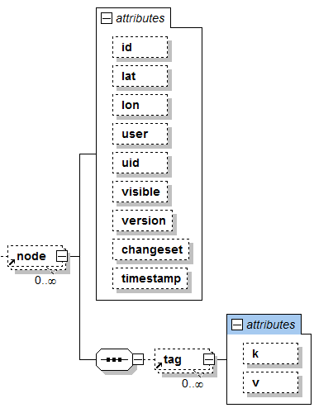
<node id=“874039” lat=“48.7728093” lon=“9.1771907”>
<tag k=“name” v=“Oblomow” />
<tag k=“created_by” v=“Potlatch” />
<tag k=“amenity” v=“phonebox” />
</node>

Slide 28


Way
A linear feature characterized by uniform properties
e.g. motorway maybe mark using a way tagging with highway=motorway
Ways can be split into shorter way if different properties exist (e.g. different material)
Notes:
Ways are ordered lists of nodes, representing a polyline, or possibly a polygon if they form a closed loop. They are used both for representing linear features such as streets and rivers, and areas, like forests, parks, parking areas and lakes.

Slide 29
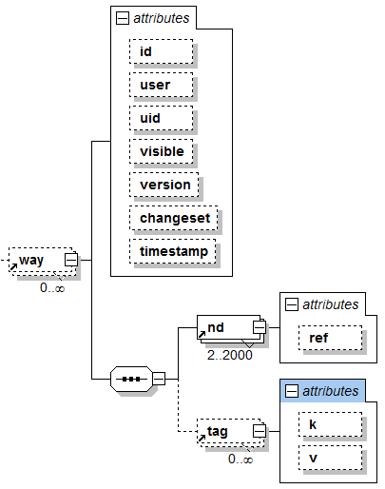
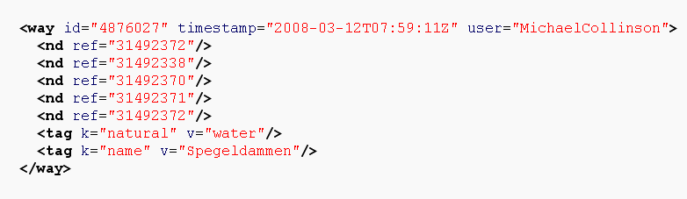

Slide 30
Closed ways: Areal Features
Should have appropriate tag, e.g. landuse
First node = last node

Slide 31
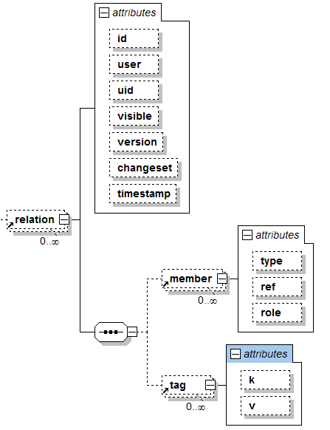
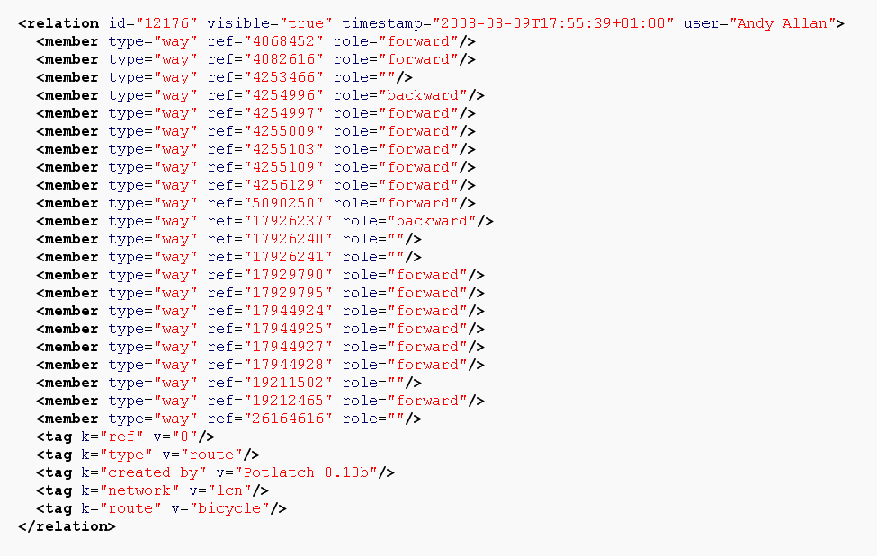
Relation
basically an ordered lists of nodes, ways and
relations where each object may have a specific role
specifying relationships between objects,
Notes:
Relations are ordered lists of nodes, ways and relations (together called "members"), where each member can optionally have a "role" (a string).
Relations are used for representing the relationship of existing nodes and ways. Examples include turn restrictions on roads, routes that span several existing ways (for instance, a long-distance motorway), and areas with holes.

Slide 32
Tagging

Slide 33
Physical Tags
highway=motorway
highway=cycleway
Highway (roads, paths, intersection features…)
Waterway (river, boatyard; mooring…)
Railway (track, stop, intersection...)
Amenity (parking, post_box, place_of_worship…)
Landuse (farm, forest, landfill, military…)
Natural (spring, wood, water, coastline…)
……
railway=subway
railway=station
railway=subway_entrance

Slide 34
Non-Physical Tags
area=yes
lane=4
layer=1
Route (bus, ferry…)
Sport (football, swimming…)
Properties (area, lane, layer, width…)
Restrictions (oneway, maxspeed, toll…)
……
oneway=yes
maxspeed=40
toll=yes
Details: http://wiki.openstreetmap.org/index.php/Map_Features

Slide 35
Further Tags
Naming tags
  Name
  References (ref…), e.g. for street numbers
  ……
Annotation
  note,
  Description
Metatags
  created_by
  version
Details: http://wiki.openstreetmap.org/index.php/Map_Features

Slide 36
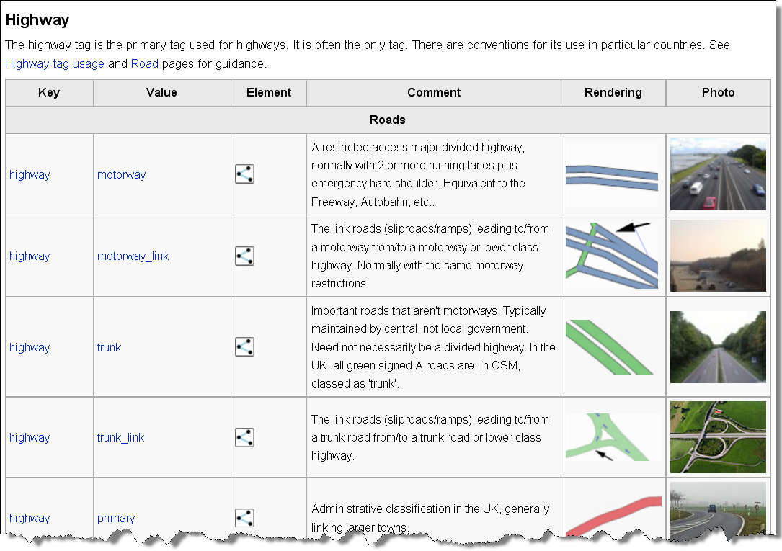
Wiki.openstreetmap.org
Source: https://wiki.openstreetmap.org/wiki/DE:Map_Features

Slide 37
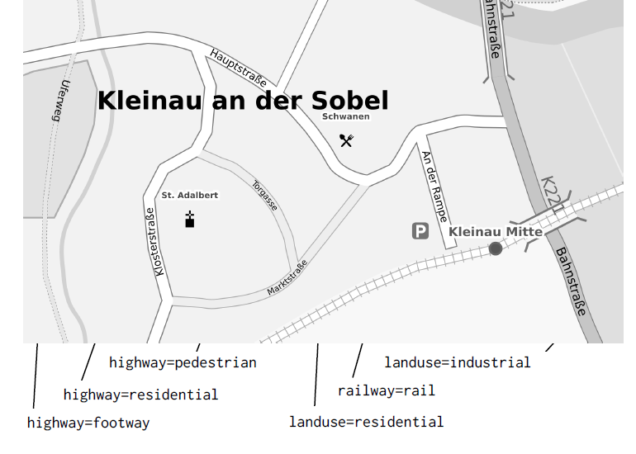
Source: Frederik Ramm, Geofabrik.de

Slide 38
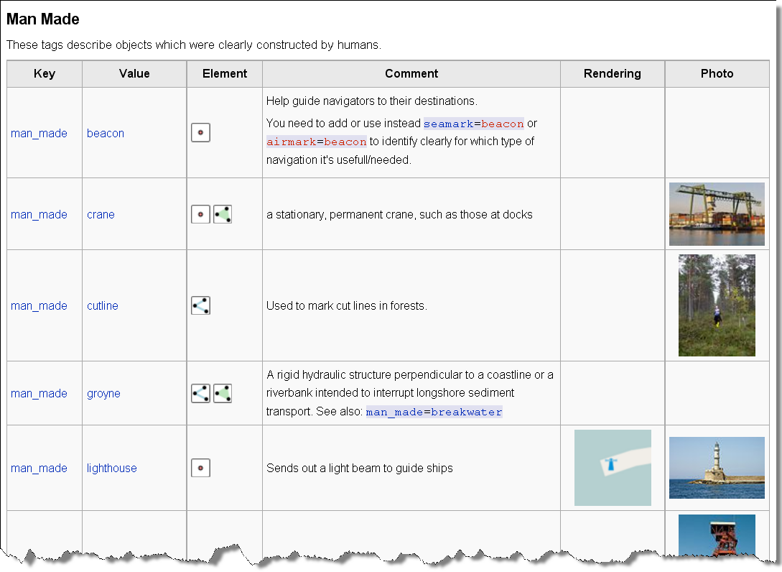

Slide 39
Tools
and Data Provision

Slide 40
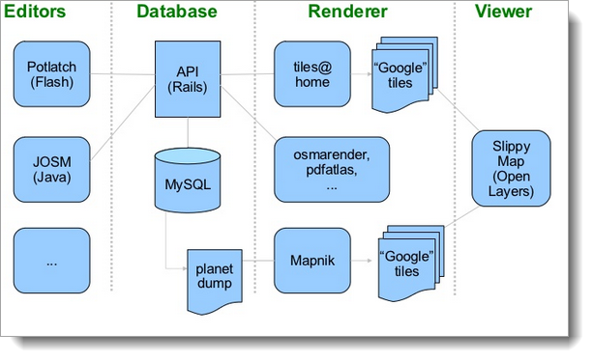
The architecture in 2008
[Michael Maron (2008)]

Slide 41
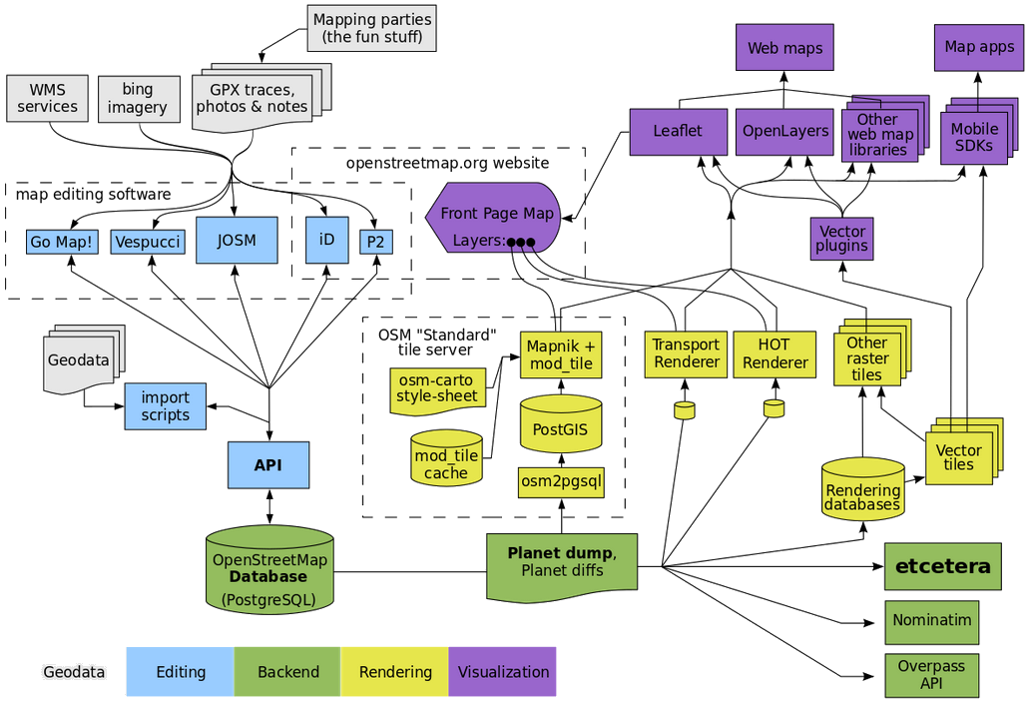
And 2020…
https://wiki.openstreetmap.org/wiki/File:OSM_Components.svg [2020-11-11]

Slide 42
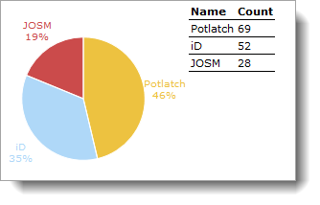
Data Editing [https://wiki.openstreetmap.org/wiki/Editors]
ID – “an overall usable tool for novice users” (Behrens 2014, https://repositum.tuwien.at/retrieve/15557 [2020-11-11])
JOSM – for more experienced users, highly effective
Others (Mercaartor or using ArcGIS, QGIS, …)
My personal (historical) preferences (2020-11-12]

Slide 43
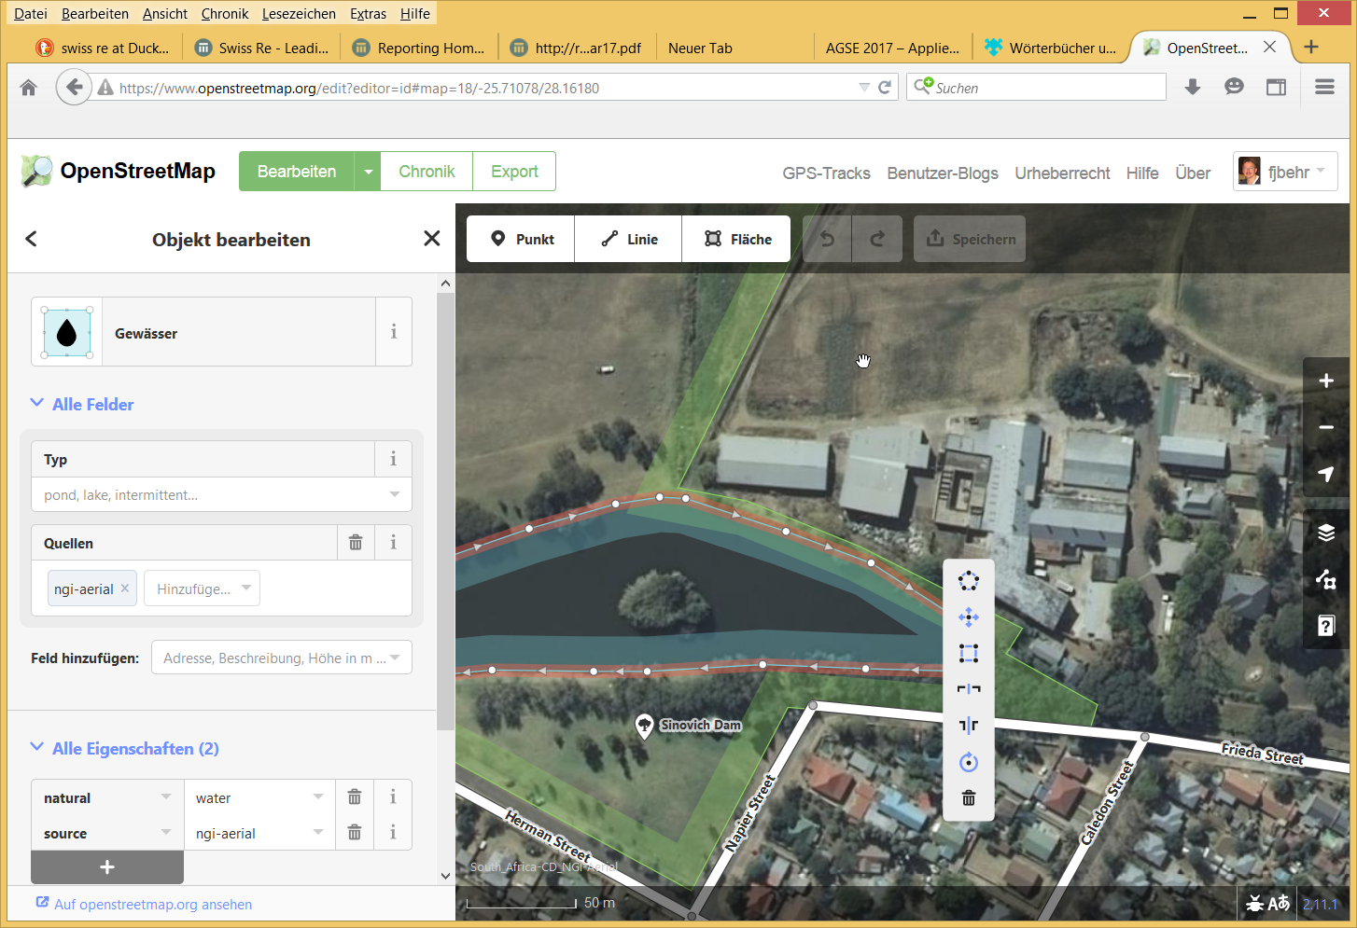
Data Editing: id

Slide 44
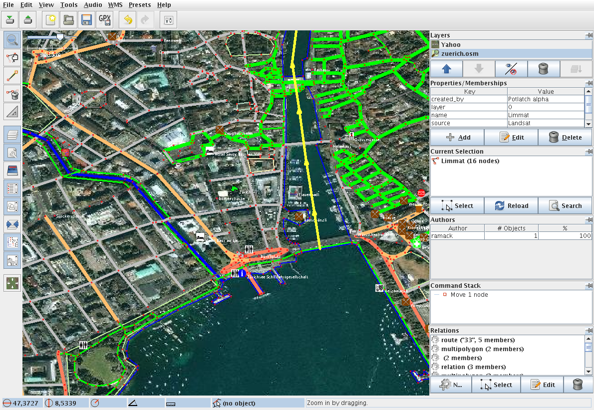
Data Editing: JOSM

Slide 45
Planet.osm
Planet.osm is the OpenStreetMap data in one file: all the nodes, ways and relations that make up our map.
A new version is released every week, Wednesday morning.
Big (2020-11-12):
  XML variant over 784.5GB uncompressed,
  96GB bz2 compressed and
  54GB PBF

Slide 46
Data rendering for visualization
Mapnik
  Programmed in C, very efficient
  Can be used for
    OSM,
    but also for data in Shape format
    Data from PostGIS geo database
For the Slippy Map on OSM’s main site.
For special purpose cartography

Slide 47
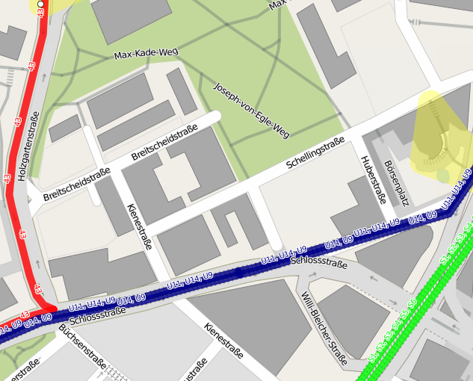
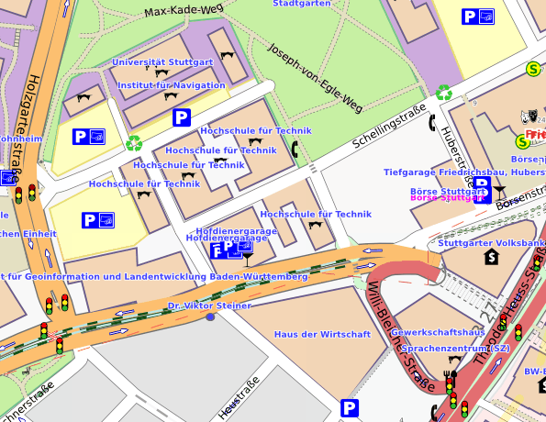
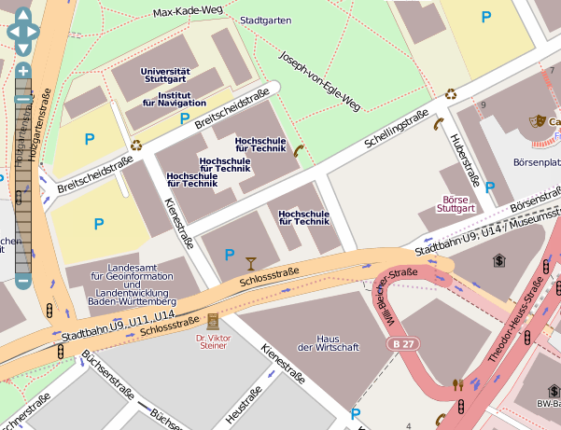
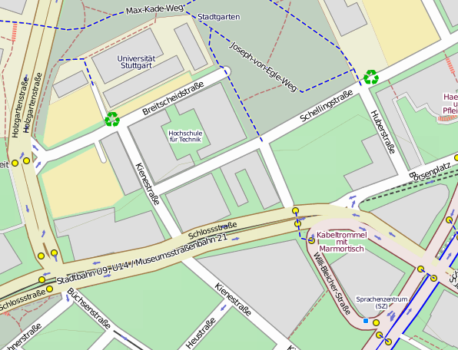
Render Styles
http://tools.geofabrik.de/mc/index.html?mt0=googlemap&mt1=mapnik&lon=76.294384&lat=9.9262423&z=12

Slide 48
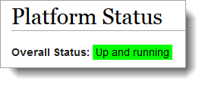
APIs
Overpass API, see http://overpass-api.de/ and
  https://overpass-turbo.eu/
  https://wiki.openstreetmap.org/wiki/Overpass_introduction (with various examples of Overpass scripts
  https://upload.wikimedia.org/wikipedia/commons/d/df/OpenStreetMap_thematic_maps_for_Wikipedia.pdf (an intro)
https://wiki.openstreetmap.org/wiki/API_v0.6
    Some restrictions related to amount of data…
https://wiki.openstreetmap.org/wiki/API_v0.7: under development (2021-04-28)
Others: see also https://wiki.openstreetmap.org/wiki/Platform_Status

Slide 49
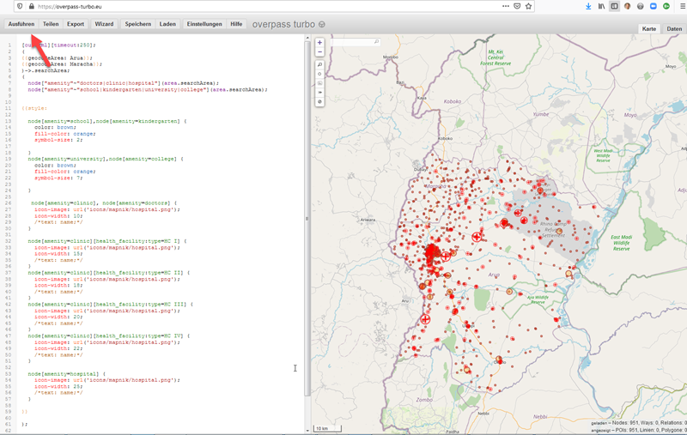
The power of an API
Evaluate http://overpass-turbo.eu/s/10nr

Slide 50
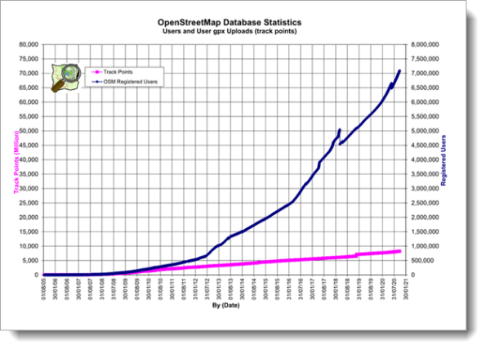
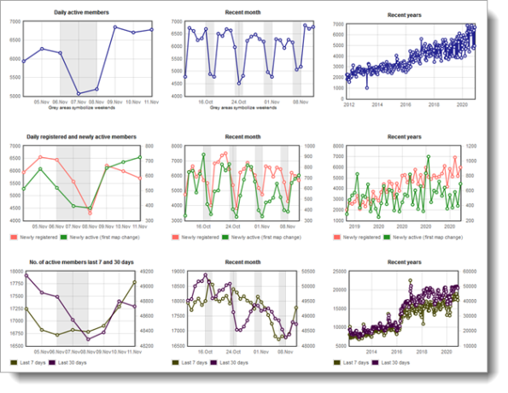
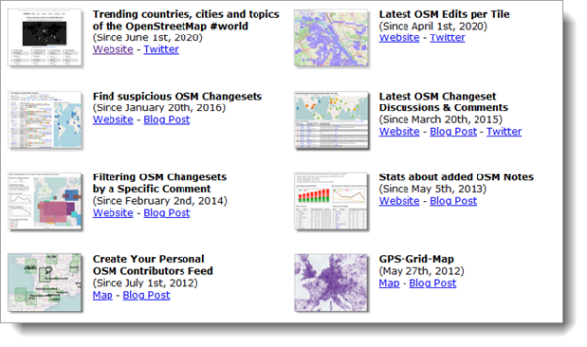
Statistics
https://wiki.openstreetmap.org/wiki/Stats
https://osmstats.neis-one.org/
http://resultmaps.neis-one.org/

Slide 51
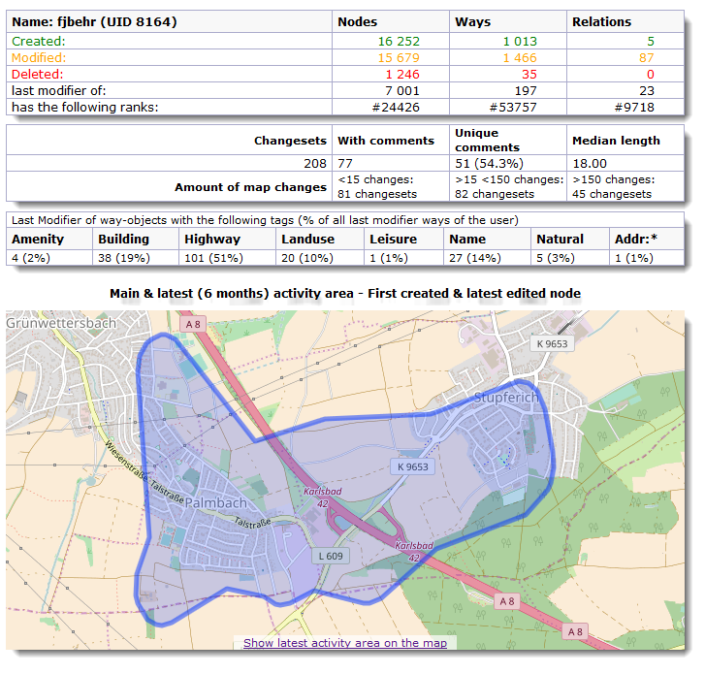
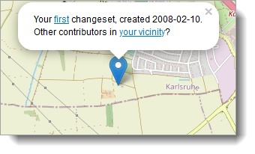
https://hdyc.neis-one.org/?fjbehr

Slide 52
Copyright and License
OpenStreetMap® is open data, but has a license!
Originally published under the Creative Commons Attribution-ShareAlike licence (CC BY-SA)
Since 2012 licensed under the Open Data Commons Open Database License (ODbL [1]) by the OpenStreetMap Foundation (OSMF [2]).
"You are free to copy, distribute, transmit and adapt our data, as long as you credit OpenStreetMap and its contributors. If you alter or build upon our data, you may distribute the result only under the same licence. The full legal code [1] explains your rights and responsibilities. "
[1] https://opendatacommons.org/licenses/odbl/1.0/
[2] http://wiki.osmfoundation.org/wiki/Main_Page

Slide 53
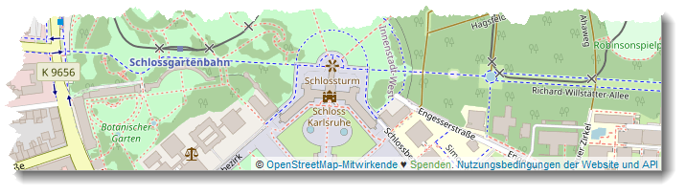
How to credit OpenStreetMap
We are required to use the credit “© OpenStreetMap contributors”.
Make it clear that the data is available under the Open Database License!
If using OSM map tiles, that the cartography is licensed as CC BY-SA (by linking to the copyright page).
Distributing OSM in a data form? Name and link explicitely directly to the license(s).
In media where links are not possible (e.g. printed works): Direct your readers to openstreetmap.org (perhaps by expanding 'OpenStreetMap' to this full address), to opendatacommons.org, and if relevant, to creativecommons.org.
For a browsable electronic map, the credit should appear in the corner of the map.

Slide 54
Summary
Copyright not by Teleatlas, Navteq, Google, . . .
Data, NOT images,
No censoring
no restrictions on use
Encouraging people from using them in creative, productive or unexpected ways.
Fun ;-)

Slide 55
Your gain
It’s your map, your project!
You see very soon the results of your hard work!
You have some kind of ownership of the data!
Open Database License - Trusted, inpedendent third party, Copyright assigned to the OpenStreetMap Foundation.
Something useful!
You’r part of the community!

Slide 56
References
Nick Black (2007): How OpenStreetMap is mapping the world. http://2007.foss4g.org/attachments/56/Nick_Black_OSM_FOSS4G2007.pdf [2020-11-12]
Mikel Maron (2008): FreeMap West Bank. Bethlehem, https://www.slideshare.net/mikel_maron/palestine-west-bank-free-map-introduction-554753 [2020-11-12]
Mikel Maron (2009): Free and Open Palestine. https://www.slideshare.net/mikel_maron/free-and-open-palestine [2020-11-12]
Neis, P.; Zipf, A. (2012) Analyzing the Contributor Activity of a Volunteered Geographic Information Project — The Case of OpenStreetMap. ISPRS Int. J. Geo-Inf. 2012, 1(2), 146-165; https://doi.org/10.3390/ijgi1020146
Papapesios, N., Ellul, C., Shakir, A. et al. (2019): Exploring the use of crowdsourced geographic information in defence: challenges and opportunities. J Geogr Syst 21, 133–160 (2019). https://doi.org/10.1007/s10109-018-0282-5, https://www.mdpi.com/2220-9964/1/2/146/htm [2020-11-12]

Slide 57
Further readings
https://wiki.openstreetmap.org/wiki/Main_Page
https://learnosm.org/en/
https://weeklyosm.eu/

