Slide 1


Open source components for
Service-Oriented Mapping applications
By Hochschule für Technik Stuttgart [CC BY-SA 3.0 (http://creativecommons.org/licenses/by-sa/3.0)], via Wikimedia Commons
Franz-Josef Behr, Stuttgart University of Applied Sciences
Co-Chair: ICA Commission on SDI & Standards
15 July 2019, Tokyo, Japan
The content is licensed under a Creative Commons-Lizenz CC BY-NC-SA.

Slide 2
Outline
Vier-Schichten-Architektur von Client-Server-Anwendungen
Softwarelösungen für jede der Schichten
Werkzeuge, Versuche zur Beurteilung der Marktbedeutung
Zusammenfassung

Slide 3
Four-Tier-Architecture

Slide 4
Architecture
DNS Server
IP address
IP address / Server Name / Host name
Client
"User Agent"
HTTP Server
Document root
Static
resources
HTTP-Client
HTTP-Client
HTTP-Client
HTTP
HTTP
80
Internet
80
Communication tier,
Web Tier
PNG, JPG, …
XML / SVG
Presentation Tier
CGI protocol
Application
Server
Apps
Local System
(GIS)
App Tier,
Business Logic Tier
SQL
Data preparation, analysis
DBMS
Server
Data Tier

Slide 5
Presentation Tier

Slide 6
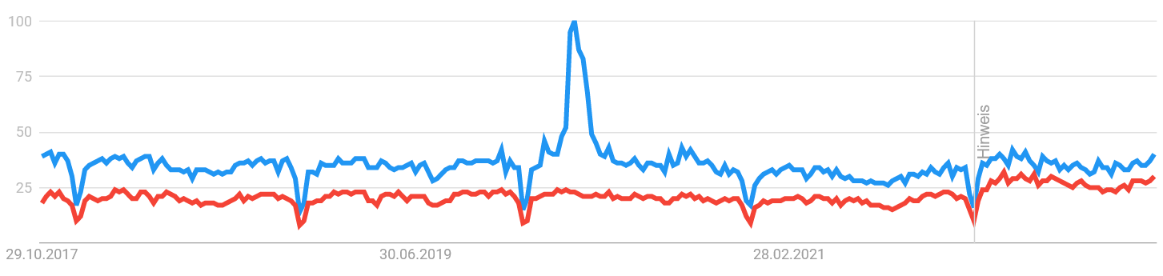
Desktop GIS
https://gisgeography.com/qgis-arcgis-differences/
https://trends.google.com/trends/explore?q=ArcGIS,QGIS [2022-10-23]

Slide 7
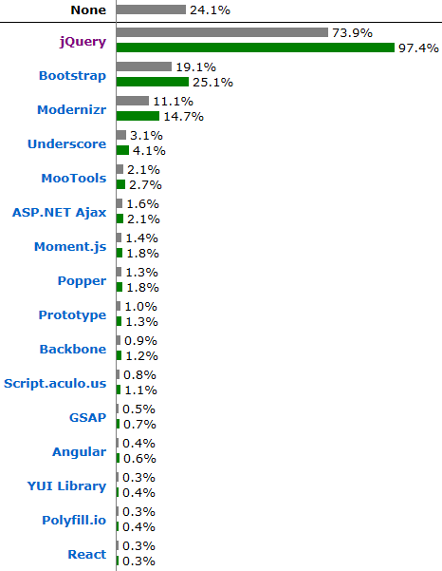
Frameworks
https://w3techs.com/technologies/overview/javascript_library/all [2019-07-08]

Slide 8
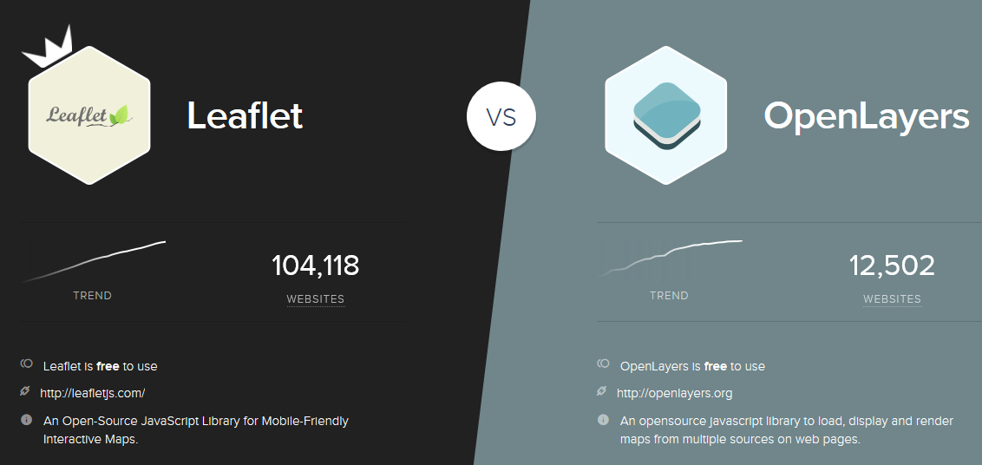
JavaScript-Libraries (Bibliotheken)
https://www.similartech.com/compare/leaflet-vs-openlayers [2010-07-08]

Slide 9
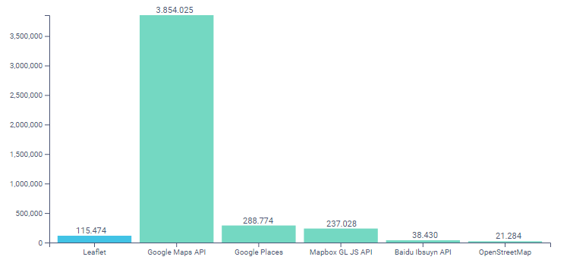
https://www.datanyze.com/market-share/mapping-and-gis/leaflet-market-share [2018-11-23]

Slide 10
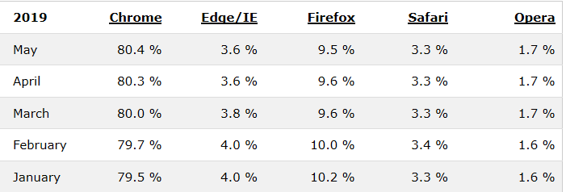
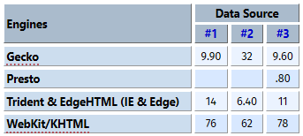
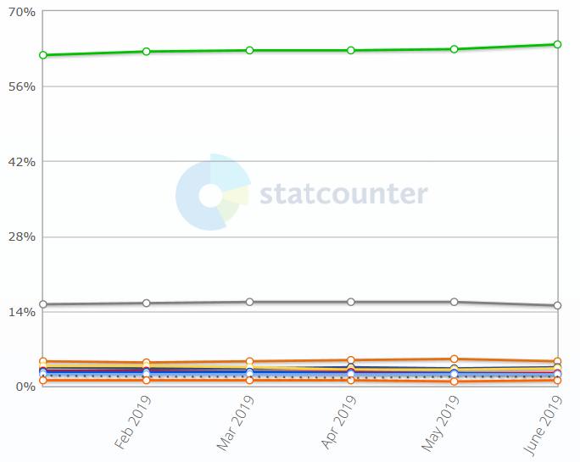
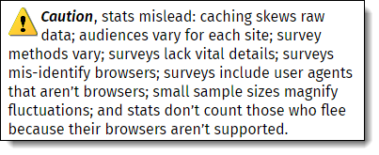
General Client programs
HTTP clients
  Google Chrome
  Firefox
  Edge/Internet Explorer
  Opera
  Safari
FTP clients
  Filezilla
Mail Clients
  Thunderbird
  Outlook
http://www.w3schools.com/browsers/browsers_stats.asp [2019-07-08]
http://www.upsdell.com/BrowserNews/stat.htm [2019-07-08]
http://gs.statcounter.com/browser-market-share [2019-07-08]

Slide 11
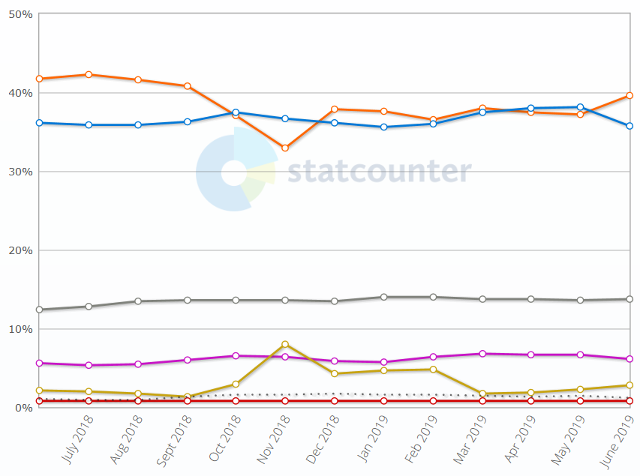
Operating System Market Share Worldwide
http://gs.statcounter.com/os-market-share [2019-07-08]

Slide 12
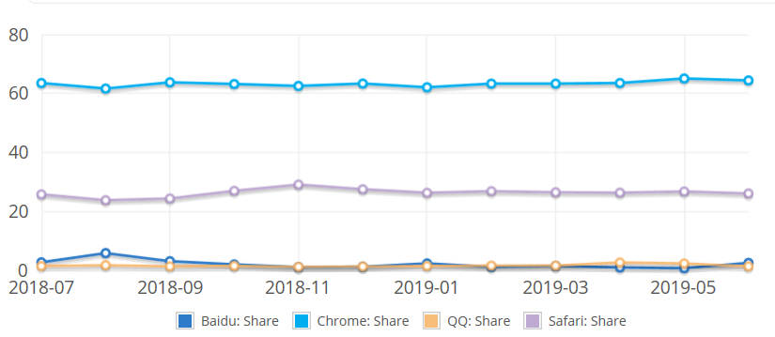
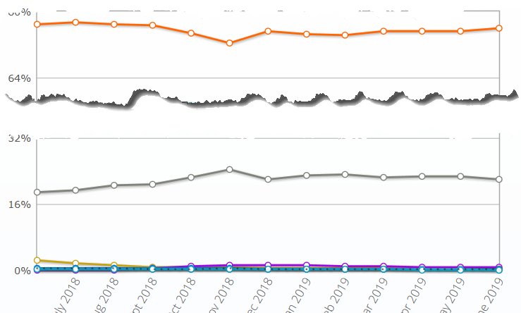

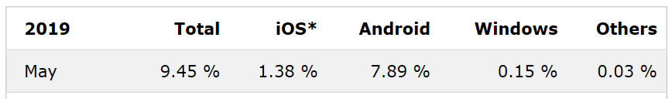
Produkte: Mobile Devices
http://gs.statcounter.com/os-market-share/mobile/worldwide [2019-07-08]
http://marketshare.hitslink.com/
http://www.w3schools.com/browsers/browsers_mobile.asp [2019-07-08]

Slide 13
Communication Tier

Slide 14
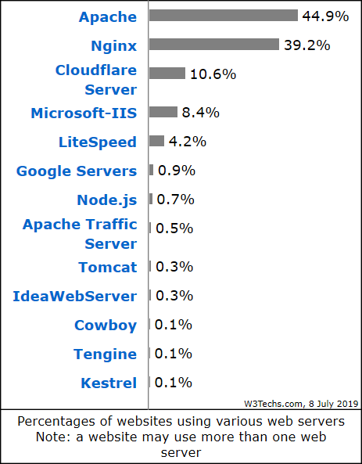
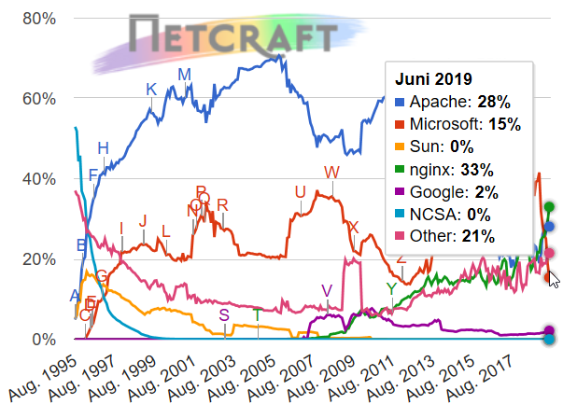
Products and Tools
HTTP Servers
  Apache HTTP Server (open source)
  Nginx (open source)
  Internet Information Server® (Microsoft)
https://w3techs.com/technologies/overview/web_server/all [2019-07-08]
http://news.netcraft.com/archives/category/web-server-survey/, based on > 1,333,421,275 sites

Slide 15
FTP
Tools for FTP based transfer
  FileZilla (Client and Server, open source)
  …

Slide 16
Application Tier

Slide 17
Applikation Server
In Geo-IT: Applikationsservers implementieren Dienste entsprechend den Empfehlungen des Open Geospatial Consortium (OGC) (Vortrag heute Nachmittag), wie
  Web Map Service
  Web Feature Service
  Web Coverage Service
  Catalogue Services
Geo-Applikationsserver
Closed Source Solutions
Open Source Solutions
https://trends.google.com/trends/explore?q=ArcGIS,GeoServer

Slide 18
Applikationsserver: Open Source
GeoServer
  „an open source software server written in Java that allows users to share and edit geospatial data. Designed for interoperability, it publishes data from any major spatial data source using open standards.“ (http://geoserver.org/display/GEOS/Welcome)
MapServer (formerly called UMN MapServer, http://www.osgeo.org/mapserver)
  Written in C, with PHP wrapper
  WMS, WFS, Strong support of Shape files
  Somehow old-fashioned, configuration by text file („map file“)
Deegree Server
  „deegree is a comprehensive geospatial software package with implementations of OGC Web Services like WMS and WFS, a geoportal, a desktop application, security mechanisms, and various tools for geospatial data processing and management. It is open source (LGPL), Java, standards-compliant (OGC, ISO) and an OSGeo project.“ (http://www.deegree.org/)
  Needs Java, and some time for configuration
QGIS Server
MapGuide Open Source
  „enables users to develop and deploy web mapping applications and geospatial web services.“ (http://www.osgeo.org/mapguide)

Slide 19
Applikationsserver : Closed Source
ArcGIS Server® http://enterprise.arcgis.com/de/server/latest/get-started/windows/what-is-arcgis-for-server-.htm
GeoMedia WebMap® https://www.hexagongeospatial.com/products/power-portfolio/geomedia-webmap
MapInfo MapXtreme® https://www.pitneybowes.com/us/location-intelligence/geographic-information-systems/mapxtreme.html

Slide 20
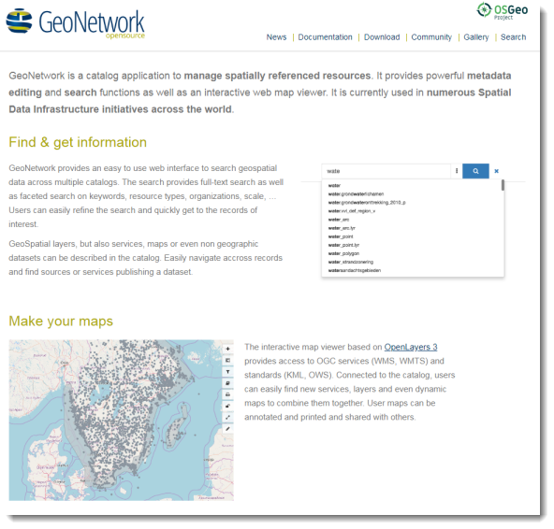
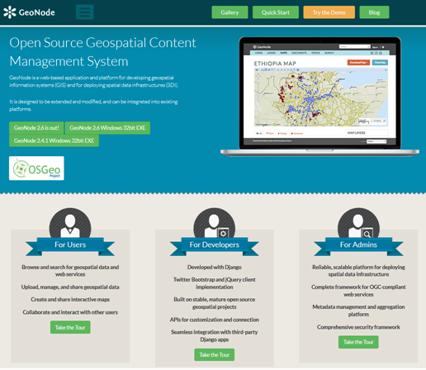
Applikationsserver: Portal Server
Geonetwork OpenSource: a widely used catalog application to manage spatially referenced resources
Geonode: for developing geospatial information systems (GIS) and for deploying spatial data infrastructures (SDI).
pycsw
https://geonetwork-opensource.org/
https://geonode.org/

Slide 21
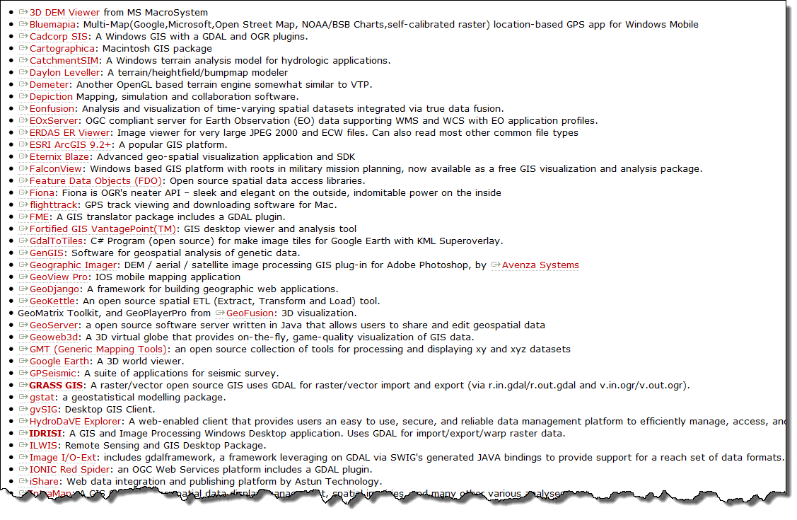
Bibliotheken: Software using GDAL

Slide 22
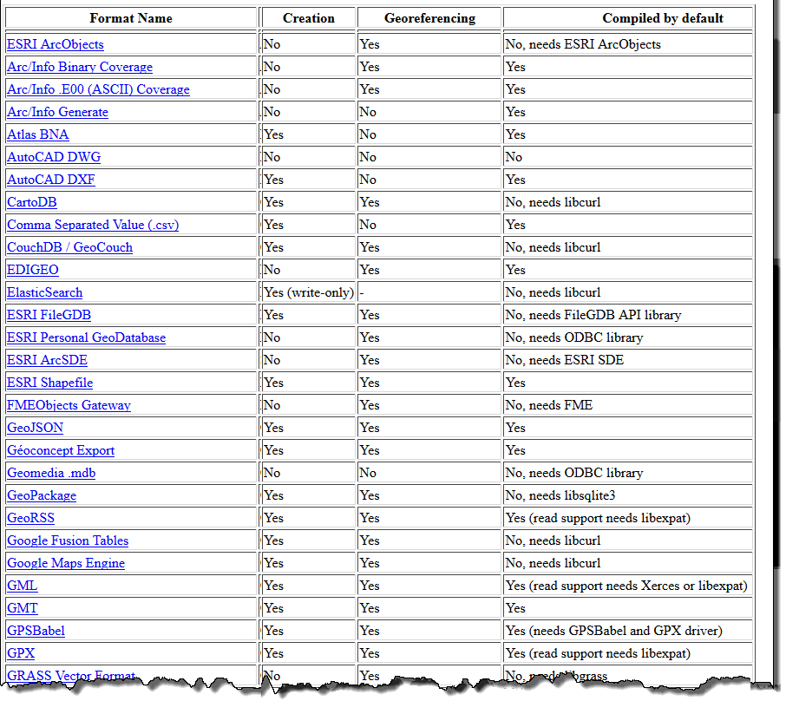
GDAL: Supported Vector formats

Slide 23
Data Tier

Slide 24
Related Products and Tools: (O)RDBMS
(O)(R)DBMS: (Object) (Relational) Database Management System
  commercial products
    Oracle,
    SQLServer (Microsoft),
    Informix, DB2 (IBM),
    …
  free
    PostGreSQL (PostGIS), fully conformant to OGC‘s Simple Feature Specification – highly recommended
    MySQL
    SpatialLite

Slide 25
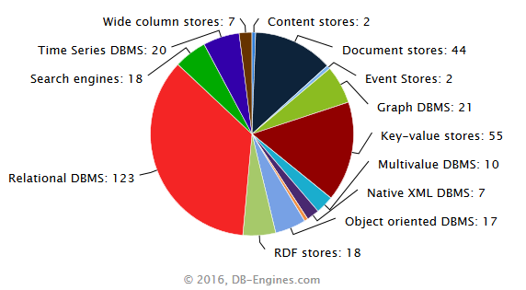
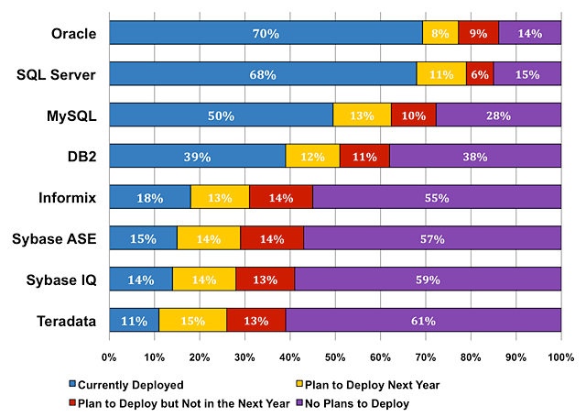
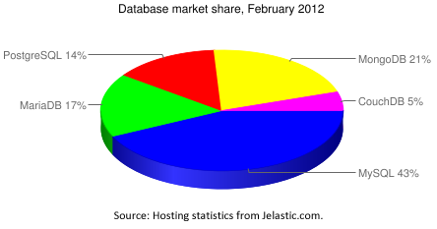
Market share
2008 (Closed Source)
2012 (FOSS)
http://blog.jelastic.com/2012/02/23/open-source-database-market-share-within-jelastic-february-2012/
http://www.mysql.com/why-mysql/marketshare/ [2008, no more available]

Slide 26
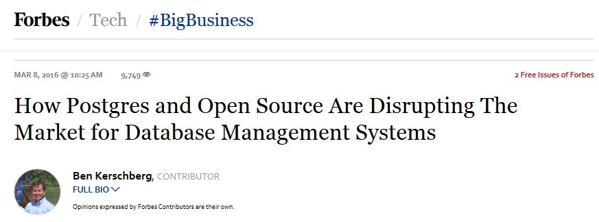
Trend of Relational DBMS Popularity
https://www.forbes.com/sites/benkerschberg/2016/03/08/how-postgres-and-open-source-are-disrupting-the-market-for-database-management-systems/#141b42e820a3

Slide 27
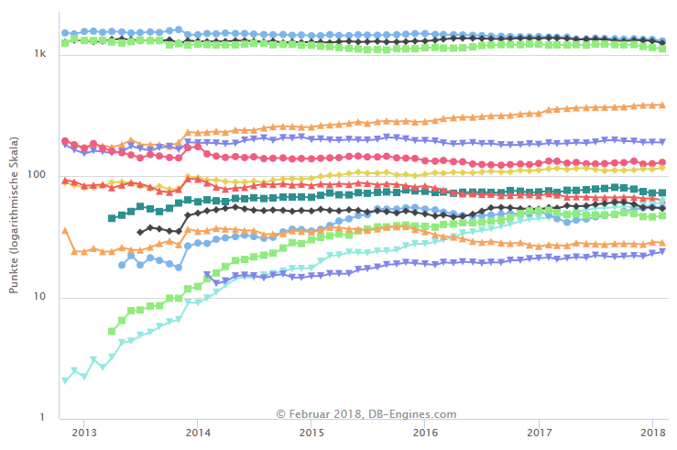
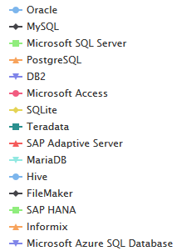
Trend of Relational DBMS Popularity
https://www.forbes.com/sites/benkerschberg/2016/03/08/how-postgres-and-open-source-are-disrupting-the-market-for-database-management-systems/#141b42e820a3
http://db-engines.com/en/ranking_trend/relational+dbms [2018-02-26]

Slide 28
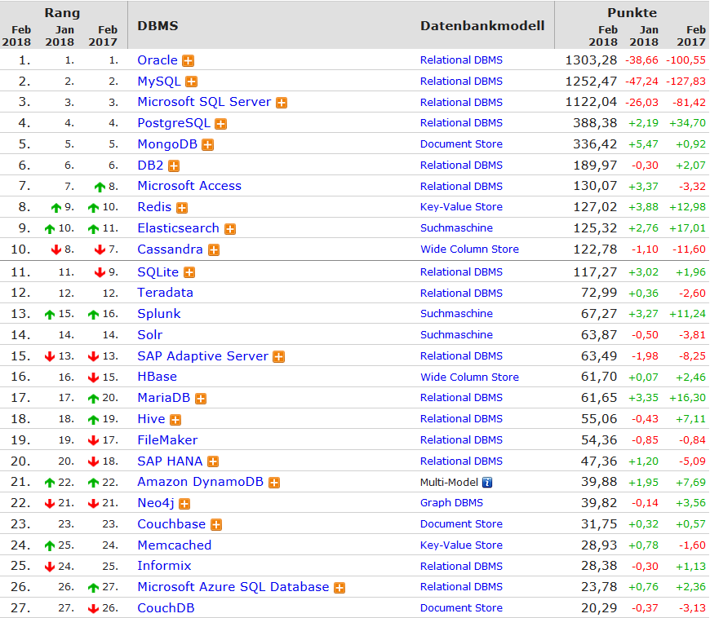
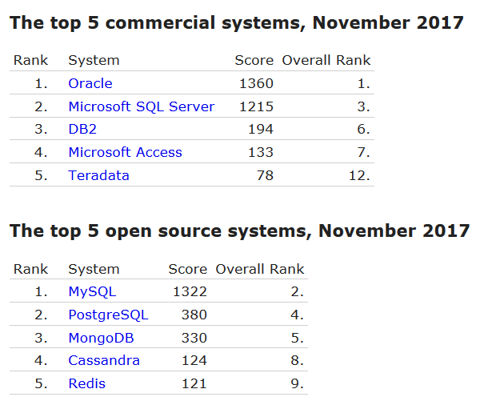
https://db-engines.com/de/ranking [2018-01-26]
http://db-engines.com/en/ranking_categories; http://db-engines.com/en/ranking_osvsc [2017-11-06]

Slide 29
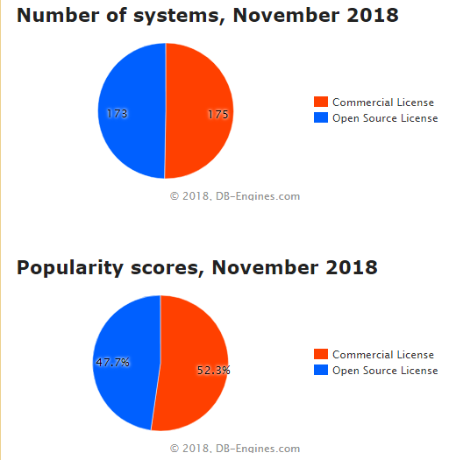
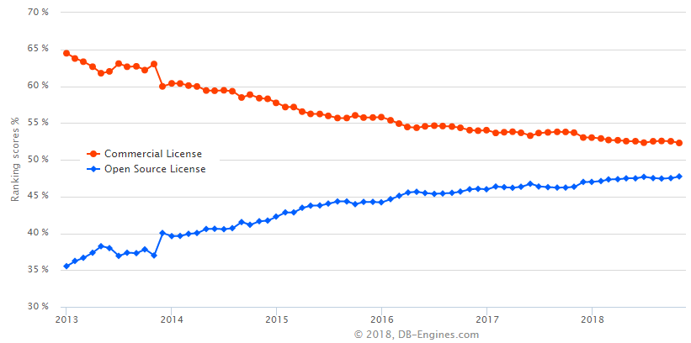
Popularity
http://db-engines.com/en/ranking_osvsc [2018-11-23]

Slide 30


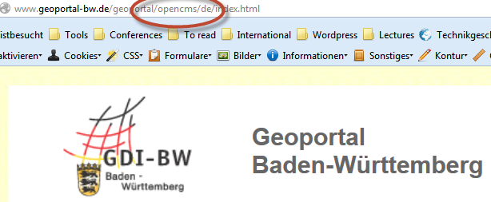
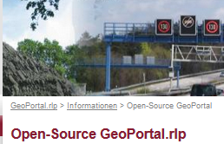
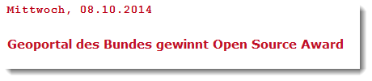
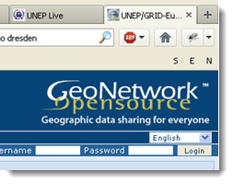
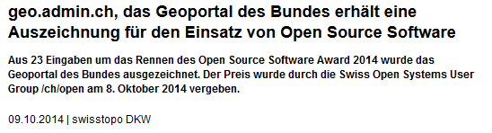


Slide 31
Zusammenfassung

Slide 32
Vier-Schichten
Für Erfüllung Ihrer Aufgaben stehen für jede Schicht eine Vielzahl von quelloffenen und Closed-Source-Lösungen zur Verfügung.
Kommunkationsschicht: i. d. R. Open Source-Lösungen
Beurteilung der Alternativen entsprechend
  den Anforderungen der jeweiligen Institution sowie
  in Bezug auf Unterstützung offener, anerkannter Standards
Tendenz zu quelloffenen Lösungen, insbesondere in der öffentlichen Verwaltung
Gesamtlösung: Software + Services

Slide 33
Literatur
S. Steiniger and A.J.S. Hunter (2012): The 2012 Free and Open Source GIS Software Map – A Guide to facilitate Research, Development and Adoption. http://www.geo.uzh.ch/~sstein/manuscripts/fosgismap_sstein_v9_web.pdf
Tim Sutton (2018): Deciding Between FOSSGIS and Proprietary Software in the Enterprise. In: Understanding the GIS Industry in 2018. https://www.gis-professional.com/magazines/gis-professional-february-2018.pdf
The Top 19 GIS Software. https://www.g2crowd.com/categories/gis#highest_rated [2018-11-22]
Comparison of geographic information systems software. https://en.wikipedia.org/wiki/Comparison_of_geographic_information_systems_software [2018-11-22]

Slide 34

Prof. Dr. Franz-Josef Behr
Hochschule für Technik Stuttgart
Stuttgart University of Applied Sciences
franz-josef.behr@hft-stuttgart.de
http://georeferenced.files.wordpress.com/2014/03/openclose_flickr_leo_reynolds_cc.jpg

