Slide 1
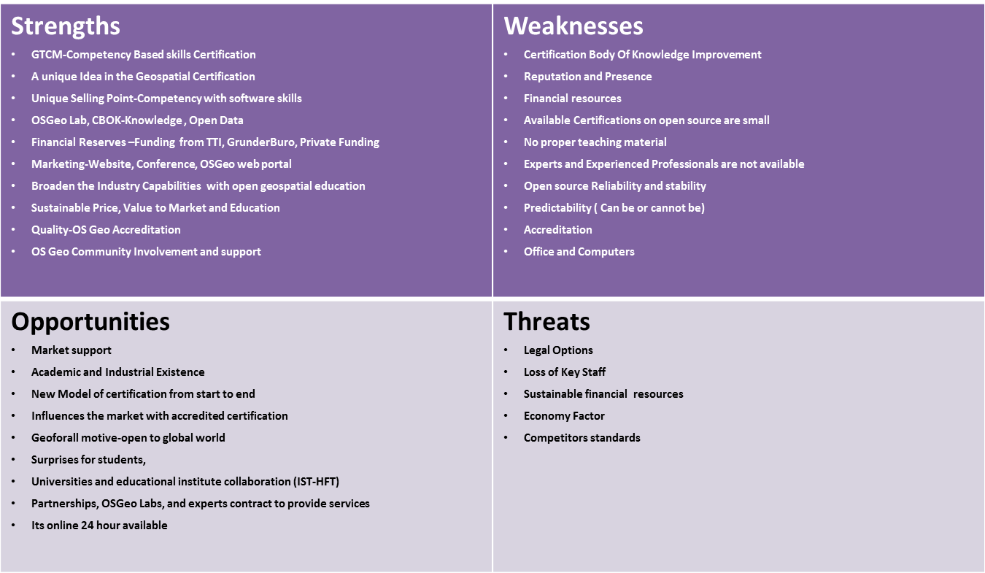
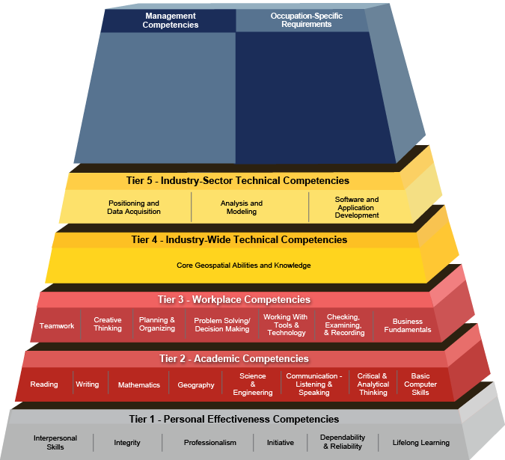
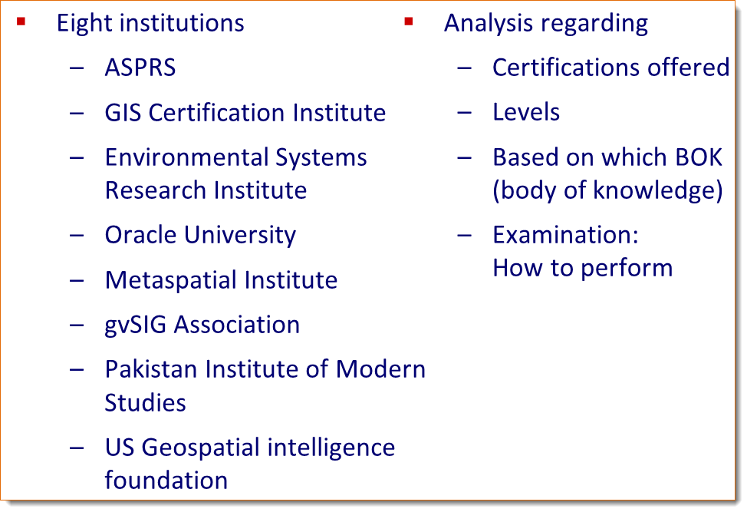
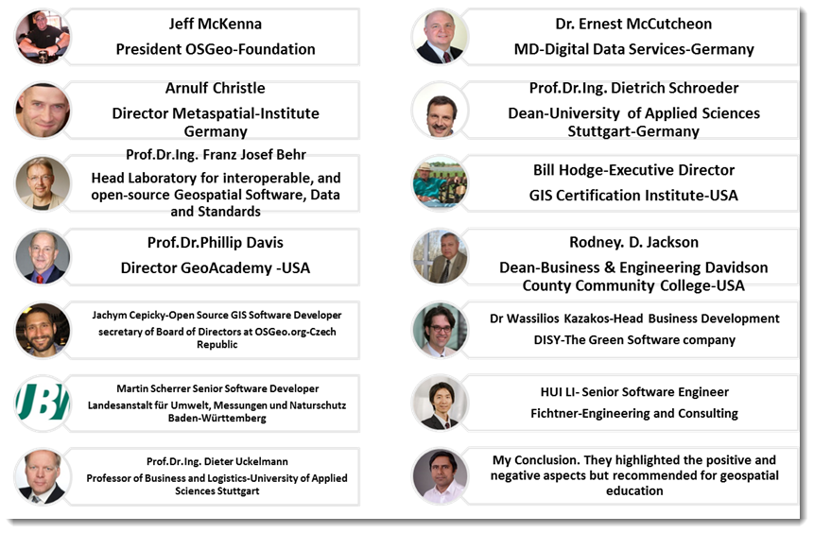
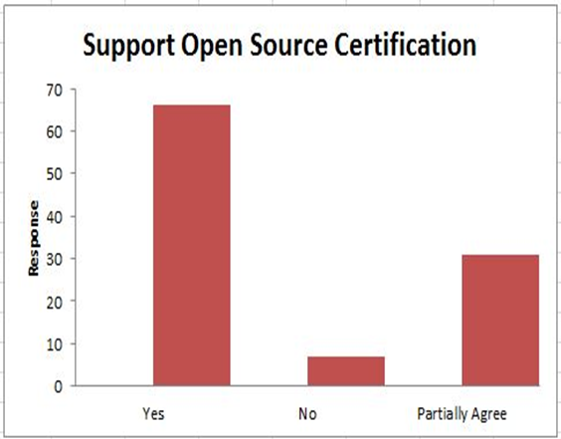
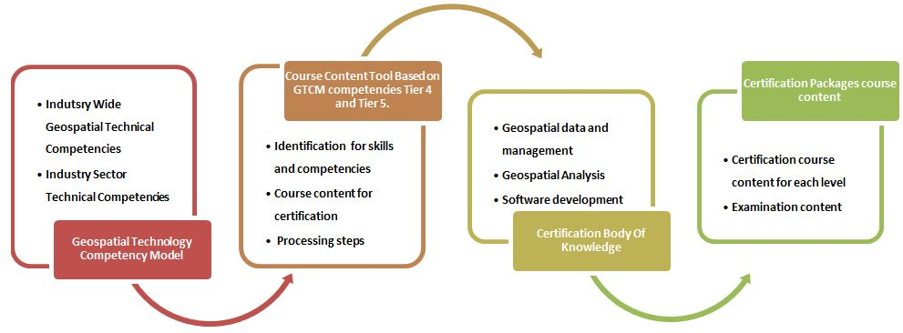
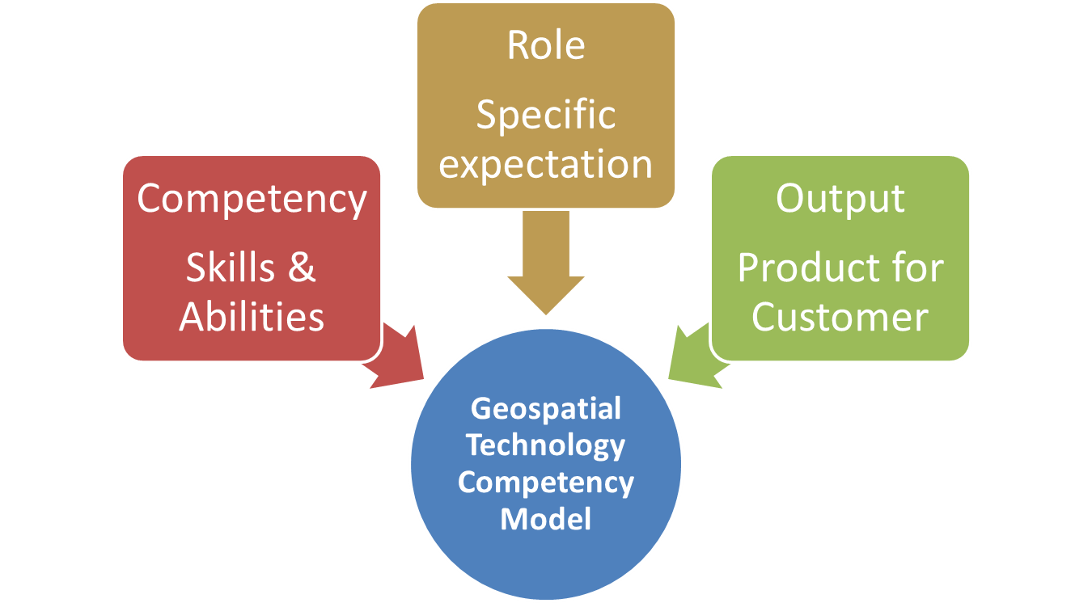
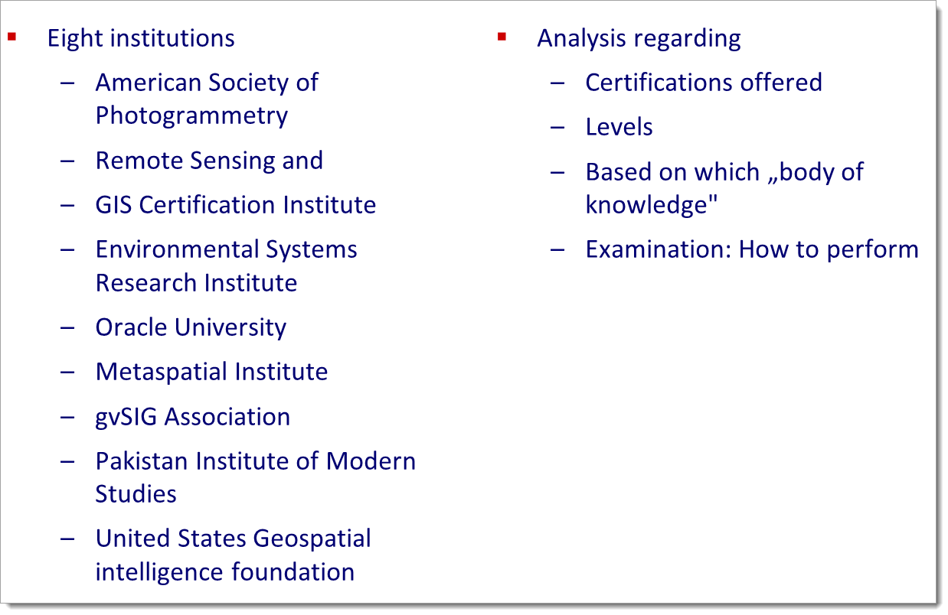
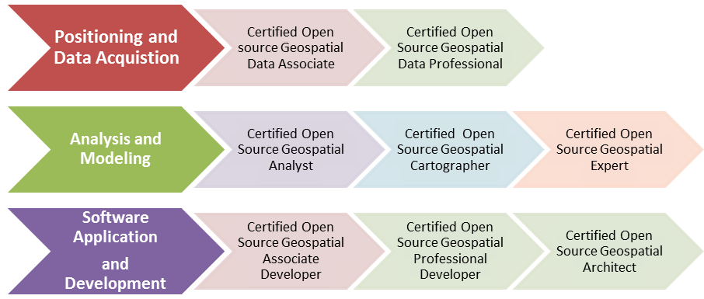
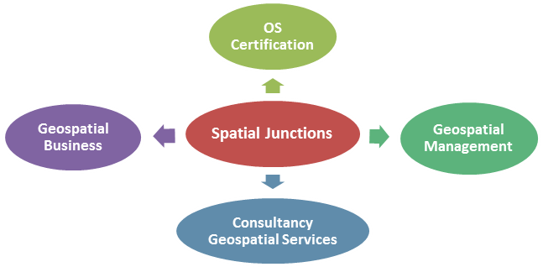


Analysis of Existing Certifications Approaches
Eight institutions
  ASPRS
  GIS Certification Institute
  Esri
  Oracle University
  Metaspatial Institute
  gvSIG Association
  Pakistan Institute of Modern Studies
  US Geospatial intelligence
  foundation
Analysis regarding
  Certifications offered
  Levels
  Based on which
  „body of knowledge"
  Examination: How to perform
A FRAMEWORK FOR AN
OPEN SOURCE GEOSPATIAL CERTIFICATION MODEL
Franz Josef Behr, Stuttgart University of Applied Sciences, Germany <franz-josef.behr@hft-stuttgart.de>, Tanzeel Ur Rehman Khan, Stuttgart University of Applied Sciences, Germany <Tanzeelrehman130@hotmail.com>, Philip Davis, Director Geo Academy, USA < pdavis@delmar.edu >
Introduction
Analysis of existing (spatial) certifications offered
(8 institutions/companies)
Analysis of existing Bodies of Knowledge, emphasizing the Geospatial Technology Competency Model (GTCM)
Online Survey with regard to Open Source relevance (105
respondents worldwide)
15 expert interviews (face-to-face and by telephone) with regard to Open Source
Synopsis of the results
Development of the certification model
Dissemination of the results
Business development
Parallel to proprietary software: Increasing impact of free and open source software/standards/data in geospatial technology research and geospatial industry.
Open source geospatial certification: A need for geospatial technology education and industry .
Support the goals of the Geo-For-All initiative of the ICA-OSGeo-ISPRS pact.
Methodological approach
SWOT Model: SWOT Model reveals the business prospects of this geospatial product.
Analysis of existing (spatial) certifications offered (8 institutions)
Analysis of existing Bodies of Knowledge, emphasizing the Geospatial
Technology Competency Model (GTCM)
Online Survey with regard to Open Source relevance
(105 respondents worldwide)
15 expert interviews (face-to-face and by telephone)
with regard to Open Source
SWOT analysis and business development
Synopsis of the results
Development of the certification model
Dissemination of the results
SWOT analysis and business development
Issuing Institute | Certifications | Levels | Based on … | Examination
American Society of Photogrammetry Remote Sensing and | Certified Photogrammetrist, Certified Photogrammetric Technologist, Certified mapping scientist-GIS/LIS, Certified mapping scientist-Remote Sensing, Certified Remote Sensing and GIS/LIS Technologist, | Professional Level Technician Level | Examination matrices for Professional and Technician Level. | Peer review of experience and training Written Exam
GIS Certification Institute | Geographic Information System Professional | Professional | URISA Body of Knowledge-2006 | Geospatial Core Technical Knowledge Exam
Environmental Systems Research Institute | Desktop Developer(Desktop and web application developer ) Enterprise-Geodata management, System Design and Administration | Associate, Professional | ArcGIS | Computer Based multiple choice exam
Oracle University | Oracle and Java Certifications | Associate, Professional, Expert, Master | Oracle Certification exam content | Computer Based multiple choice exam
Metaspatial Institute | Open Source Geospatial Software Developer Open Source Geospatial Software Professional Open Geospatial Data Professional Open Geospatial Standards Expert Open Geospatial Consultant | Professional, Expert | Open Source course Curriculum and | Online Test, Educational and Professional Credentials evaluation. Technical Interview
gvSIG Association | gvSIG user certification gvSIG expert Certification | Associate, Expert | gvSIG-content outline | Online Test
Pakistan Institute of Modern Studies | Certified Professional Manager GIS | Associate, Analyst, Expert, Manager | GIS Course Curriculum PIMS | Educational Credential Evaluation, Home based exercise.
US Geospatial Intelligence Foundation | Universal GEOINT Certification | Professional | Essential Body Of Knowledge | Exam
NCGIA Core Curriculum [Goodchild, M.F., and K.K. Kemp, eds. 1990. NCGIA Core Curriculum in GIS.]
URISA Body Of Knowledge (2006)
Geospatial Technology Competency Model (2010, 2014)
USGIF Essential Body Of Knowledge (2015)
Under development: "Geographic Information: Need to Know" (GI-N2K, http://www.gi-n2k.eu/) (incl. AGILE)
Analysis of Existing Certifications Approaches, Bodies of Knowledge, Interviews & Worldwide Survey
Survey on Open Source Geospatial Certification
https://docs.google.com/forms/d/1FPvv_QgR8zMCdFzqGgrm5zLT8KvC7j4VTmXTtflYnGk/viewform?edit_requested=true
+
+
+
Strengths 1) Competency based skill certification. 2) promotion of business and job opportunities 3) Innovation 4) Broaden the industry's capabilities 5) Empowerment for geospatial education 6) Proper and flexible alternative to proprietary software 7) straight-forward channel to gain expertise and competence over open-source software 8) provide legitimacy and understanding of Open Source tools and functionality 9) Proper and flexible alternative to proprietary software certification 10) Market analysis and trend support Open Source certification | Weakness 1) Reliability and maintenance issue. 2) Weak geospatial business in Open Source 3) support system for Open Source issue 4) Available certifications on Open Source are very rare. 5) Decision making with Open Source certification is difficult
Opportunities 1. OS Certification from basic to higher level based on GTCM. 2. Certification courses can/will increase employability and competence in market. 3. Understanding of geospatial theory and FOSS4G investigation 4. Certification will close the gap in between industry and geospatial education 5. Universities collaboration and affiliation | Threats 1) Experts and experienced professionals are not available 2) OS is not stable and reliable 3) No Owner 4) Lack of academic support
Eight institutions
  ASPRS
  GIS Certification Institute
  Esri
  Oracle University
  Metaspatial Institute
  gvSIG Association
  Pakistan Institute of Modern Studies
  US Geospatial intelligence
  foundation
Analysis regarding
  Certifications offered
  Levels
  Based on which
  „body of knowledge"
  Examination: How to perform
Geospatial Technology Competency Model (Tier 4&5, 2014)
The process
Industry-Wide Technical Competencies
Industry-Sector Technical Competencies
Course content based
on tiers 4 & 5
Content of certification packages
Identification for skills
and competences
Course content for
certification
Geospatial data and
management
Geospatial analysis
Software development
Course content for
each level
Software to use
Examination procedure
and content
Analysis of existing approaches and bodies of knowledge, expert interviews, online review
Eight different, extensible certification items are proposed relying of a network of different organisations and people.
Needed: Support / endorsement / accreditation needed from official bodies, i.e. OSGeo Foundation, ICA, ISPRS, …
Education: can be provided by private companies and universities.
Expected benefits:
    Contribution to better level of education
    Promotion of Open Source solutions,
    Promotion of and benefits for all involved contributing organisations and people
Geospatial Technology
Competency Model
Categories and Body of Knowledge
The outcome
Open Source Geospatial Certification Model
Its Stakeholders
Its Business Perspective
University
Educational Institution
Student
Open Source based Geospatial Competency Certification (Launch: Aug 2016)
University
Education
Providing
education
Student
Professional
University
Professional
Professional
University
Professional
Applicant
Broad range of competencies, Curriculum evaluation, Planning and Development
Resources for Certification and production of Geospatial Work Force.
Quality Assurance,
Endorsement
Certification
Seeking
certification
Applicant
Accreditation
Committee
Administration & Management
Accreditation,
Endorsement
Certification
Bureau
ICA
OSGeo
Certification
Bureau
Certification
Bureau
WG VI/3: Promotion of International
Collaborative Education Programs

