Slide 1
Geo4All Annual General Meeting (AGM)
Development of an
Open Source Geospatial Certification Model:
A Key To Empowerment Of Geospatial Education
Franz-Josef Behr, Tanzeel Khan
17 March 2021

Slide 2
Source
Data
Open
Standards
Education

Slide 3
Outline
Introduction
  Body of Knowledge
Methodological approach
Results
Summary

Slide 4
Certifications – What, Why, Who
What
Certification: a proof of competence, expertise, and skills. Designed to recognize expertise.
Why
Enhance market value and expertise.
Growing need of open source
Who
Development of an open source geospatial certification model
Curricula (academic, elsewhere), l certification.
Improvement in skills, knowledge and Professional network
Goal
Students, Universities, Job seekers, Professionals, Employers
Notes:
Certification: a proof of competence, expertise, and skills. Designed to recognize expertise.
Curricula (academic, elsewhere) need certification.
Benefit: Enhance market value and expertise.
Why: Growing need of open source
Improvement in skills, knowledge and Professional network
Who: Students, Universities, Job seekers, Professionals, Employers
Objective: Development of an open source geospatial certification model

Slide 5
Certification: a proof of competence, expertise, and skills. Designed to recognize expertise.
Curricula (academic, elsewhere) need certification.
Benefit: Enhance market value and expertise.
Why: Growing need of open source
Improvement in skills, knowledge and Professional network
Who: Students, Universities, Job seekers, Professionals, Employers
Objective: Development of an open source geospatial certification model

Slide 6
The foundation: Our Body of knowledge…
In the fields of geoinformatics, geoscience, computer science, cartography and IT provides
… a "complete set of concepts, terms and activities that make up a professional domain, as defined by the relevant learned society or professional association. It is a type of knowledge representation by any knowledge organization." [Wikipedia]
It's a "Benchmark for a Profession" [Wayne 2006]
But still „work in progress“ [UCGIS, 2006]
basis for curriculum planning, education, and certification.

Slide 7
Bodies Of Knowledge
NCGIA Core Curriculum [Goodchild, M.F., and K.K. Kemp, eds. 1990. NCGIA Core Curriculum in GIS.]
David DiBiase, Michael DeMers, Ann Johnson, Karen Kemp, Ann Taylor Luck, Brandon Plewe, and Elizabeth Wentz (2006): Geographic Information Science and Technology Body of Knowledge^{[1]}
URISA Body Of Knowledge
Geospatial Technology Competency Model (2010, 2014)
USGIF Essential Body Of Knowledge (July 2015, 2019)^{[2] [23]}
"Geographic Information: Need to Know" (GI-N2K, http://www.gi-n2k.eu/), 2013-2016
GIS&T Body of Knowledge. https://gistbok.ucgis.org/
[1] http://www.gi-n2k.eu/wp-content/uploads/2014/01/UCGIS_GISandT_BoK_DigReIssue2012.pdf
[2] https://usgif.org/usgif-publishes-version-2-0-of-its-geoint-essential-body-of-knowledge/
[3] https://usgif.org/wp-content/uploads/2020/11/ebk19.pdf [2021-03-16]

Slide 8
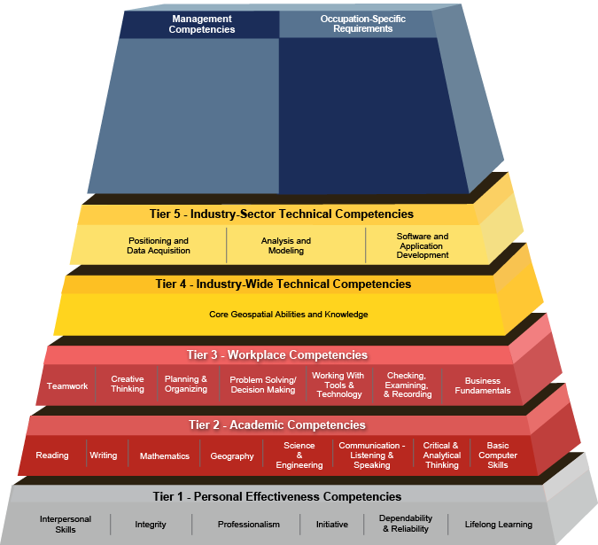

Slide 9
Methodologic approach
Analysis of existing (spatial) certifications offered (8 institutions/companies)
Analysis of existing Bodies of Knowledge, emphasizing the Geospatial Technology Competency Model (GTCM)
Online Survey with regard to Open Source relevance (105 respondents worldwide)
15 expert interviews (face-to-face and by telephone) with regard to Open Source
Synopsis of the results
Development of the certification model
Dissemination of the results

Slide 10
Analysis of Existing Certification Approaches
8 institutions
  American Society of Photogrammetry
  Remote Sensing and
  GIS Certification Institute
  Environmental Systems Research Institute
  Oracle University
  Metaspatial Institute
  gvSIG Association
  Pakistan Institute of Modern Studies
  United States Geospatial intelligence foundation
Analysis regarding
  Certifications offered
  Levels
  Based on which „body of knowledge"
  Examination: How to perform

Slide 11
Existing Certification Approaches
Certification Issuing Institute | Certifications | Levels | Based on … | Examination
American Society of Photogrammetry Remote Sensing and | Certified Photogrammetrist, Certified Photogrammetric Technologist, Certified mapping scientist-GIS/LIS, Certified mapping scientist-Remote Sensing, Certified Remote Sensing and GIS/LIS Technologist, | Professional Level Technician Level | Examination matrices for Professional and Technician Level. | Peer review of experience and training Written Exam
GIS Certification Institute | Geographic Information System Professional | Professional | URISA Body of Knowledge-2006 | Geospatial Core Technical Knowledge Exam
Environmental Systems Research Institute | Desktop Developer(Desktop and web application developer ) Enterprise-Geodata management, System Design and Administration | Associate, Professional | ArcGIS | Computer Based multiple choice exam
Oracle University | Oracle and Java Certifications | Associate, Professional, Expert, Master | Oracle Certification exam content | Computer Based multiple choice exam
Metaspatial Institute | Open Source Geospatial Software Developer Open Source Geospatial Software Professional Open Geospatial Data Professional Open Geospatial Standards Expert Open Geospatial Consultant | Professional, Expert | Open Source course Curriculum and | Online Test, Educational and Professional Credentials evaluation. Technical Interview
gvSIG Association | gvSIG user certification gvSIG expert Certification | Associate, Expert | gvSIG-content outline http://www.gvsig.com/en/services/certification | Online Test
Pakistan Institute of Modern Studies | Certified Professional Manager GIS | Associate, Analyst, Expert, Manager | GIS Course Curriculum PIMS | Educational Credential Evaluation, Home based exercise.
United States Geospatial intelligence foundation – suspended 2021-23 | Universal GEOINT Certification | Professional | Essential Body Of Knowledge | Exam

Slide 12
Some history
2011: Proposal for a OSGeo Certification Committee [1]
2014: Renewed Proposal of an OSGeo certification by Arnulf Christl at FOSS4G 2014 (Portland)
2015: Discussion at a Geo4All meeting at FOSS4G Europe (Como)
11/11/2011: Self-paced PostGIS course offered by Refractions Research [4]
12/03/2018: gvSIG announces GIS applied to municipality management course including certification, GIS for criminology [2][3]
[1] https://wiki.osgeo.org/wiki/Certification_Committee
[2] https://blog.gvsig.org/2018/03/12/gis-applied-to-municipality-management-certification-and-links-to-the-complete-course/
[3] https://blog.gvsig.org/2018/05/16/certification-of-the-free-course-about-crime-mapping-gis-for-criminology/
[4] http://refractions.net/company/news/20111111/

Slide 13
Online Survey
To know:
  … the target group and audience for this certification, i.e. academia, industry level.
  … how many people are using open source geospatial software and which type of software they use?
  … if open source certification will promote geospatial education and geospatial profession? Will it increase the competency of geo professionals?
  … to which extent the participant supports of open source certification - will their organizations require or offer certification?

Slide 14
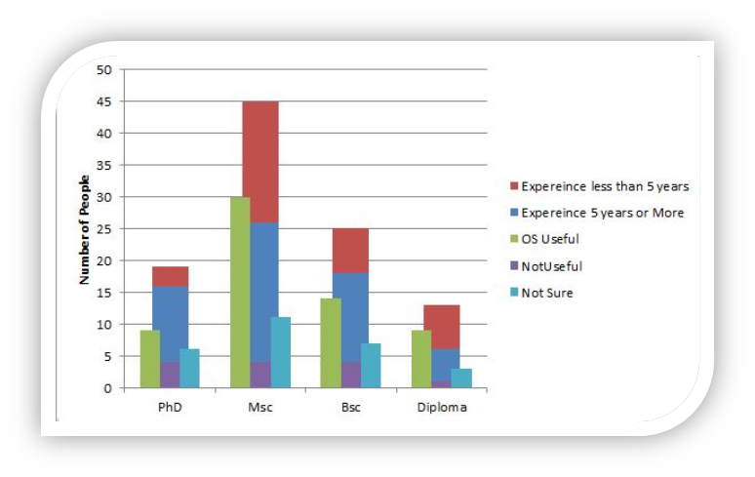
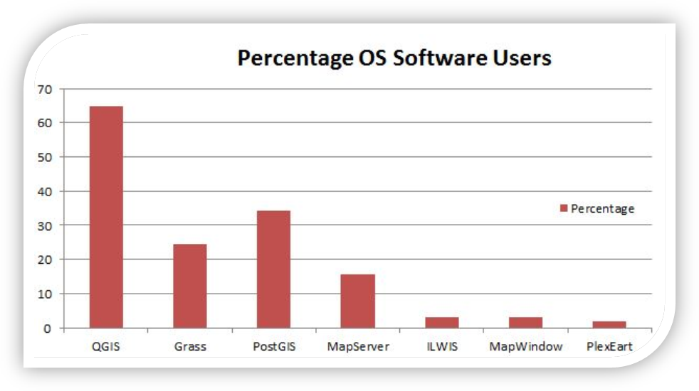

Slide 15
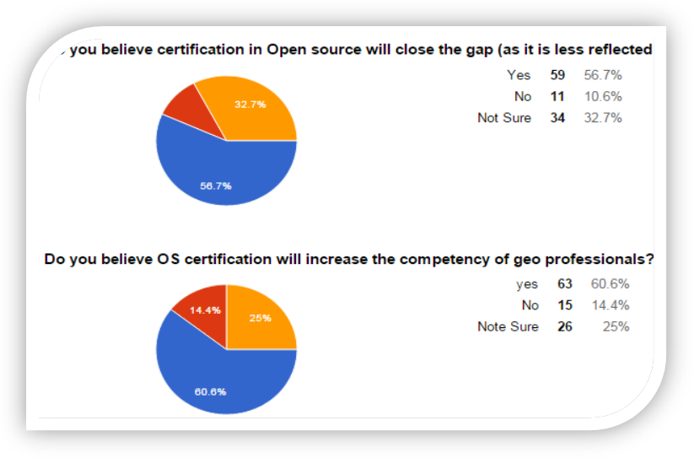
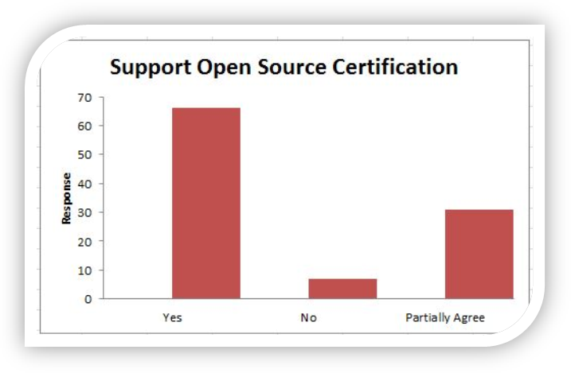
Online Survey

Slide 16
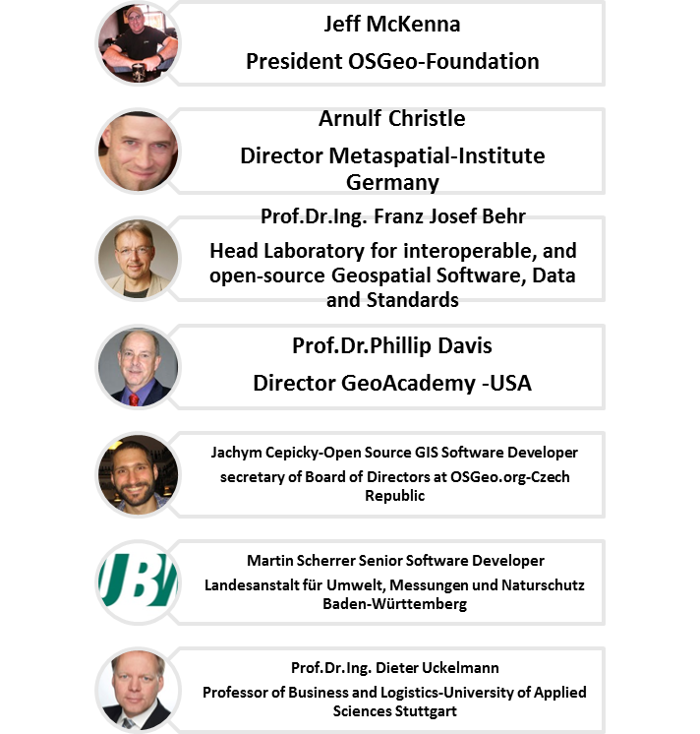
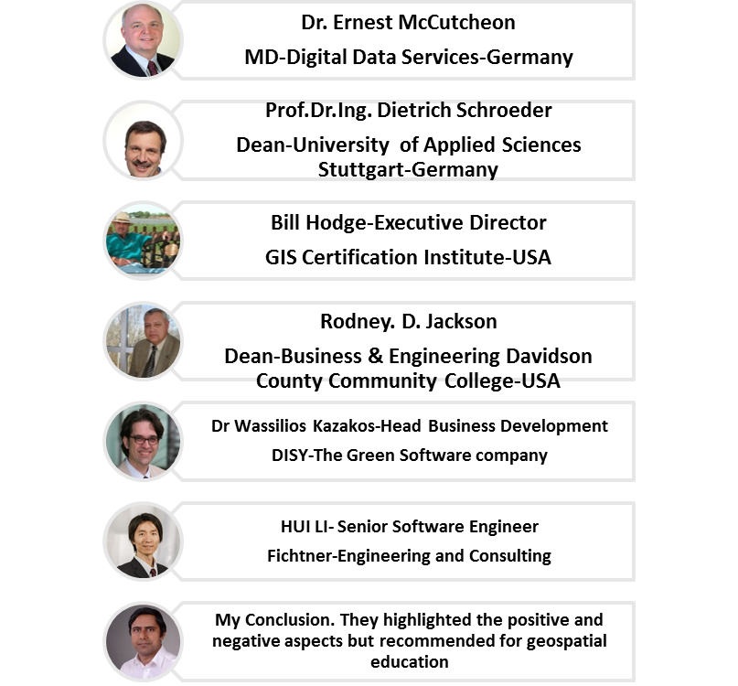
[Telefon] Interviews: Opinions on OS Certification

Slide 17
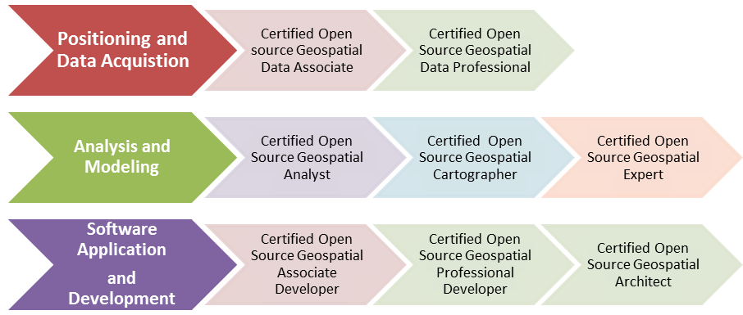
Development of the certification model
Three main categories
Further subdivision in each category, obtaining 8 certification options.

Slide 18
Certified Open Source Geospatial Data Professional
Aspects | Meta Information
Requirement | Associate Level Certification
Scope and Objective | Geospatial data and meta data information extraction Understating of data formats, standards, application of GIS models (Raster and vector) , maintenance and quality assurance measure of geospatial data FOSS- data access and management Resolution requirements for remotely sense data.
Course Content and Module Description | Acquisition and Post processing of geo data Geocoding, data format conversion Data error sources (RS, GPS) Remote sensing data requirement analysis Statistical concepts (Standard deviation, linear regression, correlation, covariance). Different strategies for autocorrelation, Acquiring georeferenced socioeconomic data by designing questionnaires NSDI development based on open source Open source vs proprietary software (Hybrid approach) Open source Geospatial standards (OGC)
Open Source Software Packages | QGIS, GRASS, gvSIG,
Benefits | Certified data professionals Understand the Data formats and standards Accuracy Assessment
Target Audience | Professionals with more than one year of experience in handling geospatial data from acquisition to manage, and organize geospatial data. Working experience with open source geospatial technology.
Examination | Online test-multiple choice selection
Certified Open Source Geospatial Data Professional
Aspects | Meta Information
Requirement | Associate Level Certification
Scope and Objective | Geospatial data and meta data information extraction Understating of data formats, standards, application of GIS models (Raster and vector) , maintenance and quality assurance measure of geospatial data FOSS- data access and management Resolution requirements for remotely sense data.
Course Content and Module Description | Acquisition and Post processing of geo data Geocoding, data format conversion Data error sources (RS, GPS) Remote sensing data requirement analysis Statistical concepts (Standard deviation, linear regression, correlation, covariance). Different strategies for autocorrelation, Acquiring georeferenced socioeconomic data by designing questionnaires NSDI development based on open source Open source vs proprietary software (Hybrid approach) Open source Geospatial standards (OGC)
Open Source Software Packages | QGIS, GRASS, gvSIG,
Benefits | Certified data professionals Understand the Data formats and standards Accuracy Assessment
Target Audience | Professionals with more than one year of experience in handling geospatial data from acquisition to manage, and organize geospatial data. Working experience with open source geospatial technology.
Examination | Online test-multiple choice selection
Certified Open Source Geospatial Data Professional
Aspects | Meta Information
Requirement | Associate Level Certification
Scope and Objective | Geospatial data and meta data information extraction Understating of data formats, standards, application of GIS models (Raster and vector) , maintenance and quality assurance measure of geospatial data FOSS- data access and management Resolution requirements for remotely sense data.
Course Content and Module Description | Acquisition and Post processing of geo data Geocoding, data format conversion Data error sources (RS, GPS) Remote sensing data requirement analysis Statistical concepts (Standard deviation, linear regression, correlation, covariance). Different strategies for autocorrelation, Acquiring georeferenced socioeconomic data by designing questionnaires NSDI development based on open source Open source vs proprietary software (Hybrid approach) Open source Geospatial standards (OGC)
Open Source Software Packages | QGIS, GRASS, gvSIG,
Benefits | Certified data professionals Understand the Data formats and standards Accuracy Assessment
Target Audience | Professionals with more than one year of experience in handling geospatial data from acquisition to manage, and organize geospatial data. Working experience with open source geospatial technology.
Examination | Online test-multiple choice selection
Certified Open Source Geospatial Data Professional
Aspects | Meta Information
Requirement | Associate Level Certification
Scope and Objective | Geospatial data and meta data information extraction Understating of data formats, standards, application of GIS models (Raster and vector) , maintenance and quality assurance measure of geospatial data FOSS- data access and management Resolution requirements for remotely sense data.
Course Content and Module Description | Acquisition and Post processing of geo data Geocoding, data format conversion Data error sources (RS, GPS) Remote sensing data requirement analysis Statistical concepts (Standard deviation, linear regression, correlation, covariance). Different strategies for autocorrelation, Acquiring georeferenced socioeconomic data by designing questionnaires NSDI development based on open source Open source vs proprietary software (Hybrid approach) Open source Geospatial standards (OGC)
Open Source Software Packages | QGIS, GRASS, gvSIG,
Benefits | Certified data professionals Understand the Data formats and standards Accuracy Assessment
Target Audience | Professionals with more than one year of experience in handling geospatial data from acquisition to manage, and organize geospatial data. Working experience with open source geospatial technology.
Examination | Online test-multiple choice selection
Certified Open Source Geospatial Data Professional
Aspects | Meta Information
Requirement | Associate Level Certification
Scope and Objective | Geospatial data and meta data information extraction Understating of data formats, standards, application of GIS models (Raster and vector) , maintenance and quality assurance measure of geospatial data FOSS- data access and management Resolution requirements for remotely sense data.
Course Content and Module Description | Acquisition and Post processing of geo data Geocoding, data format conversion Data error sources (RS, GPS) Remote sensing data requirement analysis Statistical concepts (Standard deviation, linear regression, correlation, covariance). Different strategies for autocorrelation, Acquiring georeferenced socioeconomic data by designing questionnaires NSDI development based on open source Open source vs proprietary software (Hybrid approach) Open source Geospatial standards (OGC)
Open Source Software Packages | QGIS, GRASS, gvSIG,
Benefits | Certified data professionals Understand the Data formats and standards Accuracy Assessment
Target Audience | Professionals with more than one year of experience in handling geospatial data from acquisition to manage, and organize geospatial data. Working experience with open source geospatial technology.
Examination | Online test-multiple choice selection
Certified Open Source Geospatial Data Professional
Aspects | Meta Information
Requirement | Associate Level Certification
Scope and Objective | Geospatial data and meta data information extraction Understating of data formats, standards, application of GIS models (Raster and vector) , maintenance and quality assurance measure of geospatial data FOSS- data access and management Resolution requirements for remotely sense data.
Course Content and Module Description | Acquisition and Post processing of geo data Geocoding, data format conversion Data error sources (RS, GPS) Remote sensing data requirement analysis Statistical concepts (Standard deviation, linear regression, correlation, covariance). Different strategies for autocorrelation, Acquiring georeferenced socioeconomic data by designing questionnaires NSDI development based on open source Open source vs proprietary software (Hybrid approach) Open source Geospatial standards (OGC)
Open Source Software Packages | QGIS, GRASS, gvSIG,
Benefits | Certified data professionals Understand the Data formats and standards Accuracy Assessment
Target Audience | Professionals with more than one year of experience in handling geospatial data from acquisition to manage, and organize geospatial data. Working experience with open source geospatial technology.
Examination | Online test-multiple choice selection

Slide 19
Certification Packages with OSS
Certification package | OS Software
Certified Open Source Geospatial Data Associate, Professional | QGIS, GRASS-GIS, gvSIG
Certified Open Source Geospatial Analyst (Remote Sensing & GIS) | QGIS, GRASS-GIS,gvSIG
Certified Open Source Geospatial Cartographer | QGIS, GRASS-GIS,gvSIG
Certified Open Source Geospatial Expert | QGIS, GRASS
Certified Open Source Geospatial Associate Developer, Professional Developer | QGIS, GRASS,
Certified Open Source Geospatial Architect | QGIS, GRASS,
Certified Open Source Geospatial GURU | Future

Slide 20
Certification prerequisites
Educational Achievement: [A combination of formal university GIS- related coursework and] informal GIS-related training/educational conference experience, attested by Continuing Professional Development (CPD) points
  Could be automated through Online Tests (or personal tests at a University)
Professional Experience: i.e. 4-years in GIS application and/or data development (or equivalent).
Contributions to the Profession: Modest involvement with publications, professional associations, conference participation, workshops instruction, awards, etc.
Code of Ethics: Appropriate and ethical guidelines for professional practice and conduct.
Peer Qualification Evaluation
https://www.gisci.org/AboutUs/History.aspx

Slide 21
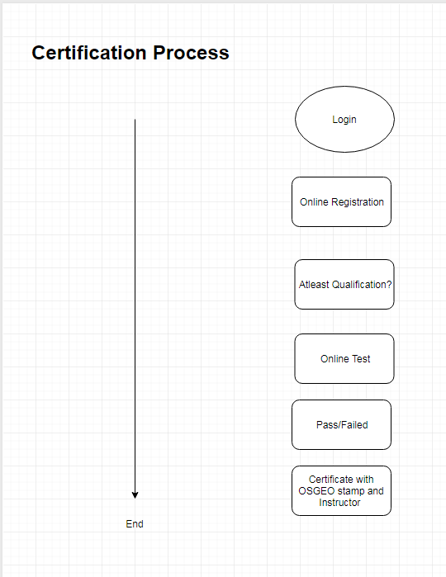
Planned Examination for Certification
Based on a Certification Body of Knowledge
Online Test and Peer Qualification Evaluation
Setup of a partner programme (like Astun, Refractions Research, Lutra Consulting, and many more, inclusing universities)
Re-certification after 3 – 5 years

Slide 22
University
Education
Educational Institution
Providing
education
Student
Student
Professional
University
Professional
University
Professional
University
Professional
Applicant
Applicant
Quality Assurance,
Endorsement
Certification
Seeking
certification
Administration & Management
Accreditation
Committee
Accreditation,
Endorsement
Certification
Bureau
ICA
Certification
Bureau
Certification
Bureau
OSGeo

Slide 23
Business Model for Certification (Ideas)
"Application fee of $ 100, an Exam fee of $ 250, and a Portfolio Review fee of $ 100.“”Maintenance fee of $95/year“ [1]
"1.000 Euros" [2]
"This cost will be € 30." [3]
"Contact us for pricing and ordering information." [4]
"Course price $39" [5]
Certification must be offered for an affordable, but sustainable fee.
[1] https://www.gisci.org/AboutUs/AboutGISCI.aspx 2021-03-16
[2] Metaspatial Institute, no current reference, but see http://metaspatial.net/en/stdm/
[3] https://blog.gvsig.org/2018/03/12/gis-applied-to-municipality-management-certification-and-links-to-the-complete-course/
[4] http://refractions.net/company/news/20111111/
[5] https://academy.vertabelo.com/course/postgis

Slide 24
Needed: Accreditation of the Certification
The whole certification approach needs an endorsing environment, i.e. one or more bodies which give accreditation or endorsement.
Possible candidates:
  OSGeo Foundation
  ICA,
  ISPRS,
  …
And we need endorsing universities.

Slide 25
Conclusions I
We did:
Analysis of existing approaches and bodies of knowledge, expert interviews, online review.
We propose currently:
Eight different, extensible certification items.
We need:
  Support / endorsement / accreditation needed from official bodies, i.e. OSGeo Foundation, ICA, ISPRS, …
  Education: can be provided by private companies and universities.
We want to do:
Examination process and online sample exams for the start with low examination fee or may be free to start

Slide 26
Conclusions II
We expect benefits:
  Contribution to better level of education
  Promotion of Open Source solutions
  Promotion of individuals
  Promotion of and benefits for all involved contributing organisations and people
May I invite you to contribute and to disseminate?

