Slide 1
Global Challenges:
Towards an Interoperability Manifesto
Franz-Josef Behr
Stuttgart University of Applied Sciences
ICA Commission on SDI and Standards
International CODATA 2017 Conference “Global Challenges and Data-Driven Science” - 11/10/2017

Slide 2
Outline
Some thoughts and observations regarding interoperability
Lessons learned from the OO Database Manifesto
Towards an Interoperability Manifest to foster international (scientific and technical) interoperability

Slide 3
Interoperability: OGC‘s Definition
„…software components operating reciprocally (working with each other) to overcome
tedious batch conversion tasks,
import/export obstacles, and
distributed resource access barriers
imposed by heterogeneous processing environments and heterogeneous data.
(McKee and Buehler, 1998 ; Sondheim, Gardels and Buehler 1999)

Slide 4
Interoperability: IEEE‘s Definition
„Ability of two or more systems or components to exchange information and to use the information that has been exchanged.”
(IEEE 1990)

Slide 5
Interoperability: ISO‘s Definition
"The capability to communicate, execute programs, or transfer data among various functional units in a manner that requires the user to have little or no knowledge of the unique characteristics of those units".
(ISO/IEC 2382-36:2008)

Slide 6
Extend Interoperability!
The ability to collaborate and to exchange information seeminglessly and without any barriers.
Often restricted to technical aspects.
But: Interoperability should be extended (as discussed these days).
Notes:
Technical Interoperabilty
Personal Interoperabilty
Semantical Interoperabilty
Institutional Interoperabilty
Political Interoperabilty

Slide 7
Interoperability: a stack of means and contributions
Technical
Interoperabilty
Standards,
scientific work
Personal
Interoperabilty
Challenges & Activities
Semantical
Interoperabilty
Institutional
Interoperabilty
Common Scientific Activities
Political
Interoperabilty
Notes:
Technical Interoperabilty
Personal Interoperabilty
Semantical Interoperabilty
Institutional Interoperabilty
Political Interoperabilty

Slide 8
Technical Interoperability: between IT systems
Technical
Interoperabilty
HTTP, XML, JavaScript, AJAX, SOAP, WMS, WFS, WCS, WPS,, GML, KML, …
Personal
Interoperabilty
Internatioal Standards
OGC, W3C, ISO & others
Semantical
Interoperabilty
Awareness,
Capacity building,
Education
Contribution
Institutional
Interoperabilty
Standards evolved in many years, often in consensus driven processes
well established
Political
Interoperabilty
Presentations,
workshops, education

Slide 9
Class A
liaison
OpenGeospatial
Consortium
(OGC)
Internet Engineering
Task Force (IETF)
ISO
OGC: Web Map Server, Web Feature Server, GML, Web Coverage Server, Style Layer Descriptor, Catalog Service
XML Protocol (XMLP),
XML Signature, I18N
TC 211
TC 204
World Wide
Web Consortium
(W3C)
Class C Liaison:
XML, I18N
JTC-1
W3C: HTTP, PNG, RDF, SOAP/XMLP (Web Services Activity), XML, Xlink, Xpath, Xpointer, XSL/XSLT, XML Schema
ISO: Ref Model, Terminology, Conformance testing, Profiles, Spatial Schema, Temporal Schema, Feature Cataloguing Methodology, Spatial Ref by Coords and Ids, Quality, Metadata, WMS, GML, LBS, Registration of Geo-information Items
Review &
approve
stds.
Provide
expertise &
candidate stds.
Facilitation Bodies
GSDI
ANZLIC
PCGIAP
FGDC
PC-IDEA
INSPIRE
GeoConnections
AdV
AGI
…
National
Standards
Organizations
We
Metadata Profile, Data Content Standards, etc.
Establish definition of and terms of engagement in SDI
Source: Doug Nebert (n.d.): Standards for Geographic Information and Services.
http://redgeomatica.rediris.es/CURSO_IDE2/documentos/2.Datos_Espaciales/FGDC_GIS_Standards.ppt
Notes:
Adopter/
Implementer Community

Slide 10
Personal Interoperability: between people
Communication skills,
personal relationships,
social networking,
cultural understanding,
foreign languages
Technical
Interoperabilty
Personal
Interoperabilty
Relationships
Semantical
Interoperabilty
Interpersonal Standards
Sharing our data
sharing through web services
student / staff / academic exchange
common research
common publications
evolving over years,
Based on trust
and on scientific ethics
Institutional
Interoperabilty
Political
Interoperabilty
Presentations,
Tea breaks,
…

Slide 11
Semantical Interoperability: between knowledge islands
Technical
Interoperabilty
Personal
Interoperabilty
Semantical
Interoperabilty
Collaboration between groups and extreme different disciplines
Personal
Interoperabilty
Vocabularies, taxonomies,
ontologies
Institutional
Interoperabilty
Collaboration between groups and disciplines
Keynotes, presentations,
workshops,
tea breaks,
sharing time
Transcending the barriers
communication
evolving over years,
based on knowledge
still part of scientific research
Political
Interoperabilty

Slide 12
Semantics
Part of the linguistics (study of language) and semiotics (study of signs)
According to Wikipedia:
  From the ancient Greek: σημαντικός sēmantikós; important),
  the study of meaning
  focuses on the relation between signifiers, like words, phrases, signs, and symbols, and what they stand for, their denotation.

Slide 13
Ontology
In philosphy: "metaphysical science or study of being” [1] study of the nature of being, becoming, existence, or reality, as well as the basic categories of being and their relations
In computer science and information science, an ontology formally represents knowledge as a hierarchy of concepts within a domain, using a shared vocabulary to denote the types, properties and interrelationships of those concepts
"The hierarchical structuring of knowledge about things by subcategorising them according to their essential (or at least relevant and/or cognitive) qualities." [2]
[1] http://www.etymonline.com/index.php?search=ontology&searchmode=none [2014-04-11]
[2] http://foldoc.org/ontology [2014-04-11]

Slide 14
Institutional Interoperability: between organisations
Technical
Interoperabilty
Institutional
Interoperabilty
Personal
Interoperabilty
Personal
Interoperabilty
Semantical
Interoperabilty
Common projects,
common publications,
Memorandum of Understand
(MoU),
Dual degree programs
Relationships
dependencies
evolving over years,
based on decision, shaped by communicated convictions
Interpersonal Standards
Political
Interoperabilty
How can we learn to extend
collaboration?
Notes:
Workshops, presentation?

Slide 15
Political Interoperability: between communities
Our responsibility?
Technical
Interoperabilty
Our impact?
Technical
Interoperabilty
Institutional
Interoperabilty
Personal
Interoperabilty
Personal
Interoperabilty
Political
Interoperabilty
Semantical
Interoperabilty
Institutional
Interoperabilty
political interests, economical interests
Long term process

Slide 16
“We all learn
if we share what we know.“
Robert R. DiBlasi

Slide 17
Lessons learned from the OO Database Manifesto
https://www.cl.cam.ac.uk/teaching/2003/DBaseThy/oo-manifesto.pdf []
Notes:
Thanks to discussions with colleagues here!
AGSE 2013: a wide range of expert knowledge, practical experiences with focus of current trends in Geoinformatics

Slide 18
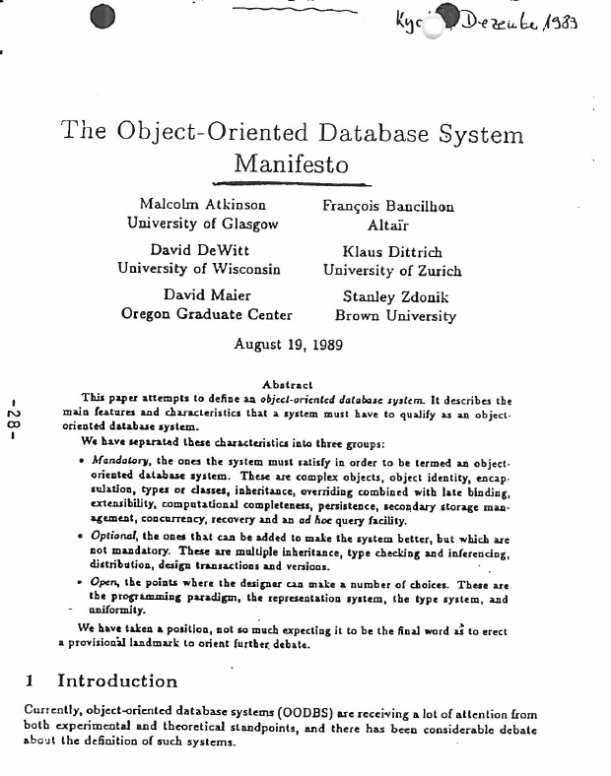
International team of authors from academia and business

Slide 19
Core set of rules in the sense of Commandments
A recognized standard paper in this field of Computer Science
Influencing further developments

Slide 20
In the Manifesto: Several levels of liability
Mandatory, "golden" rules ("commandments")
Optional recommendations
Open Criteria

Slide 21
Steps towards Interoperability Manifesto
Notes:
Thanks to discussions with colleagues here!
AGSE 2013: a wide range of expert knowledge, practical experiences with focus of current trends in Geoinformatics

Slide 22
Our Manifesto…
Can contribute to the Openess of data, science etc
can bundle our forces,
can be attractive to the scientific community worldwide (for support, for collaboration and dissemination),
can be used to influence stakeholders in the political and technical arena
can disseminate our ideas and convictions
can extend our impact as CODATA
  …

Slide 23
Some basic rules in a manifesto
Just as a start - to be discussed and extended:
  Thou shalt support open standards!
  Thou shalt provide appropriate licences!
  Thou shalt support a reasonable amount of meta data in a standardized format!
  Thou shalt not charge for public data.
  Thine data shalt be reliable and complete
  …

Slide 24
Some steps
Setting up a CODATA working group /task group, superseeding several CODATA task groups
Thorough scientific work on the different fields of interoperability
Searching für liaisons to other bodies
Development of a draft
Setting up of a website for outreach and to provide the option to sign the Interoperability Manifesto.
Further discussion and refinement

Slide 25
Essential messages
CODATA (as part of ICSU) can play an effective rule to leverage an Interoperability Manifesto.
The Interoperability Manifesto has to be developed by a consortium of scientists from different discplines.
The target must be a world-wide visibility across technical and social disciplines.
Drop me a mail if you plan to support:
franz-josef.behr@hft-stuttgart.de

Slide 26
Further reading
G7 SCIENCE MINISTERS’ COMMUNIQUÉ, Turin, 27 – 28 September , www.g7italy.it/sites/default/files/documents/G7%20Science%20Communiqu%C3%A9.pdf

