Slide 1
Some Observations on Common Patterns in
Information Technology
Prof. Dr. Franz-Josef Behr, Stuttgart University of Applied Sciences
Comilla University, Bangladesh, 2021
franz-josef.behr@hft-stuttgart.de

Slide 2
Outline
Introduction
Features and collections of them, and their identity
Encoding
  Markup Languages, Structuring vocabularies by namespaces
  Key value pairs
  Separating information chunks
Standards
Openness
Networking and Service Orientation
Conclusions

Slide 3
Mobile Apps
Geodatabases, Big Data
Spatial Data Infrastructures
Data Harmonization
Service oriented Architectures
Web Mapping
OGC WebServices
Architectures
Reports & Presentations
3D, 4D, …
AI, IoT
Field data collection
Surveying
Photogrammetry
Remote sensing

Slide 4
Complexity

Slide 5
Reduction of
Complexity

Slide 6
Recognition of
Pattern

Slide 7
Features and
their collections

Slide 8
Features
Entity
Real world
real world: consisting of entities / phenomena (latin: ens: a being)
feature = an abstraction of real world phenomena (ISO 19101)
geographic feature: associated with a location relative to the Earth.
The state of a feature is defined by a set of properties, where each property may be thought of as a {name, type, value} triple.
Technical viewpoint,
abstraction,
generalization
feature
Model
Identity
attributes
properties
geometry
relationships
styling properties
meta properties
behaviour

Slide 9
feature
feature
feature
feature
feature
Feature Collection
feature
feature
feature
feature
feature
feature
feature
feature
feature

Slide 10
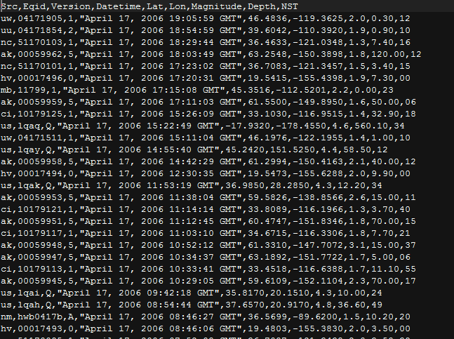
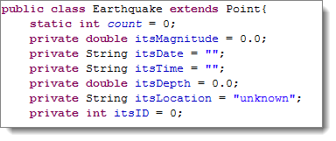

Single features and collections: in Java

Slide 11
Single features and collections: in GML
[ISO 19136]
FeatureCollection: a collection of GML Features, having own properties and an optional list of Spatial Reference System Definitions. [1]
GML feature collections are themselves valid GML features. [2]
<complexType name="AbstractFeatureCollectionType" abstract="true">
<complexContent>
<extension base="gml:AbstractFeatureType">
<sequence>
<element ref="gml:featureMember" minOccurs="0" maxOccurs="unbounded"/>
<element ref="gml:featureMembers" minOccurs="0"/>
</sequence>
</extension>
</complexContent>
</complexType>>
<element name="AbstractFeatureCollection"
type="gml:AbstractFeatureCollectionType" abstract="true"
substitutionGroup="gml:AbstractFeature" />
[1] http://www.w3.org/Mobile/posdep/GMLIntroduction.html
[2] OpenGIS Geography Markup Language (GML) Encoding Standard, v 3.2.1, http://portal.opengeospatial.org/files/?artifact_id=20509

Slide 12
Identity

Slide 13
Identity of features
Entity
Real world
Technical viewpoint,
abstraction,
generalization
Each feature must be identifiable.
Need of identification systems – perhaps many
Identification also needed in networking/IoT (discussed later)
feature
Model
Identity
attributes
properties
geometry
relationships
styling properties
meta properties
behaviour

Slide 14
Identity of features
<gml:featureMember>
<AX_Flurstueck gml:id="DEBWL0010001UiIg">
<gml:identifier codeSpace="http://www.adv-online.de/">urn:adv:oid:DEBWL0010001UiIg</gml:identifier>
<zeigtAufExternes>
<AA_Fachdatenverbindung>
<art>urn:bw:fdv:1000</art>
<fachdatenobjekt>
<AA_Fachdatenobjekt><name>0680199400016V</name></AA_Fachdatenobjekt>
…
<position>
<gml:Surface srsName="urn:adv:crs:DE_DHDN_3GK3_BW100" gml:id="Y33">
…
<gml:Curve gml:id="Y34">
<gml:segments>
<gml:LineStringSegment>
<gml:posList>515748.750 5454798.050 515758.590 5454780.310</gml:posList>
</gml:LineStringSegment>
</gml:segments>
…
</gml:polygonPatches>
</gml:Surface>
</position>
<gemarkung>
<AX_Gemarkung_Schluessel>
<land>08</land>
<gemarkungsnummer>680</gemarkungsnummer>
</AX_Gemarkung_Schluessel>
…
<flurstueckskennzeichen>08068000300592____00</flurstueckskennzeichen>
<amtlicheFlaeche uom="urn:adv:uom:m2">290.00</amtlicheFlaeche>cou
Parcel identifier
Notes:
If the codeSpace attribute is present, then its value should identify a dictionary, thesaurus or authority for the term, such as the organisation who assigned the value, or the dictionary from which it is taken.

Slide 15

Identification of a trade item (GTIN)
The GS1 identification system provides the world a globally unique and unambiguous identification system for physical entities, parties, and relationships exchanged in the supply chain.
Each trade item that is different from another in design and/or content is allocated a unique identification number, which remains the same as long as it is traded. […] Such numbers must be treated in their entirety throughout the supply chain.
Global, open is an identification number used in unrestricted distribution which signifies that such system data may be applied on goods to be processed anywhere in the world without restraint as to such things as country, company, and industry.
https://gs1go2.azureedge.net/cdn/ff/anGYyA0tjGnAKfVZnVnt_sUznX6Wlkm_mUPNFBELYy0/1635150541/public/2021-07/gs1_general_specifications.pdf
Notes:
Globale, offene Identifikationsnummern können in einem uneingeschränkten Warenfluss verwendet werden, d. h. dass sie, auf Waren aufgebracht, überall auf der Welt ohne Einschränkungen bezüglich Land, Unternehmen und Industriesektoren verarbeitet werden können.
Das GS1 System stellt ein global einzigartiges und eindeutiges Identifikations- und Kennzeichnungssystem für physische Einheiten, Unternehmen und Dienstleistungsbeziehungen in der Versorgungskette zur Verfügung.
https://shop.gs1.ch/img/A~17490/20/Gen%20Specs.pdf?xet=1585125546986
The same identification number is given to all trade items sharing key characteristics.

Slide 16
Encoding Data

Slide 17
"In communications and information processing, code is a system of rules to convert information—such as a letter, word, sound, image, or gesture—into another form or representation, sometimes shortened or secret, for communication through a channel or storage in a medium.“
"The process of encoding converts information from a source into symbols for communication or storage. Decoding is the reverse process, converting code symbols back into a form that the recipient understands."
https://en.wikipedia.org/wiki/Code

Slide 18
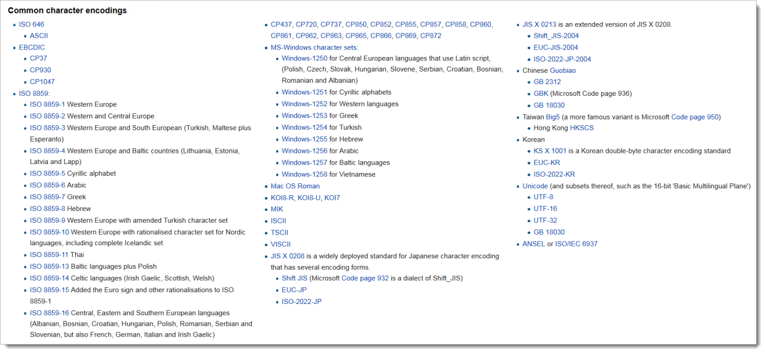
Character sets
UTF-8 has been the dominant character encoding for the World Wide Web since 2009, and as of December 2021 accounts for 97.6% of all Web pages. [2], [3]
[1] https://en.wikipedia.org/wiki/Character_encoding
[2] https://en.wikipedia.org/wiki/UTF-8
[3] https://w3techs.com/technologies/history_overview/character_encoding
[4] https://werner-zenk.de/tipps/schriftzeichen_richtig_darstellen.php

Slide 19
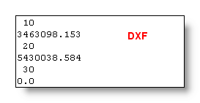
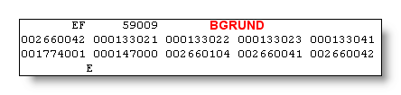
Principle of MarkUp
eXtensible
Markup Language
Definition of structural elements for data
Strict syntax
Element name
Attribute name
Attribute value
<person city="Karlsruhe">Franz-Josef Behr</person>
Encoding Data
Encoding Data
Start tag with attribute
Element content
End-Tag

Slide 20
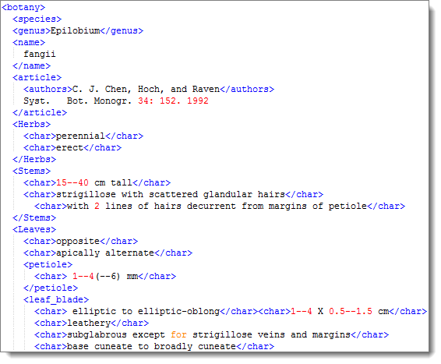
Markup Languages: XML
https://www.w3.org/standards/xml/ca
You can have your own Markup Language
It‘s understandable for human beings and for computer programs
After: http://wwbota.free.fr/Samples/parsing.htm
Encoding Data

Slide 21
Ambiguity of names in different XML Dialects
<geo:Point>
<geo:lat>48.947534</geo:lat>
<geo:long>8.482132</geo:long>
</geo:Point>
<georss:where>
<gml:Point>
<gml:pos>48.947534 8.482132</gml:pos>
</gml:Point>
</georss:where>
W3C Geo
GeoRSS (GML)
<georss:point>48.947534 8.482132</georss:point>
GeoRSS (simple)
<?xml version='1.0' encoding='UTF-8'?>
<kml>
<Placemark>
<name>48° 56' 51.120623'' N, 8° 28' 55.675049' E</name>
<description></description>
<Point>
<coordinates>8.482132, 48.947534, 0</coordinates>
</Point>
</Placemark>
</kml>
KML

Slide 22
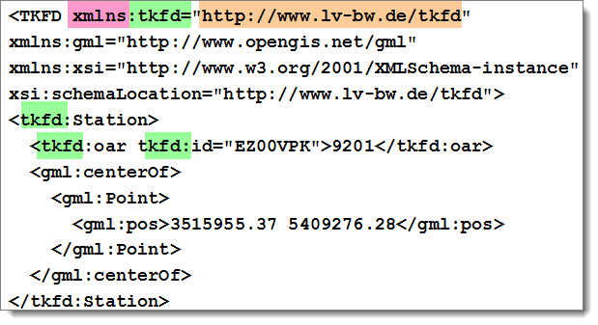
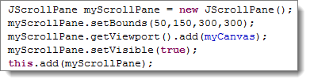
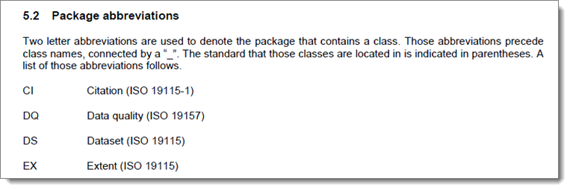
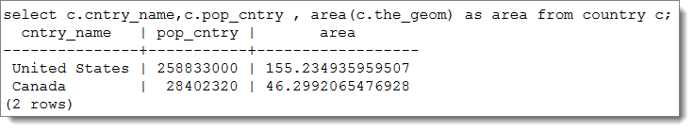
Solution: Structuring vocabularies by namespaces
In XML
In programming languages (here: Java)
In Database technology: context for database names
Source: ISO 19101, ISO 19115

Slide 23
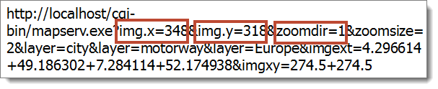
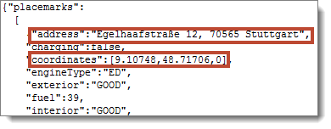
Key value pairs (KVP)
In URLs to identify resources
https://www.car2go.com/api/v2.1/vehicles?loc=stuttgart&oauth_consumer_key=car2gowebsite&format=json&callback=jQuery17108792290978299311_1369324710467&_=1369324710759
in JSON

Slide 24

Separating information chunks
In URLs to identify resources:
http://www.gis-news.de/cgi-bin/mapserv.exe?img.x=348&img.y=318&zoomdir=1&zoomsize=2&layer=city&layer=motorway&layer=Europe&imgext=4.296614+49.186302+7.284114+52.174938&imgxy=274.5+274.5
In GML encodings:
?

Slide 25
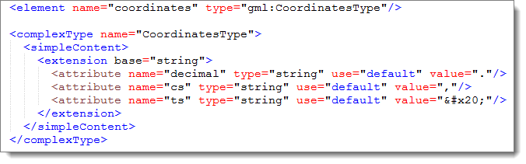
All details have to be defined!
Decimal separator (.)
coordinate separator (,)
tuple separator (space)

Slide 26
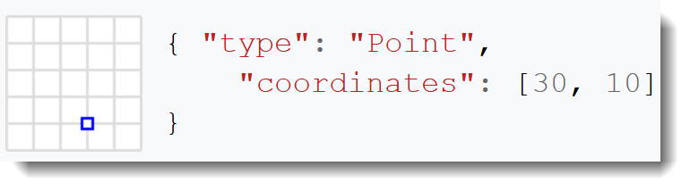
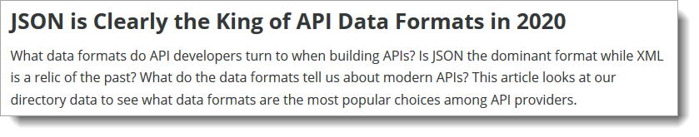
JavaScript Object Notation (JSON)
Für den nahtlosen Datentransport in die IT- Welt hat sich JSON (Java Script Object Notation) als sehr schlankes und über alle Systemgrenzen hinweg nutzbares Austauschformat etabliert.
https://factorynet.at/a/json-wie-sich-daten-nahtlos-transportieren-lassen
https://www.programmableweb.com/api-research

Slide 27
Source
Open
Data
Standards

Slide 28
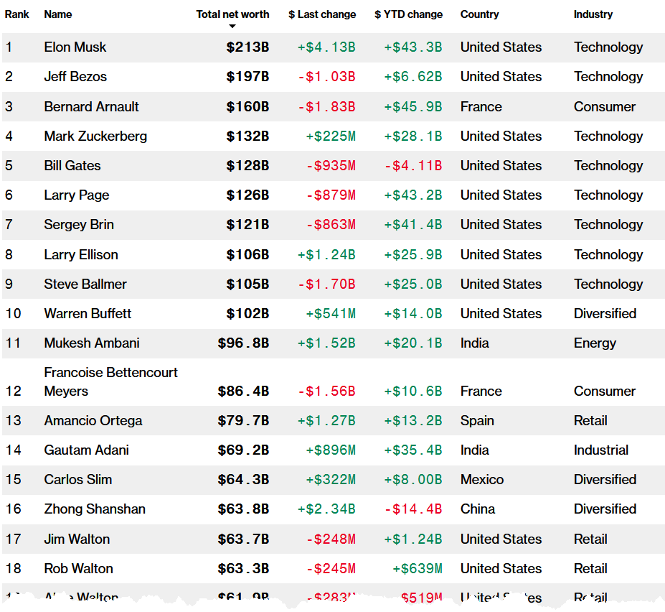
https://www.bloomberg.com/billionaires/ [2018-09-29]
Notes:
Perhaps also widely known are the lists of billionaires published by Bloomberg and Forbes. Well, I guess, most of you will know names like Jeff Bezos, Bill Gates, Warren Buffet and so on.
If we have a closer look we can recognize a predominance of richness in one country.
As well we recognize that a lot of riches are adjunct to technology, especially Information technology.
Some of these people respectively companies earn their income partially related to geospatial data processing (like DBMS, Web mapping, Routing).
Bezos is the founder and largest shareholder of Amazon, the world's biggest online retailer.
Ballmer is the former CEO of Microsoft, the world’s biggest software maker.
Especially close to Geospatial IT is number 496 of the billionaires…

Slide 29
Many/all of us use Open Source products:
Wordpress
Apache HTTP-Server: ~50% Market Share
Eclipse
Apple IOS
Linux
Gimp
Firefox
OpenOffice
LibreOffice
LaTeX
Notepad++
Android

Slide 30
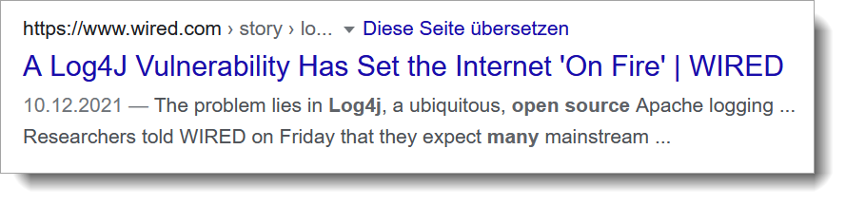
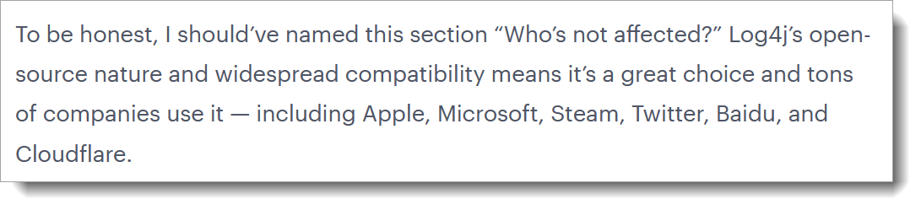
The Log4J case
https://thenextweb.com/news/log4j-bug-internet-open-source-contributors-analysis [2021-12-25]

Slide 31
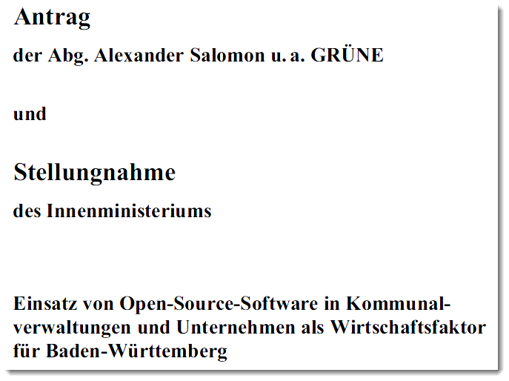
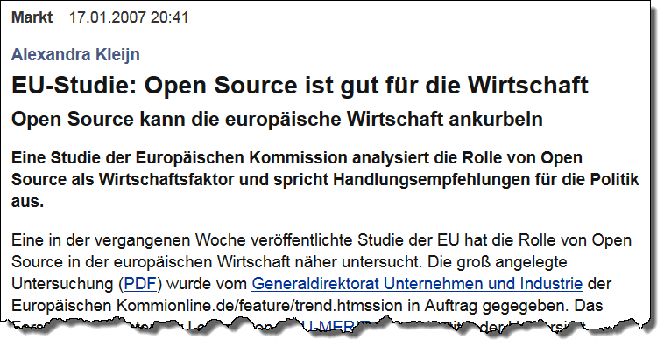
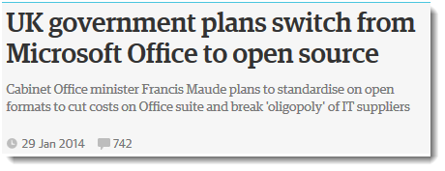
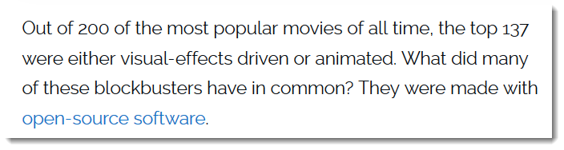
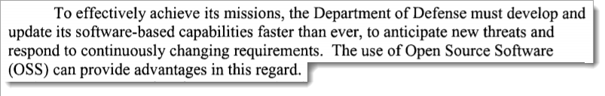
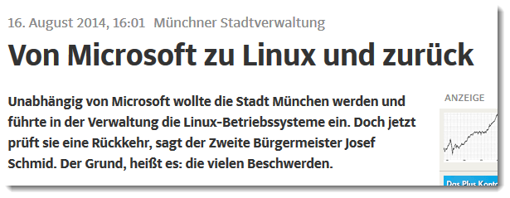

https://www.zdnet.com/article/hollywood-goes-open-source/
Source: a.o. http://www.heise.de/open/artikel/EU-Studie-Open-Source-ist-gut-fuer-die-Wirtschaft-222037.html
US Department of Defence (2009: Clarifying Guidance Regarding Open Source Software (OSS). https://dodcio.defense.gov/Portals/0/Documents/OSSFAQ/2009OSS.pdf [2018-10-09]

Slide 32

http://www.telegraph.co.uk/news/2017/10/23/stephen-hawkings-phd-crashes-university-cambridge-website-made/ [2017-11-01]

Slide 33

Open Data requires… [1]
Data must be in XML (or JSON nowadays )
Each discipline must create or re-use XML vocabularies
Domain metadata is provided through community ontologies
XML/JSON-aware software
Repositories
Metadata and Discovery services
Quality and validation
Source: http://www-pmr.ch.cam.ac.uk/wiki/Peter_Murray-Rust [2017-10-05]
Peter Murray-Rust, Open access and open data activist, University of Cambridge
[1] Peter Murray-Rust (n.d.): Data-driven science - a scientist's view. http://www.ibrarian.net/-navon/paper/-Data_driven_science___a_scientist_s_view.pdf?paperid=9300672 [2017-10-05]

Slide 34
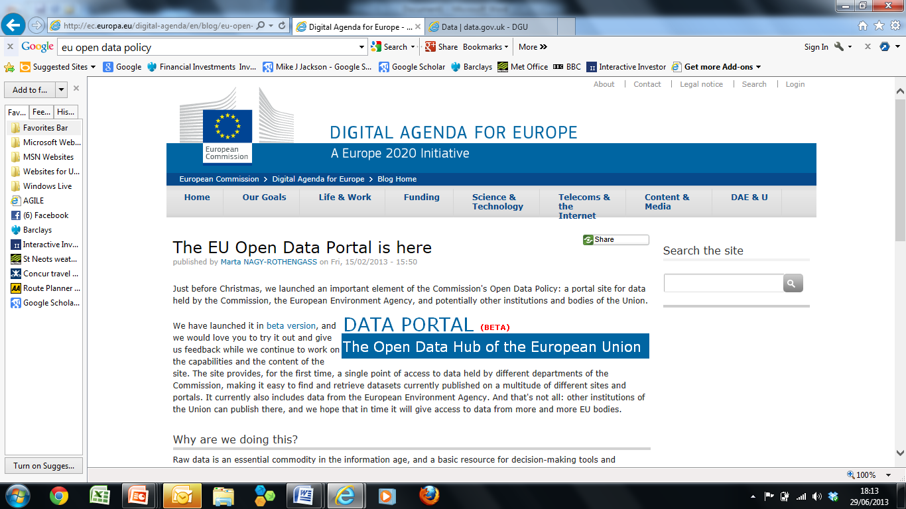
EU Digital Agenda and Open Data
Source: http://ec.europa.eu/digital-agenda/en/blog/eu-open-data-portal-here [2014-06-21]

Slide 35
Openess
Source
Data must be complete.
Data must be primary.
Data must be timely.
Data must be accessible.
Data must be machine-processable.
Access must be non-discriminatory.
Data formats must be non-proprietary.
Data must be under an open license or license free.
Data must have permanence and be findable over time.
Usage costs must be affordable (de minimis).
Open
Data
Standards

Slide 36
FAIR data principles (I)
To be Findable:
F1. (meta)data are assigned a globally unique and eternally persistent identifier.
F2. data are described with rich metadata.
F3. (meta)data are registered or indexed in a searchable resource.
F4. metadata specify the data identifier.
To be Accessible:
A1 (meta)data are retrievable by their identifier using a standardized communications protocol.
A1.1 the protocol is open, free, and universally implementable.
A1.2 the protocol allows for an authentication and authorization procedure, where necessary.
A2 metadata are accessible, even when the data are no longer available.
https://www.force11.org/group/fairgroup/fairprinciples [2017-10-03]

Slide 37
FAIR data principles (II)
To be Interoperable:
I1. (meta)data use a formal, accessible, shared, and broadly applicable language for knowledge representation.
I2. (meta)data use vocabularies that follow FAIR principles.
I3. (meta)data include qualified references to other (meta)data.
To be Re-usable:
R1. meta(data) have a plurality of accurate and relevant attributes.
R1.1. (meta)data are released with a clear and accessible data usage license.
R1.2. (meta)data are associated with their provenance.
R1.3. (meta)data meet domain-relevant community standards.
https://www.force11.org/group/fairgroup/fairprinciples [2017-10-03]

Slide 38
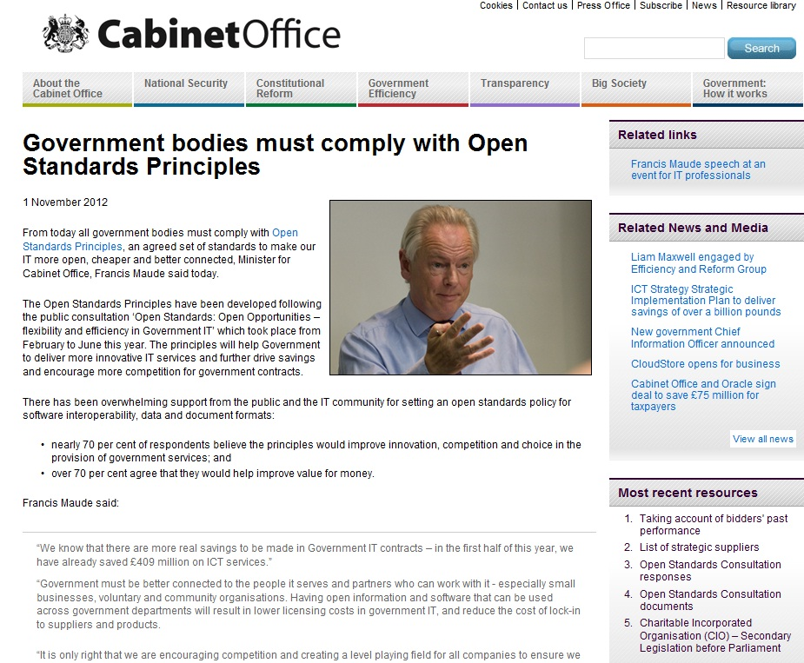
Open agenda is now implemented by the UK Government and delivering huge cost savings for government
£409 million in the first half of this year
Read on: https://www.gov.uk/government/news/government-bodies-must-comply-with-open-standards-principles

Slide 39
Standards
Notes:
to enable
Interoperability

Slide 40
Organisations and their dependencies
ISPRS
ICA
…
Class A
liaison
OpenGIS
Consortium
(OGC)
Internet Engineering
Task Force (IETF)
ISO
OGC: Web Map Server, Web Feature Server, GML, Web Coverage Server, Style Layer Descriptor, Catalog Service, OpenAPI
XML Protocol (XMLP),
XML Signature, I18N
TC 211
TC 204
World Wide
Web Consortium
(W3C)
Class C Liaison:
XML, I18N
JTC-1
W3C: HTTP, PNG, RDF, SOAP, XML, Xlink, Xpath, Xpointer, XSL/XSLT, XML Schema
ISO: Ref Model, Terminology, Conformance testing, Profiles, Spatial Schema, Temporal Schema, Feature Cataloguing Methodology, Spatial Ref by Coords and Ids, Quality, Metadata, WMS, GML, LBS, Registration of Geo-information Items
Review &
approve
stds.
Provide
expertise &
candidate stds.
Facilitation Bodies
GSDI
ANZLIC
PCGIAP
FGDC
PC-IDEA
INSPIRE
GeoConnections
CODI/UNECA
AGI
ASPRS, AdV
…
National
Standards
Organizations
DIN
BSTI
BSI
…
Adopter/
Implementer Community
Metadata Profile, Data Content Standards, etc.
Establish definition of and terms of engagement in SDI
Modified after: Douglas Nebert. http://www.fgdc.gov/library/presentations/documents/2003-presentations/GIS_Standards_Rockies1003.ppt [2013-05-31]

Slide 41
Collaboration
Notes:
to enable
Interoperability

Slide 42
Organisations and their dependencies
ISPRS
ICA
…
Class A
liaison
OpenGIS
Consortium
(OGC)
Internet Engineering
Task Force (IETF)
ISO
OGC: Web Map Server, Web Feature Server, GML, Web Coverage Server, Style Layer Descriptor, Catalog Service, OpenAPI
XML Protocol (XMLP),
XML Signature, I18N
TC 211
TC 204
World Wide
Web Consortium
(W3C)
Class C Liaison:
XML, I18N
JTC-1
W3C: HTTP, PNG, RDF, SOAP, XML, Xlink, Xpath, Xpointer, XSL/XSLT, XML Schema
ISO: Ref Model, Terminology, Conformance testing, Profiles, Spatial Schema, Temporal Schema, Feature Cataloguing Methodology, Spatial Ref by Coords and Ids, Quality, Metadata, WMS, GML, LBS, Registration of Geo-information Items
Review &
approve
stds.
Provide
expertise &
candidate stds.
Facilitation Bodies
GSDI
ANZLIC
PCGIAP
FGDC
PC-IDEA
INSPIRE
GeoConnections
CODI/UNECA
AGI
ASPRS, AdV
…
National
Standards
Organizations
DIN
BSTI
…
Adopter/
Implementer Community
Metadata Profile, Data Content Standards, etc.
Establish definition of and terms of engagement in SDI
Modified after: Douglas Nebert. http://www.fgdc.gov/library/presentations/documents/2003-presentations/GIS_Standards_Rockies1003.ppt [2013-05-31]

Slide 43
Liaisons
Liaisons A: Organizations that make an effective contribution to the work of the technical committee or subcommittee for questions dealt with by this technical committee or subcommittee.
Liaisons B: Organizations that have indicated a wish to be kept informed of the work of the technical committee or subcommittee.
Liaisons C: Organizations that make a technical contribution to and participate actively in the work of a working group (for ISO/IEC JTC1 only).
Liaisons D: Organizations that make a technical contribution to and participate actively in the work of a working group.
Source: https://www.iso.org/organization/297457.html [2017-10-16]

Slide 44
Sharing
Interoperability

Slide 45
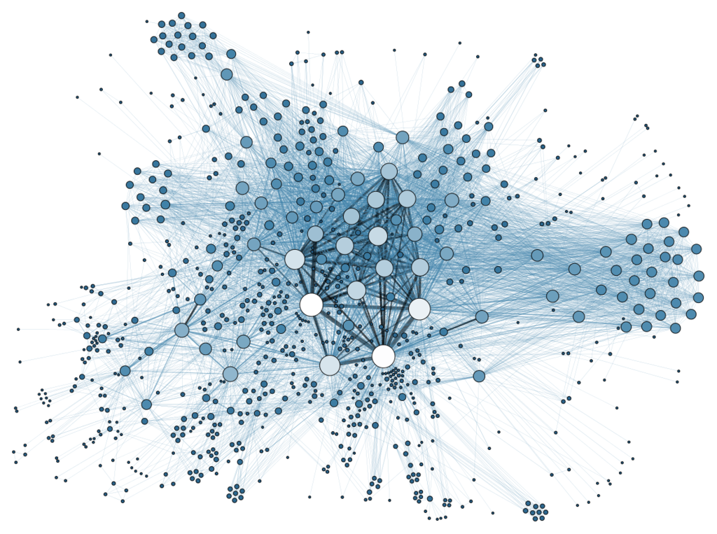
Networking and Service Orientation
Desktop Systems, i.e. GIS
= High Complexity = Empowering a Few
Web Services:
Simplicity = Empowering Millions
Source: http://commons.wikimedia.org/wiki/File:Social_Network_Analysis_Visualization.png

Slide 46

Networking
Uniform Resource Identifier (URI). URIs can be:
  Locations / adresses: Uniform Resource Locator (URL) , [RFC2396]
  Names: Uniform Resource Name (URN) [RFC 1737, RFC 2141, RFC 3061]
  IP-Adresses (IPv4, IPv6)
https://www.w3.org/Provider/Style/URI
<gml:Point srsname=“urn:adv:crs:ETRS89_UTM32“>
<gml:coordinates>369949.671 5615301.383</gml:coordinates>
</gml:Point>
Protocol:["//"] [user [":"password] "@"] host [":"port] ["/"url-path]

Slide 47
Client Server Architecture
DNS Server
IP address
IP address / Server Name / Host name
Client
"User Agent"
Web Server
Document root
Static
resources
HTTP-Client
HTTP-Client
HTTP-Client
HTTP
HTTP
xx
Internet
80
Communication Tier
Communication Tier,
Web Tier
Presentation Tier
PNG, JPG, …
XML / SVG
Presentation Tier
CGI protocol
Application
Server
Server side programs
Dynamic Generation of resources
Application Tier
Local GIS
Application Tier,
Business Logic Tier
SQL
Data preparation, analysis
DBMS
Server
Data Tier
Data Tier

Slide 48
Architecture: The protocols
DNS Server
IP address
URI
RFC 1630
IP address / Server Name / Host name
Client
"User Agent"
Content-Type
RFC 2045
HTTP
RFC 2616
Webserver
Document root
Static
resources
HTTP-Client
HTTP-Client
HTTP-Client
HTTP
HTTP
80
Internet
80
Communication Tier,
Web Tier
PNG, JPG, …
XML / SVG
XML
w3.org/XML/
CGI
RFC 3875
CGI protocol
Presentation Tier
Application
Server
Server side programs
Dynamic Generation of resources
Local GIS
Application Tier,
Business Logic Tier
SQL
ISO/IEC 9075
SQL
Data preparation, analysis
DBMS
Server
Data Tier

Slide 49



Publish-Find-Bind-Pattern
View Services, Download Services, …
Web
Service Offer
OGC GetCapabilities,
WSDL
„bind“ = "consuming" the service
publish
OGC Web Catalogue Service,
UDDI, Discovery Service
Service Registry
Catalogue
Client
Service Comsumer, OpenLayers
Search & Find = "discover"

Slide 50
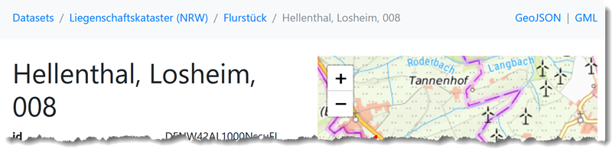
Open API (emerging standard)
Underlying standards/concepts
    HTTP: GET, POST, PUT, DELETE, PATCH
    REST
    OpenAPI Specification; https://spec.openapis.org/oas/latest.html
  Swagger: Open-Source tools to design, create, document and use
https://www.ldproxy.nrw.de/kataster/collections/flurstueck/items/DENW42AL1000NscuFL

Slide 51
Summary

Slide 52
Summary / Outlook
Several observable patterns in ICT were shown.
Try ALWAYS to figure out the design pattern in information technology
applicable for YOUR field of work.
Take care of standards.
Be open regarding data, services, collaboration – be interoperable.

