Slide 1

Concept and implementation of an architecture for the immediate provision of geodata in disaster management
Franz-Josef Behr & Steven Fleischhauer
AGSE 2018, NUST, Windhoek, Namibia
Content is licensed under Creative Commons-License CC BY-NC-SA

Slide 2
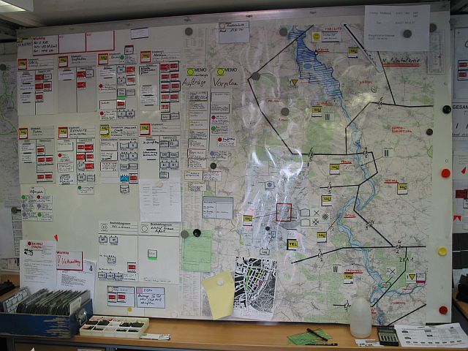
Source: Prägitzer (2006)

Slide 3
Outline
Motivation & relevance
Some existing solutions
Our approach: It's architectiure and data sources
Results & summary

Slide 4
A first definition
Disaster: a serious disruption of the functioning of society, which poses a significant, widespread threat to human life, health, property, infrastructure or the environment, whether arising from accident, nature or human activity, whether developing suddenly or as the result of long-term processes, but excluding armed conflict. [IdRL 2011]
Rapid response is needed, comprising geospatial information.
[1] http://emergency.copernicus.eu/mapping/ems/service-overview
[2] http://www.statcan.gc.ca/pub/92-195-x/2011001/other-autre/map-carte/def-eng.htm
International Federation of Red Cross and Red Crescent Societies (2011): IDRL Guidelines Guidelines for the domestic facilitation and regulation of international disaster relief and initial recovery assistance

Slide 5
Motivation
http://www.prevention-web.net/files/44281_19802014paketworldusde4zu3.pdf, [08.12.2016]: S. 3
A gradual but clear upward trend […] likely to continue into the future (World Bank/ United Nations, 2010)
Notes:
A gradual but clear upward trend can be observed, which is likely to continue into the future due to the impacts of climate change and population growth in areas exposed to natural hazards (World Bank/ United Nations, 2010).

Slide 6
Relevance
Disaster management
Information needs for planning and decision making
Geodata

Slide 7
„The Management […] of disasters require static geodata (for certain areas) as well dynamic geodata (i.e. flooded areas).“
(Municipal Coordination Board 2013)
Kommunales Koordinierungsgremium (Municipal Coordination Board) GDI-DE, 2013: Einsatz von Geoinformationen in den Kommunen. Ergebnisse der Umfrage Good Practice Beispiele Handlungsempfehlungen Deutscher Städtetag; Deutscher Landkreistag; Deutscher Städte- und Gemeindebund. Berlin. Online verfügbar unter http://www.geoportal.de/SharedDocs/Downloads/DE/GDI-DE/KoKoStudie_Einsatz_Geoinfo_Kommun-nen.pdf?__blob=publicationFile.

Slide 8
Topographic data
In vector format
„The Management […] of disasters require static geodata (for certain areas) as well dynamic geodata (i.e. flooded areas).“
(Municipal Coordination Board 2013).
Up-to-date remotely sensed data
Koordinierungsgremium 2013] Kommunales Koordinierungsgremium GDI-DE, 2013: Einsatz von Geoinformatio-nen in den Kommunen. Ergebnisse der Umfrage Good Practice Beispiele Handlungsempfehlungen Deutscher Städtetag; Deutscher Landkreistag; Deutscher Städte- und Gemeindebund. Berlin. Online verfügbar unter http://www.geoportal.de/SharedDocs/Downloads/DE/GDI-DE/KoKoStudie_Einsatz_Geoinfo_Kommun-nen.pdf?__blob=publicationFile.

Slide 9
Topographic data
Terrain height, toponyms (names and unique identifiers of standard geographic areas),
major cultural and physical features, i.e. roads, railroads, coastlines, rivers and lakes
Buildings
By
  mapping agencies or
  Crowd based geographical information(VGI)

Slide 10
Satellite Imagery
Regional or global coverage, with certain repetition rate
Platforms
  Satellite-borne,
  airborne sensors (UAV, balloons)
To deal with natural or man-made disasters, i.e.
  Floods, Earthquakes & tsunamis, Landslides, Severe Storms, Volcanic eruptions
  Forest fires
  Drought and Humanitarian crises
  Technological disasters

Slide 11
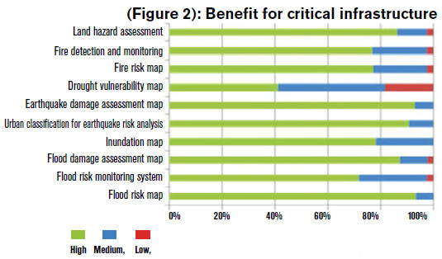
The benefits of Geospatial Information
Economical Benefits
Strategic benefits
  pre-disaster planning
  Mitigation phase: economical losses and reconstruction
For critical infrastructures
For healthcare
For security
Altan et al. 2013: The Value of Geoinformation for Disaster and Risk Management (VALID)
Robert Backhaus (2013): Value of geoinformation for disaster and risk management. http://geospatialworld.net

Slide 12
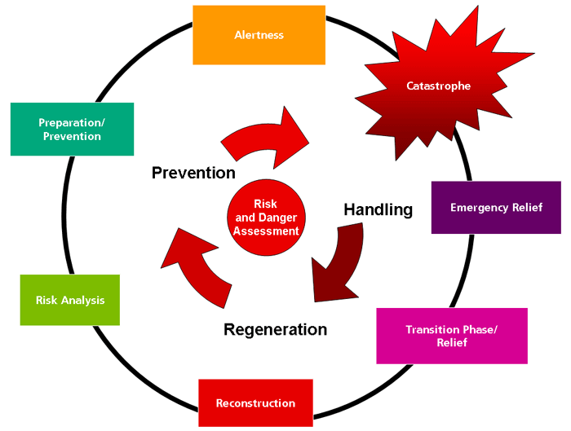
Source: https://www.zki.dlr.de/image/937

Slide 13
Some definitions regarding disaster mapping I
Rapid Mapping: “consists of the [… ] provision (within hours or days) of geospatial information in support of emergency management activities immediately following an emergency event. The products are standardized.”
Reference Maps: shows the boundaries, names and unique identifiers of standard geographic areas, as well as major cultural and physical features, such as roads, railroads, coastlines, rivers and lakes, i.e. topography
Delineation Maps: extents of the area affected by the disaster
Grading Maps: assessment of the damage grade and its spatial distribution after the disaster
[1] http://emergency.copernicus.eu/mapping/ems/service-overview
[2] http://www.statcan.gc.ca/pub/92-195-x/2011001/other-autre/map-carte/def-eng.htm
International Federation of Red Cross and Red Crescent Societies (2011): IDRL Guidelines Guidelines for the domestic facilitation and regulation of international disaster relief and initial recovery assistance

Slide 14
Some definitions regarding disaster mapping II
Emergency Mapping: creation of
  maps,
  geo-information products and
  spatial analyses
dedicated to providing situational awareness emergency management and immediate crisis information for response by means of extraction of reference (pre-event) and crisis (post-event) geographic information/data.
Emergency Mapping Guidelines drafted by the International Working Group on Satellite Emergency Mapping (IWG-SEM), cited after: http://www.ithacaweb.org/projects/rapid-mapping/

Slide 15
Some players
Copernicus Emergency Management Service (EMS) Mapping (started February 2015)
http://emergency.copernicus.eu/
International Charter 'Space and Major Disasters'
https://www.disasterscharter.org/
Humanitarian OpenStreetMap Team (HOT) – VGI (!), updating the OpenStreetMap database.
https://www.hotosm.org/
United Nations Platform for Space-based Information for Disaster Management and Emergency Response (UN SPIDER)
…

Slide 16
International Charter 'Space and Major Disasters'
a consortium of space agencies and satellite data providers, founded 1999, aiming at providing a unified system of rapid space data acquisition and delivery in case of natural or man-made disasters.
Each member agency of the Charter has committed resources to support some specified authorised users such as relief organisations as well as civil protection and defence organisations with free of charge satellite data in order to help mitigating the effects of disasters on human life and property.
The Charter data […] will be analysed by associated Value Adders, like the ZKI.
The results are provided to the Authorized Users, requesting authorities and also to the public.
16 partners, providing data of approx. 30 satellite missions
Notes:
Some of the missions within the Charter are: SPOT 6/7, Pléiades, Landsat-7/8, RADARSAT 2, ALOS-2, RISAT-1, KOMPSAT-2/3 or the DMC-constellation. DLR cooperates with the Charter by providing management resources and satellite images acquired by TerraSAR-X/TanDEM-X. Additionally, DLR provides satellite images from the RapidEye mission.
The tasks of DLR ZKI are grouped into two categories:
1) The provision of the technical contribution (operations) to the Charter. This task comprises the satellite tasking and data delivery of TerraSAR-X and TanDEM-X data and the ordering and delivery of RapidEye data, the Project Management for selected Charter activations and the Emergency On-Call Officer duties. This task is supported by the Federal Ministry of Economics and Technology.
2) Value adding based on Charter data. The analysis of the data is outside the scope of the Charter. These activities are realized through other mechanisms (e.g. COPERNICUS) or organizations closely linked to the Charter. If DLR/ZKI is performing the value adding, all products are provided through the ZKI website.
Additional information about the “International Charter Space and Major Disasters” can be found on the Charter homepage.

Slide 17
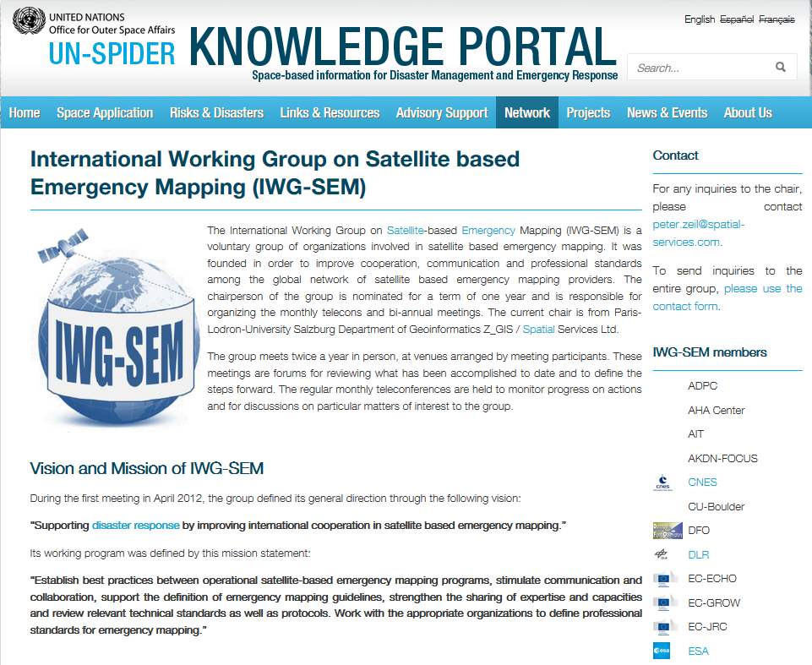
UN-SPIDER

Slide 18
Our approach: „disasterGIS"
Open Source Software Tools
Script driven
disasterGIS
Open Data
Windows as OS
Delivers rapidly geodata products to support disaster management

Slide 19
Architecture
Data Import Tier
Data Tier
Application Tier
Web Tier
Persistence Layer

Slide 20
Data Import Tier
Data Tier
Application Tier
Web Tier
OSM Update Sets
Topographic data by Initial OpenStreetMap (OSM) Import
Remotely sensed Imagery: USGS EarthExplorer resp. Sentinels Scientific data Hub
Persistence Layer

Slide 21
Data Import Tier
Data Tier
Application Tier
Web Tier
OSM Update Sets
Map Coverage Planner
Initial OSM Import
Remotely sensed Imagery: USGS EarthExplorer resp. Sentinels Scientific data Hub
Persistence Layer

Slide 22
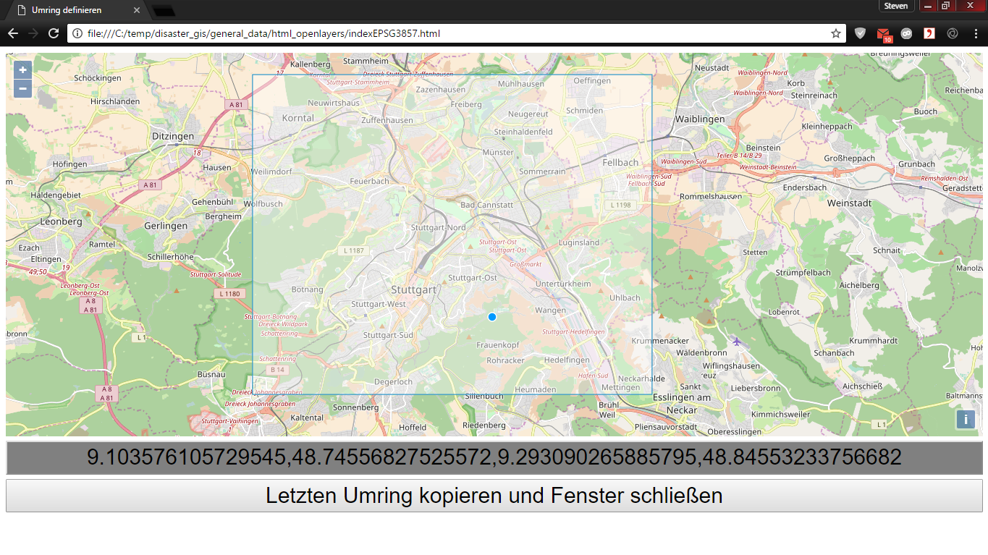
Data Import Tier
Data Tier
Application Tier
Web Tier
OSM Update Sets
Map Coverage Planner
Initial OSM Import
Remotely sensed Imagery: USGS EarthExplorer resp. Sentinels Scientific data Hub
Persistence Layer

Slide 23
Update OSM
osm2pgsql
OSM Database
OSM Server
region
extract
Map Coverage Planner
wget
PostGIS
XAPI
Initial OSM Import
Dateisystem
Remotely sensed Imagery
Data Import Tier
Data Tier

Slide 24
Our aproach – „disasterGIS“
Update OSM
Osmosis
OSM Database
OpenStreetMap
osm2pgsql
Map Coverage Planner
regional
extract
PostGIS
wget
XAPI
Dateisystem
USGS EarthExplorer
SNAP pconvert
GDAL gdalwarp
Remote Sensing
Data Import Tier
Data Tier

Slide 25
Our aproach – „disasterGIS“
Update OSM
OpenStreetMap
osm2pgsql
OSM-Data Base
regional
extract
wget
Map Coverage Planner
Erstimport OSM
XAPI
PostGIS
USGS EarthExplorer
SNAP pconvert
GDAL gdalwarp
File System
Remote Sensed Imagery
Data Import Tier
Data Tier

Slide 26
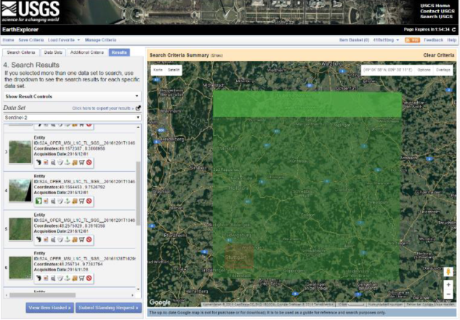
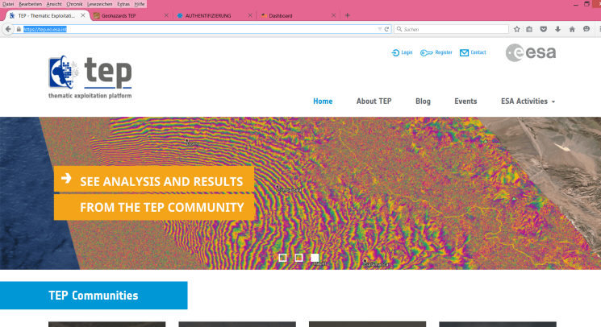
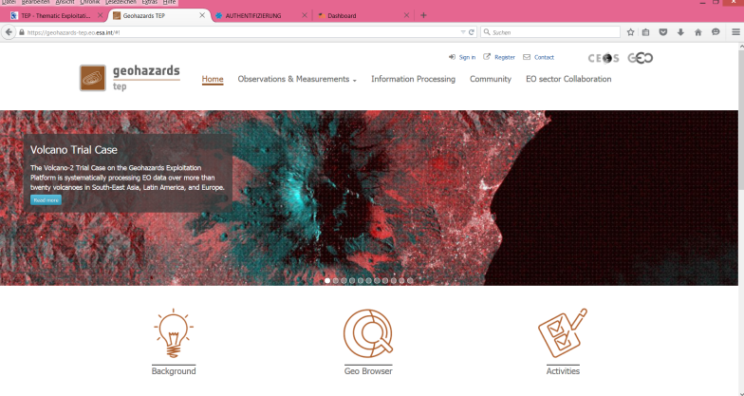
Open Data Sources for Remotely Sensed Imagery
USGS EarthExplorer,
https://earthexplorer.usgs.gov/
ESA's Thematic Expolitation Platform, https://tep.eo.esa.int/
see Salvatore Pinto's talk, FOSS4G 2017

Slide 27
Our aproach – „disasterGIS“
Update OSM
OpenStreetMap
osm2pgsql
OSM-Data Base
regional
extract
wget
Map Coverage Planner
Erstimport OSM
XAPI
PostGIS
USGS EarthExplorer
SNAP pconvert
GDAL gdalwarp
File System
Remote Sensed Imagery
Data Import Tier
Data Tier

Slide 28
Data provision
Osmosis
osm2pgsql
OSM Database
Python
OpenStreetMap
regional
extract
Internet
Map Coverage Planner
PostgreSQL + PostGIS
Image
wget
XAPI
Mapnik
File System
HTTP
Server
Tiles
Tiles
USGS EarthExplorer
Tiles
SNAP pconvert
GDAL gdalwarp
Style File
modTile
Data Import Tier
Data Tier
Application Tier
Web Tier

Slide 29
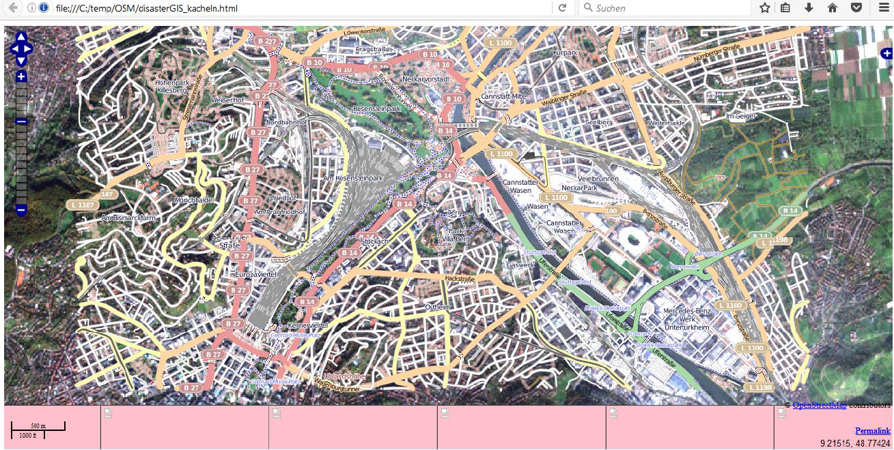
Output – Example of Stuttgart

Slide 30
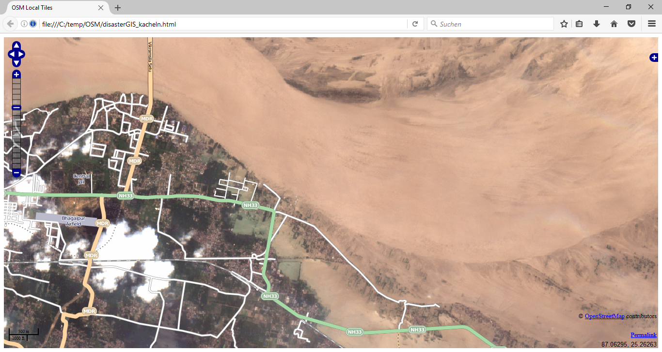
Flood event,
India

Slide 31
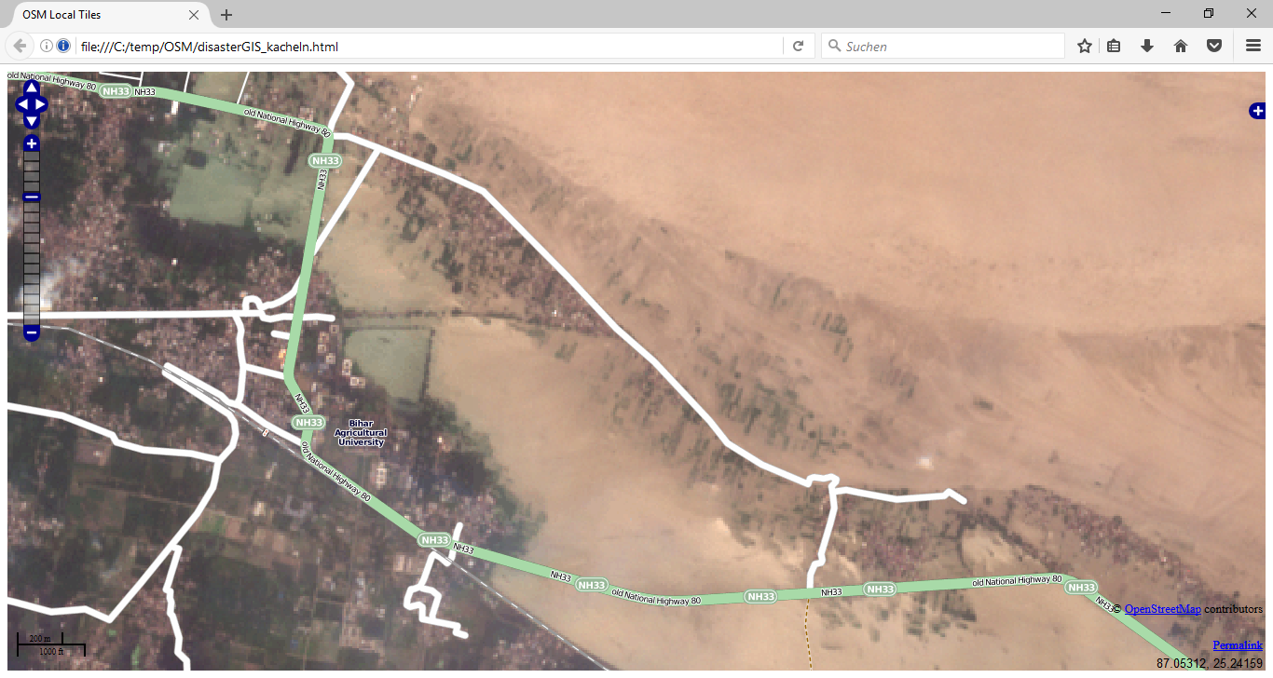
Flood event,
after zoom in

Slide 32
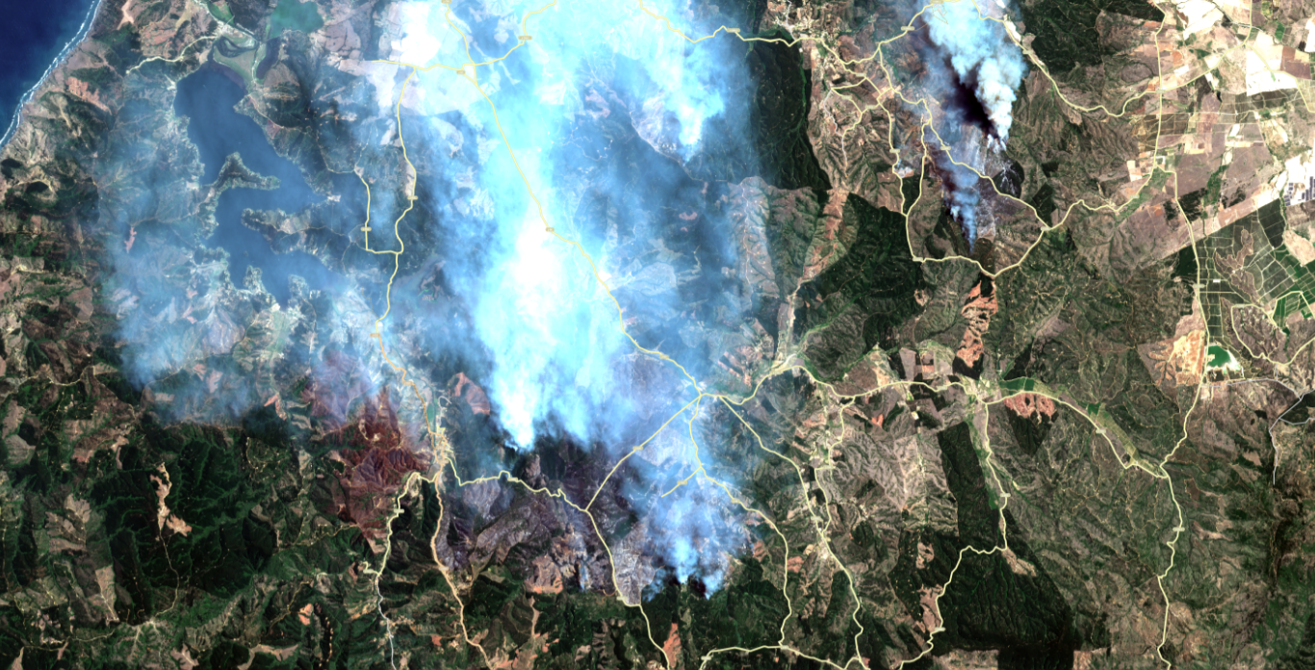
Forest Fires, Chile,
Spring 2017

Slide 33
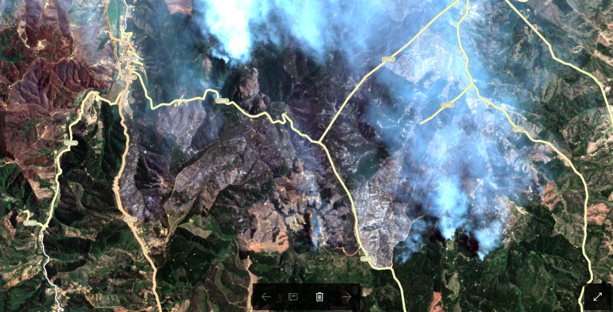
Forest Fires, Peru, after zoom in

Slide 34
Summary
Open Source, open data
Quite complex architecture, but yet easy to deploy/to install, also for developing countries, small public agencies and NGOs
  “Domestic actors have the primary role” [1]– the approach enables local actors to collect and provide geospatial information
Automated, rapid workflow:
  7 minutes
  +
  download time for vector and raster data (depending on area extent and network connectivity)
Reference Map created – including vector data as well as remotely sensed imagery
However:
  limited spatial resolution and accuracy (approx. 10m)
  Satellite imagery can be cloud-covered
  Should be ported to Linux
[1] International Federation of Red Cross and Red Crescent Societies (2011): IDRL Guidelines Guidelines for the domestic facilitation and regulation of international disaster relief and initial recovery assistance

