Slide 1


Supporting OGC APIs: An Updated and Contemporary Approach to Geodata Provision in Disaster Mapping
Franz-Josef Behr, Lazuardy Fajar Pratama Sulaeman, Winhard
Tampubolon, Steven Fleischmann
ICCGIS 2024
Own Content is licensed under Creative Commons-License CC BY-NC-SA

Slide 2
Outline
Introduction: Motivation & relevance
Some players (and the hurdles imposed)
Data Sources
Our implementations
  disasterGIS I: It's architecture and components
  disasterGIS II: It's architecture and data sources
Results & summary

Slide 3
Introduction

Slide 4
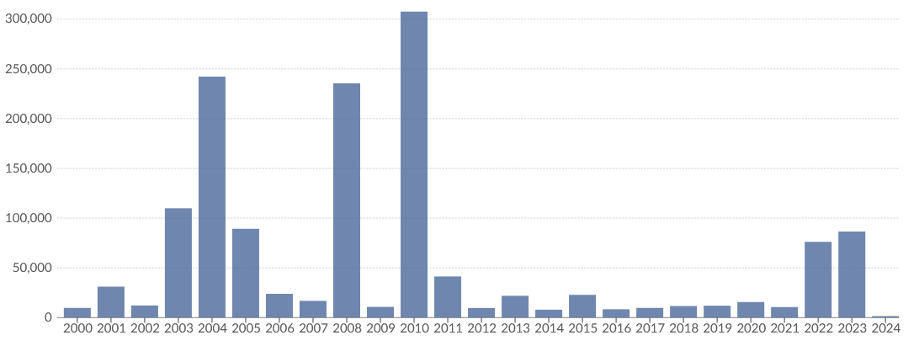

Number of deaths from disasters
A gradual but clear upward trend […] likely to continue into the future (World Bank/ United Nations, 2010) ?
https://ourworldindata.org/natural-disasters
based on EM-DAT[2024-06-17]
see also: https://ourworldindata.org/disaster-database-limitations

Slide 5
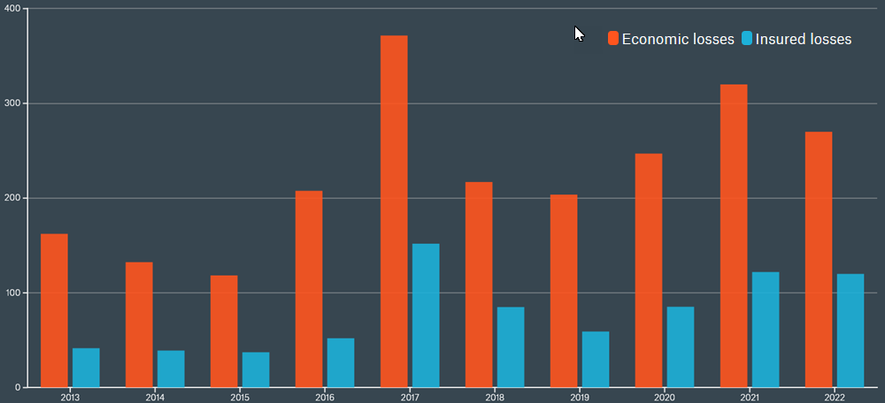
Global losses from natural disasters 2013-2022
(US$ bn, inflation-adjusted, Source: MunichRe
https://www.munichre.com/de/risiken/naturkatastrophen.html)

Slide 6
„The Management […] of disasters require static geodata (for certain areas) as well dynamic geodata (i.e. flooded areas).“
(Municipal Coordination Board,Germany, 2013)
Kommunales Koordinierungsgremium (Municipal Coordination Board) GDI-DE, 2013: Einsatz von Geoinformationen in den Kommunen. Ergebnisse der Umfrage Good Practice Beispiele Handlungsempfehlungen Deutscher Städtetag; Deutscher Landkreistag; Deutscher Städte- und Gemeindebund. Berlin. Online verfügbar unter http://www.geoportal.de/SharedDocs/Downloads/DE/GDI-DE/KoKoStudie_Einsatz_Geoinfo_Kommun-nen.pdf?__blob=publicationFile.
Notes:
These numbers show the importance of efficient disaster management. One fundamental element in the disaster management process is the basis of information and in particular geospatial information, as the Spatial Data Infrastructure Germany (GDI-DE) committee, an initiative of public authorities in Germany, states (Ostrau et al., 2013): „The Management […] of disasters require static geodata (for certain areas) as well dynamic geodata (i.e. flooded areas).“

Slide 7
Topographic data
(in vector format)
„The Management […] of disasters require static geodata (for certain areas) as well dynamic geodata (i.e. flooded areas).“
(Municipal Coordination Board, Germany 2013)
Up-to-date remotely sensed imagery (pre- and post-event)
Kommunales Koordinierungsgremium (Municipal Coordination Board) GDI-DE, 2013: Einsatz von Geoinformationen in den Kommunen. Ergebnisse der Umfrage Good Practice Beispiele Handlungsempfehlungen Deutscher Städtetag; Deutscher Landkreistag; Deutscher Städte- und Gemeindebund. Berlin. Online verfügbar unter http://www.geoportal.de/SharedDocs/Downloads/DE/GDI-DE/KoKoStudie_Einsatz_Geoinfo_Kommun-nen.pdf?__blob=publicationFile.
Notes:
These numbers show the importance of efficient disaster management. One fundamental element in the disaster management process is the basis of information and in particular geospatial information, as the Spatial Data Infrastructure Germany (GDI-DE) committee, an initiative of public authorities in Germany, states (Ostrau et al., 2013): „The Management […] of disasters require static geodata (for certain areas) as well dynamic geodata (i.e. flooded areas).“

Slide 8
Comprise
  Terrain height, toponyms (names and unique identifiers of standard geographic areas),
  major cultural and physical infrastructure, i.e. roads, railroads, coastlines, rivers and lakes
  buildings
Are provided by
  mapping agencies (traditional approach) or
  crowd based geographical information (VGI) [Goodchild 2007]
Not available everywhere
Topographic data
(in vector format)
„The Management […] of disasters require static geodata (for certain areas) as well dynamic geodata (i.e. flooded areas).“
(Municipal Coordination Board, Germany 2013)
Up-to-date remotely sensed imagery (pre- and post-event)
Platforms
  Satellite-borne,
  airborne sensors (airplanes, UAVs, balloons)
Local, regional or global coverage, with certain repetition rate, swath and resolution
Automatic data processing and analysis techniques, including AI-based approaches

Slide 9
What means „rapid“?
Rapid Mapping: “consists of the [… ] provision (within hours or days) of geospatial information in support of emergency management activities immediately following an emergency event. The products are standardized.”
International Federation of Red Cross and Red Crescent Societies (2011): IDRL Guidelines for the domestic facilitation and regulation of international disaster relief and initial recovery assistance
Emergency Mapping Guidelines drafted by the International Working Group on Satellite Emergency Mapping (IWG-SEM) 2014, https://un-spider.org/sites/default/files/IWG_SEM_EmergencyMappingGuidelines_A4_v1_March2014.pdf [2020-10-12] cited after: http://www.ithacaweb.org/projects/rapid-mapping/
Notes:
Reference Maps: shows the boundaries, names and unique identifiers of standard geographic areas, as well as major cultural and physical features, such as roads, railroads, coastlines, rivers and lakes, i.e. topography
Delineation Maps: extents of the area affected by the disaster
Grading Maps: assessment of the damage grade and its spatial distribution after the disaster (in-situ or based on remote sensing data)

Slide 10
Un-FAIR

Slide 11
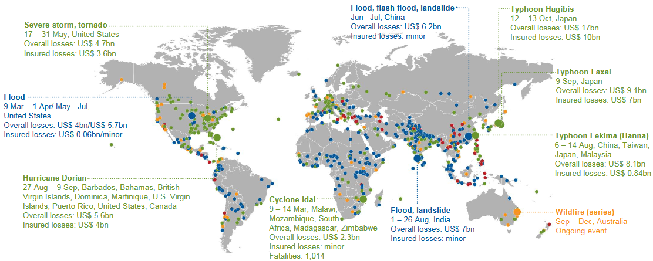
2019:Tropical cyclones, extreme storms and floods caused overall losses of US$ 150bn
Source: https://www.munichre.com/content/dam/munichre/global/content-pieces/documents/media-relations/2019-nat-cat-world-map.pdf/_jcr_content/renditions/original./2019-nat-cat-world-map.pdf [2020-10-12]
Notes:
At least in 2015 80% affected the continent of Asia, a substantially higher figure than the long-term average of approximately 70% (https://www.munichre.com/topics-online/en/climate-change-and-natural-disasters/resilience/year-in-figures.html)

Slide 12
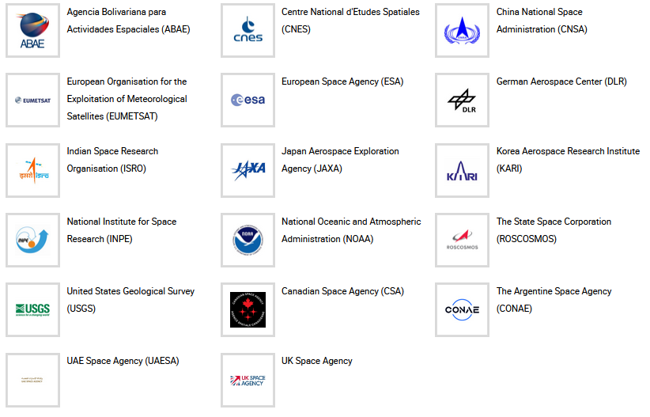
International Charter 'Space and Major Disasters'
a consortium of space agencies and satellite data providers, founded 1999, aiming at providing a unified system of rapid space data acquisition and delivery in case of natural or man-made disasters.
Each member agency of the Charter has committed resources to support some specified authorised users such as relief organisations as well as civil protection and defence organisations with free of charge satellite data in order to help mitigating the effects of disasters on human life and property.
The Charter data […] will be analysed by associated Value Adders, like the ZKI (with some links to CPOERNICUS).
The results are provided to the Authorized Users, requesting authorities and also to the public.
17 partners, providing data of approx. 30 satellite missions
https://disasterscharter.org/web/guest/text-of-the-charter
887 activations (until June 2024),
see https://cgt.disasterscharter.org/en/887/1015
Notes:
Some of the missions within the Charter are: SPOT 6/7, Pléiades, Landsat-7/8, RADARSAT 2, ALOS-2, RISAT-1, KOMPSAT-2/3 or the DMC-constellation. DLR cooperates with the Charter by providing management resources and satellite images acquired by TerraSAR-X/TanDEM-X. Additionally, DLR provides satellite images from the RapidEye mission.
The tasks of DLR ZKI are grouped into two categories:
1) The provision of the technical contribution (operations) to the Charter. This task comprises the satellite tasking and data delivery of TerraSAR-X and TanDEM-X data and the ordering and delivery of RapidEye data, the Project Management for selected Charter activations and the Emergency On-Call Officer duties. This task is supported by the Federal Ministry of Economics and Technology.
2) Value adding based on Charter data. The analysis of the data is outside the scope of the Charter. These activities are realized through other mechanisms (e.g. COPERNICUS) or organizations closely linked to the Charter. If DLR/ZKI is performing the value adding, all products are provided through the ZKI website.
Additional information about the “International Charter Space and Major Disasters” can be found on the Charter homepage.

Slide 13
Design criteria for our rapid mapping system
All countries, institutions, agencies etc should have FAIR access to the geodata.
Software solutions should be based on open source.
Ease of installation and handling
      “Domestic actors have the primary role” [1] – the solution enables local actors to collect and provide geospatial information
    Really rapid response is needed, comprising geospatial information, to combat climate change and its impacts (SDG 13).
[1] International Federation of Red Cross and Red Crescent Societies (2011): IDRL Guidelines Guidelines for the domestic facilitation and regulation of international disaster relief and initial recovery assistance

Slide 14
Data sources
Topographical data (vector data)
Remote Sensing Data

Slide 15
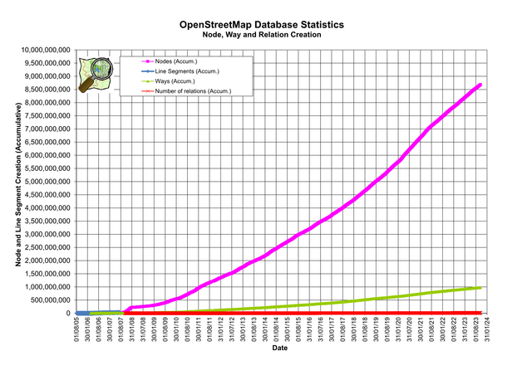

Open Data Sources for Geographical Base Data
OpenStreetMap & Humanitarian OpenStreetMap Team (HOT)
  Geodatabase: Topographic basedata,
  worldwide, increasing coverage
  Mapping tools (open source)
  Processing tools (open source)
  According to Rupert Allan, former country manager of HOT Uganda, this organisation is “now the biggest contributor to the United Nations Office for the Coordination of Humanitarian Affairs […] for Uganda, and has become the go-to resource for geospatial analysis and intervention in the country“ (Politzer 2021).
Digital Elevation Models: SRTM (NASA), ASTER
Increasing amount of Open Data from national mapping agencies
…
https://wiki.openstreetmap.org/wiki/Stats [2024-06-18]

Slide 16
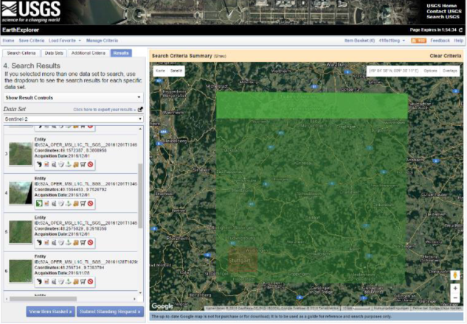
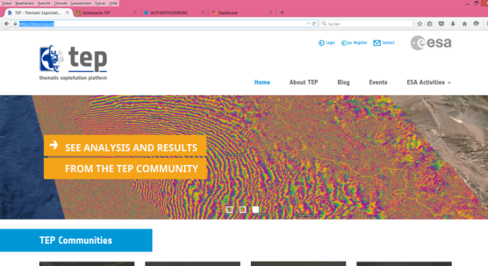
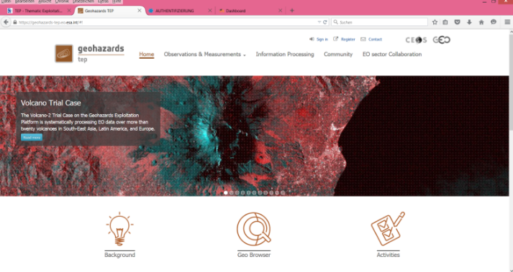
Open Data Sources for Remotely Sensed Imagery
USGS EarthExplorer,
https://earthexplorer.usgs.gov/
Copernicus Emergency Management Service (EMS) Mapping (started February 2015)
https://emergency.copernicus.eu/
Google Earth Engine (GEE)
https://earthengine.google.com/

Slide 17
disasterGIS I
Tiers
Example

Slide 18
Four Tier Architecture
Initial OSM Import
Data provision
Osmosis
osm2pgsql
Python
OpenStreetMap
Internet
regional
extract
Map Coverage Planner
OSM Update Sets
PostgreSQL / PostGIS
Image
wget
Overpass
Mapnik
File System
HTTP
Server
Tiles
Tiles
Remotely sensed Imagery:
USGS EarthExplorer resp. Sentinels Scientific data Hub
Tiles
USGS EarthExplorer
SNAP pconvert
GDAL gdalwarp
Style File
modTile
Data Import Tier
Data Tier
Application Tier
Web Tier
Notes:
Vector and raster data are now available in the platform’s data tier. Mapnik (http://mapnik.org/), a well-known render tool for various OSM maps which can be seen in the application tier, is used to generate a map image resp. map tiles using the Python bindings.
https://wiki.openstreetmap.org/wiki/Mod_tile

Slide 19
disasterGIS II
Tiers
Example

Slide 20
Aspects
Implementation and interoperability based on based on acknowledged Web standards
  Hypertext Transfer protocol (HTTP) with its operations („verbs“) like GET, DELETE, POST etc.
    HTTP status codes
  REST-based approach (Representational State Transfer): (Re)Presentation of resources, i.e. geodata in the case of disaster as map or in a specific data format
  OpenAPI (since approx. 2016): Clear depiction of the interface of webservices („end points“) with (semi-)automatic generation of software stubs for client and server side plus documentation
  OGC‘s OpenAPI specifications (starting in 2017, now mature and ongoing)
Single Page Application: everything happens in one webpage
Looking out for promising technologies: NodeJS- allowing to use JavaScript on server- und client-side

Slide 21

Architecture
Client
Server
OverPass Server
HTTP
HTTP
Presentation Tier
HTTP Server
OverPass
API
HTML, PNG, JPG, …
JSON
HTTP-Client
HTTP-Client
NodeJS
Web Browser
Internet
OSM
Database
Internet
Web Tier
Desktop GIS
Application
Services
GeoServer
ldProxy
Google Earth Engine (GEE)
Desktop GIS
App Tier
SQL
GEE
API
Data collection, preparation, analysis
DBMS
Server
Instance
PostGreSQL
Databases
Data Tier
Notes:
Google Earth Engine (GEE), a cloud-based platform, combines a multipetabyte catalogue of satellite imagery and geospatial datasets with planetary-scale analysis capabilities needed to detect changes, map trends, and quantify differences
on the Earth’s surface. GEE is open access and allows users to conduct analyses that would otherwise require enormous resources to access, download, store, and analyse

Slide 22
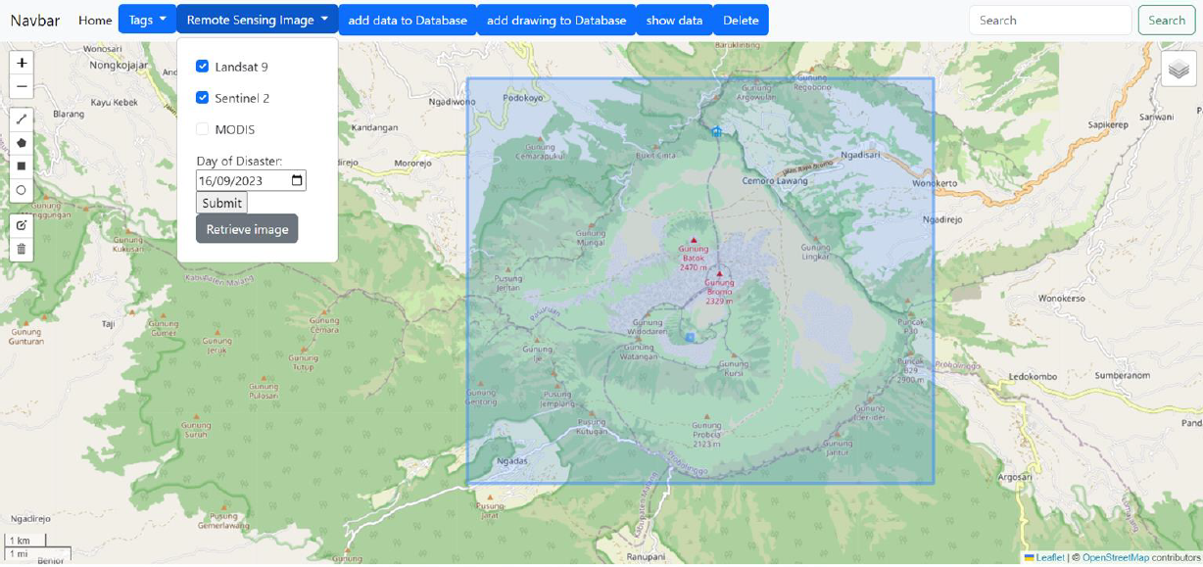
User interface: browser-based

Slide 23
Comparision ldproxy vs. GeoServer

Slide 24
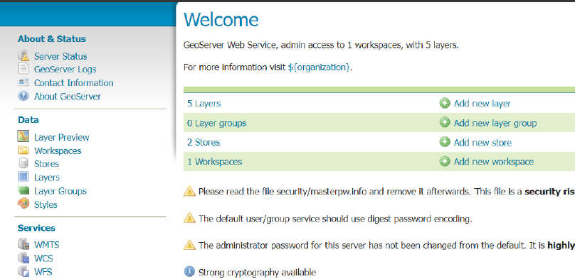
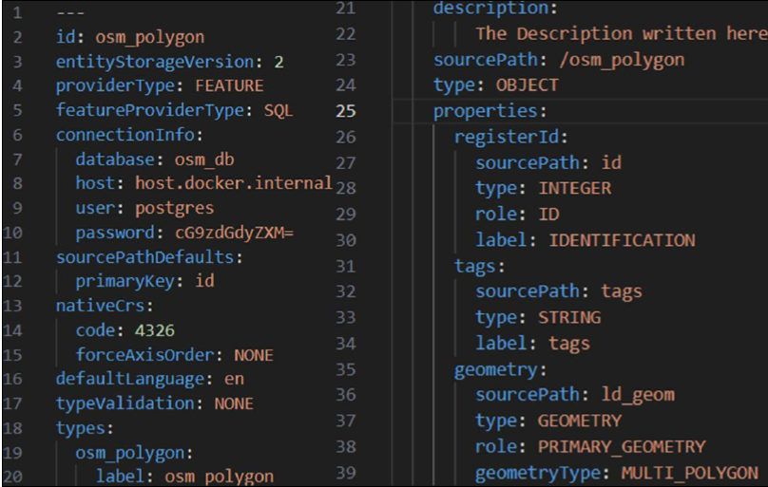
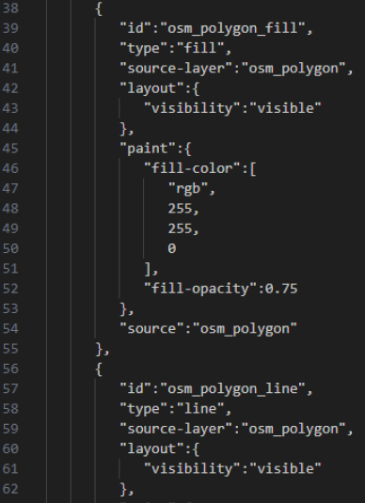
Administration
GeoServer: powerful, browser-based complex user interface
ldproxy: some configuration files (YAML),
styling based on MapBox format

Slide 25
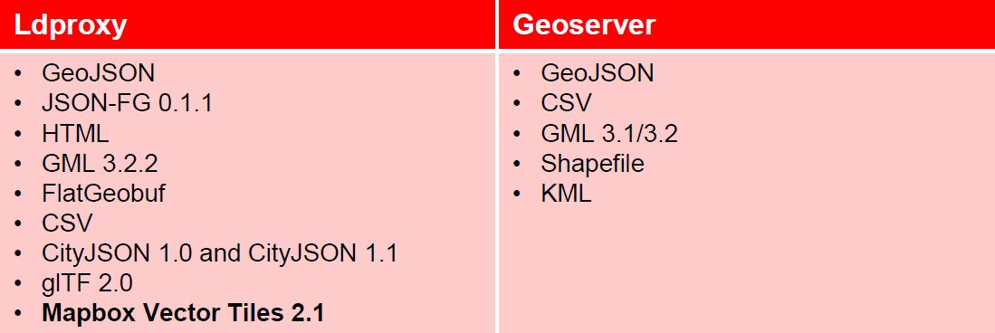
Output formats
Ldproxy supports formats used in modern APIs, e.g. GeoJSON, Mapbox Vector Tiles, Mapbox Styles or TileJSON
GeoServer focused on traditional encodings.
https://github.com/interactive-instruments/ldproxy/blob/master/README.md
https://geoserver.org/

Slide 26
Performance
Ldproxy outperformed Geoserver in almost all parameters except network server latency where the latency of ldproxy is 10 and 25 times higher [Sulaeman 2024].
 | GeoServer |  | ldproxy
Zoom Level | 13 | 15 | 13 | 15
SI (s) | 5.8 | 7.0 | 3.5 | 2.1
TBT (s) | 3.3 | 3.2 | 2.0 | 0.1
TI (s) | 8.5 | 8.4 | 4.3 | 1.9
FID (s) | 2.6 | 2.5 | 0.4 | 0.08
NSL (s) | 0.06 | 0.06 | 0.6 | 1.5
TBW (KiB) | 5597.2 | 5597.2 | 1777.9 | 402.5
Speed Index (SI), Total Blocking Time (TBT), Time To Interactive (TI), Max Potential First Input Delay (FID), Network Server Latency (NSL), and Total Byte Weight (TBW).

Slide 27
Summary/Limitations/Outlook

Slide 28
DisasterGIS I – Open Source
  Completely written for Windows OS (using Windows Batch Script and Python language)
  Open Data
  Relies on the open source ecosystem (of OSGeo foundation): OSMOSIS, PostGIS, …
  Quite complex architecture, but yet easy to deploy/to install, also for „developing“ countries, small public agencies and NGOs
DisasterGIS II – Open Source, GitHub
  Operating System independent
  OpenAPI based, using ldproxy, an OGC reference implementation
  support of various data formats
  completely open source
  (almost) only open Data
  Remote Sensing Imagery: Pre- and Post-Disaster
  Interface completely browser based – user can navigate and interact in an environment he is used to

Slide 29
Automated, rapid workflow to create a reference (online) map:
  7 minutes
  plus
  download time for vector and raster data (depending on area extent and network connectivity)
  including vector data as well as remotely sensed imagery
However:
  limited spatial resolution and accuracy (approx. 10m) for remote sensing imagery
  Limited repetion rate
  Satellite imagery can be cloud-covered
Further development should be done
  user interface,
  creation of a true map layout (for printing)
  integration of additional data sources
  creation of a user community
  dissemination of the solution.

Slide 30
Thank you!
Contact
Prof. Dr. Franz-Josef Behr, Stuttgart University of Applied Sciences
franz-josef.behr@hft-stuttgart.de

