Slide 1

OGC: An overview
Prof. Dr. Franz-Josef Behr
Own content is licensed under a Creative Commons-Lizenz CC BY-NC-SA.

Slide 2
Class A
liaison
OpenGeospatial
Consortium
(OGC)
Internet Engineering
Task Force (IETF)
ISO
OGC: Web Map Server, Web Feature Server, GML, Web Coverage Server, Style Layer Descriptor, Catalog Service
XML Protocol (XMLP),
XML Signature, I18N
TC 211
TC 204
World Wide
Web Consortium
(W3C)
Class C Liaison:
XML, I18N
JTC-1
W3C: HTTP, PNG, RDF, SOAP/XMLP (Web Services Activity), XML, Xlink, Xpath, Xpointer, XSL/XSLT, XML Schema
ISO: Ref Model, Terminology, Conformance testing, Profiles, Spatial Schema, Temporal Schema, Feature Cataloguing Methodology, Spatial Ref by Coords and Ids, Quality, Metadata, WMS, GML, LBS, Registration of Geo-information Items
Review &
approve
stds.
Provide
expertise &
candidate stds.
Facilitation Bodies
GSDI
ANZLIC
PCGIAP
FGDC
PC-IDEA
INSPIRE
GeoConnections
AdV
AGI
…
National
Standards
Organizations
We
Metadata Profile, Data Content Standards, etc.
Establish definition of and terms of engagement in *SDI
Source: Dough Nebert
Notes:
Adopter/
Implementer Community

Slide 3
Founded 1994 (from Open GRASS Foundation)
> 525 member organisationen
2011: "Number of European members exceeded number of North American members for the first time."
100 innovation initiatives
48 Open Standards
230 OGC certified products
Thousands of implementations
https://www.ogc.org/2020infographic
https://www.opengeospatial.org/ogc/historylong [2020-11-13]

Slide 4
Founded 1994 (from Open GRASS Foundation)
> 525 member organisationen
2011: "Number of European members exceeded number of North American members for the first time."
100 innovation initiatives
48 Open Standards
230 OGC certified products
Thousands of implementations
About 2020: see https://www.ogc.org/2020infographic
https://www.opengeospatial.org/ogc/historylong [2020-11-13]

Slide 5
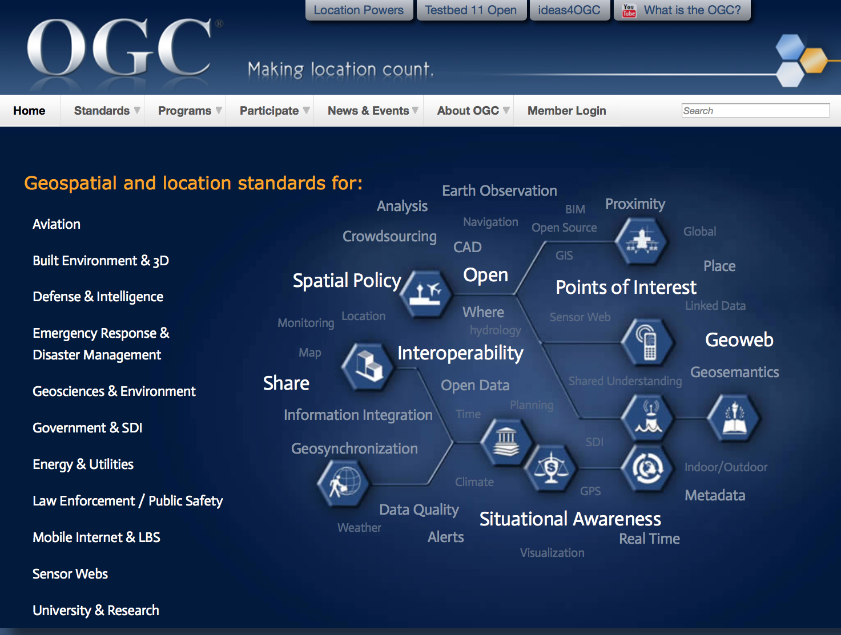
Gebiete
Aviation
Built Environment & 3D
Business Intelligence
Defence & Intelligence (D&I)
Emergency Response & Disaster Management
Energy & Utilities
Geosciences & Environment
Government & Spatial Data Infrastructure
Mobile Internet & Location Services
Sensor Webs
University and Research
Vgl. http://www.opengeospatial.org/domain
Business Intelligence
Domains 2019

Slide 6
Interoperability: OGC‘s Definition
„…software components operating reciprocally (working with each other) to overcome
tedious batch conversion tasks,
import/export obstacles, and
distributed resource access barriers
imposed by heterogeneous processing environments and heterogeneous data.
(McKee and Buehler, 1998 ; Sondheim, Gardels and Buehler 1999)

Slide 7
Interoperability: IEEE‘s Definition
„Ability of two or more systems or components to exchange information and to use the information that has been exchanged.”
(IEEE 1990)
"The capability to communicate, execute programs, or transfer data among various functional units in a manner that requires the user to have little or no knowledge of the unique characteristics of those units".
(ISO/IEC 2382-36:2008)

Slide 8
Interoperabilität verbessert die Vernetzung beziehungsweise Vernetzbarkeit von Systemen und ermöglicht den elektronischen Datenaustausch jenseits des Horizonts des ursprünglich geplanten Einsatzbereiches. Sie ermöglicht die Realisierung von vernetzten Software-Systemen mit unterschiedlichen Lieferanten. Interoperabilität führt dazu, dass die Kunden bei der Auswahl von Software-Systemen nicht eingeschränkt werden und fördert so den Wettbewerb und die Verbreitung von Innovationen in der IT-Branche. Sie fördert die Nachhaltigkeit von Software-Systemen und unterstützt zugleich weitere Ziele, wie Agilität, Offenheit und Wiederverwendbarkeit.
[1] Die Beauftragte der Bundesregierung für Informationstechnik (BfIT) (2011): SAGA-Modul Grundlagen. http://www.cio.bund.de/SharedDocs/Publikationen/DE/Architekturen-und-Standards/SAGA/saga_modul_grundlagen_de_bund_5_1_0_download.pdf?__blob=publicationFile [2019-03-17]

Slide 9
Interoperability: Definition
The ability to collaborate and to exchange information seeminglessly and without barriers.
Often restricted to technical aspects.
But: Interoperability should be extended to organisational, personal, semantical, institutional and political aspects.
Notes:
Technical Interoperabilty
Personal Interoperabilty
Semantical Interoperabilty
Institutional Interoperabilty
Political Interoperabilty

Slide 10
REQUEST FOR COMMENTS (RFC)
Candidate Standard (CS)
OGC
Abstract Specification
Adaption of ISO Standards is possible
Feedback
Enhancements
OGC Compliance Testing Portal
Testbed
Modifiied after: Wolfgang Reinhart (2016). https://www.unibw.de/inf4/professuren/geoinformatik/lehre/skripten/herbsttrimester-2016/gi-kapitel-1-standards-intro.pdf/at_download/file
Engineering Reports (ER),
Change Requests (CR)
CSW
WCS
WFS
WMS
Implementation Specification
Implementation/Development of products
Implementations
OGC Compliance Testing
Reference Implementation
Objective: standardized products for the market
Notes:
Während die Implementation Spezifikation konkrete Standards für die Realisierung von
Software definiert, bildet die Abstrakt Spezifikation den konzeptionellen Unterbau für die
Implementation Spezifikation.

Slide 11
Participation through requests
RFP (Request for Proposal): released by the OGC, after an OGC abstract specification is published. OGC members submit proposals for an implementation specification based on the abstract specification.
RFC (Request for Comment): describes a process, wherein the OGC members are asked to comment a published proposal for an implementation specification.
RFI (Request for Information): A RFI is published to the public by the OGC in order to introduce their experiences into the process of specification (especially in critical cases).
Quelle: Wolfgang Reinhart (2016). https://www.unibw.de/inf4/professuren/geoinformatik/lehre/skripten/herbsttrimester-2016/gi-kapitel-1-standards-intro.pdf/at_download/file

Slide 12
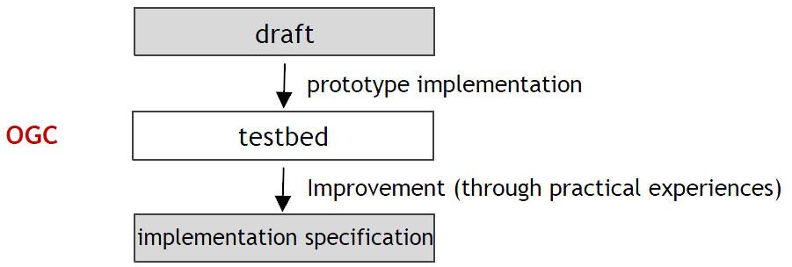
OGC Web Services testbeds
To accelerate the processes
"Organizations selected to participate […] will develop prototype solutions based on the sponsors’ use cases, requirements and scenarios. "
http://www.opengeospatial.org/standards/requests/160?utm_source=phplist558&utm_medium=email&utm_content=HTML&utm_campaign=OGC+Calls+for+Participation+in+Major+Innovation+Testbed+%28Testbed+14%29 [2017-12-10]
Quelle: Wolfgang Reinhart (2016). https://www.unibw.de/inf4/professuren/geoinformatik/lehre/skripten/herbsttrimester-2016/gi-kapitel-1-standards-intro.pdf/at_download/file

Slide 13
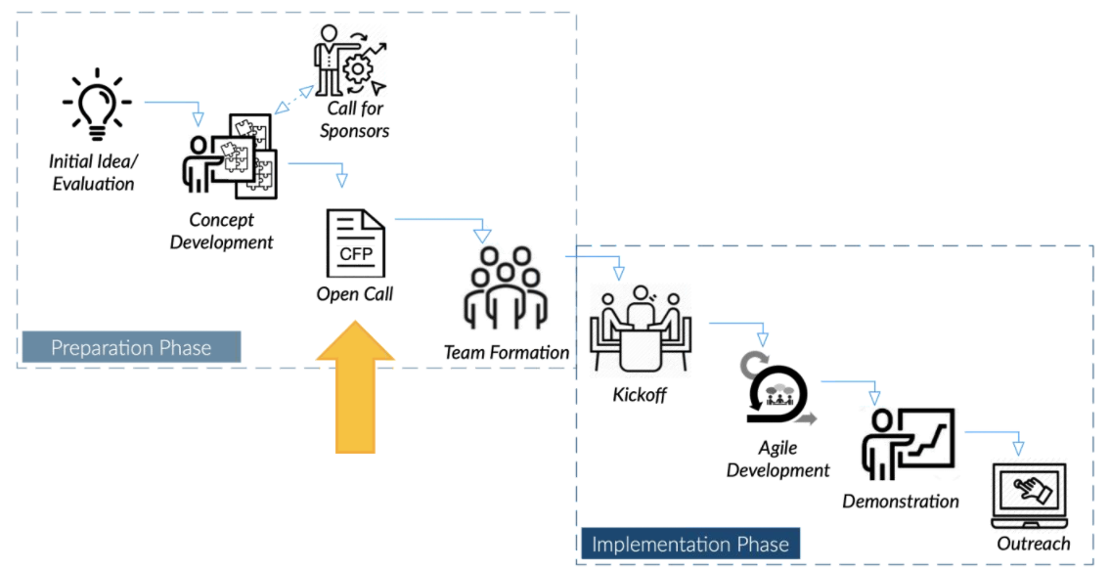
Source: Ingo Simonis: OGC Techn. Meeting 2020

Slide 14
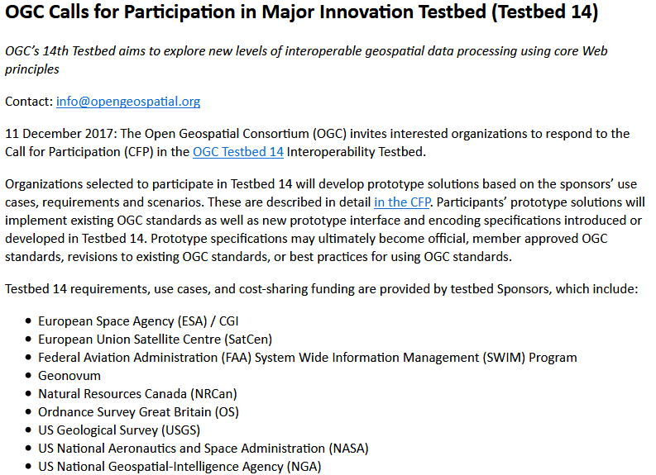

Slide 15
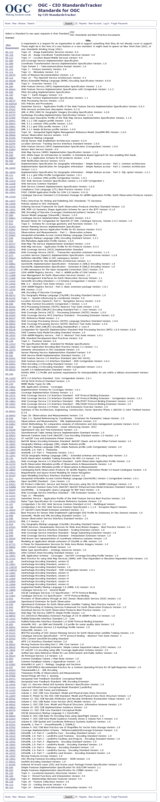
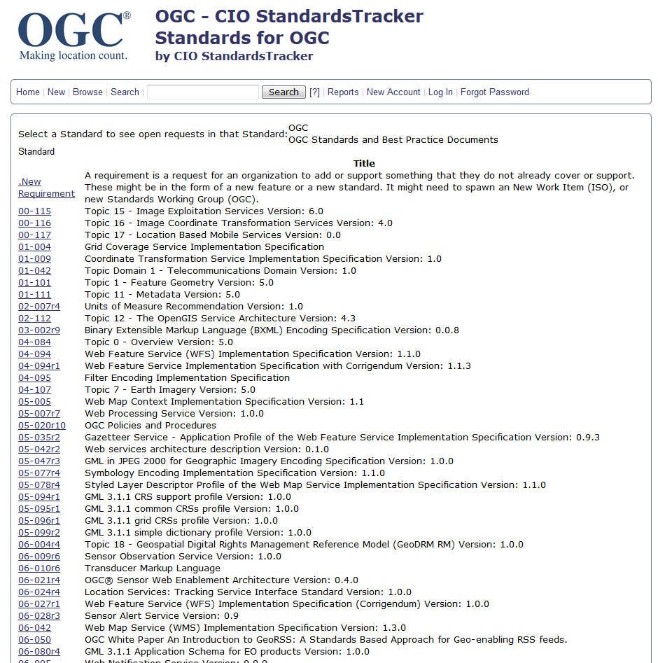
http://ogc.standardstracker.org/describecomponents.cgi

Slide 16
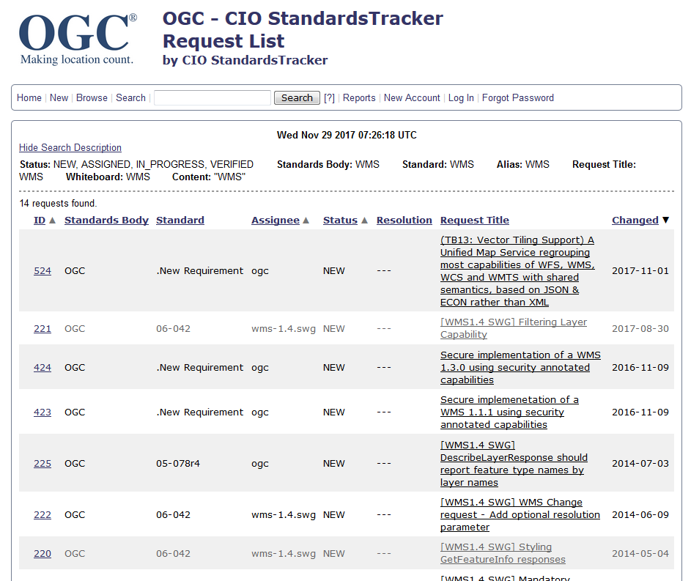

Slide 17
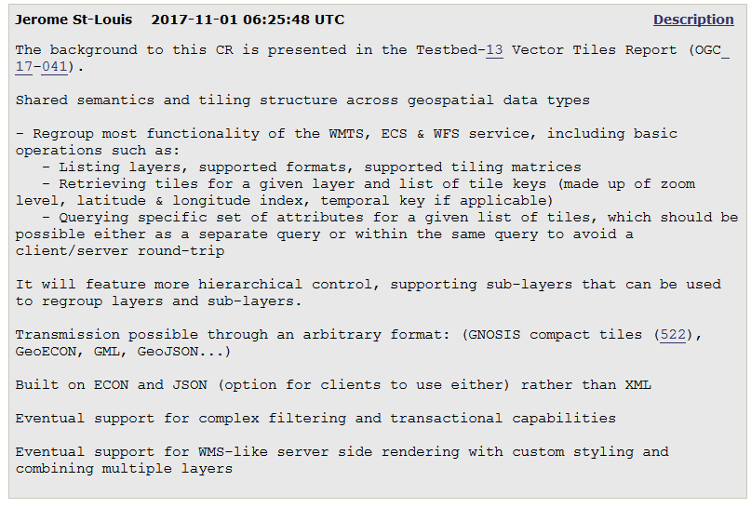

Slide 18
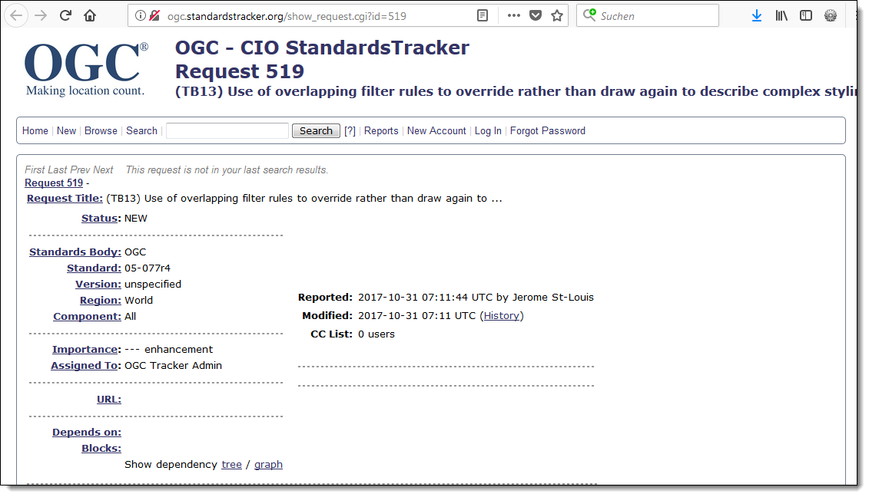
http://ogc.standardstracker.org/show_request.cgi?id=519 [2017-11-29]

Slide 19
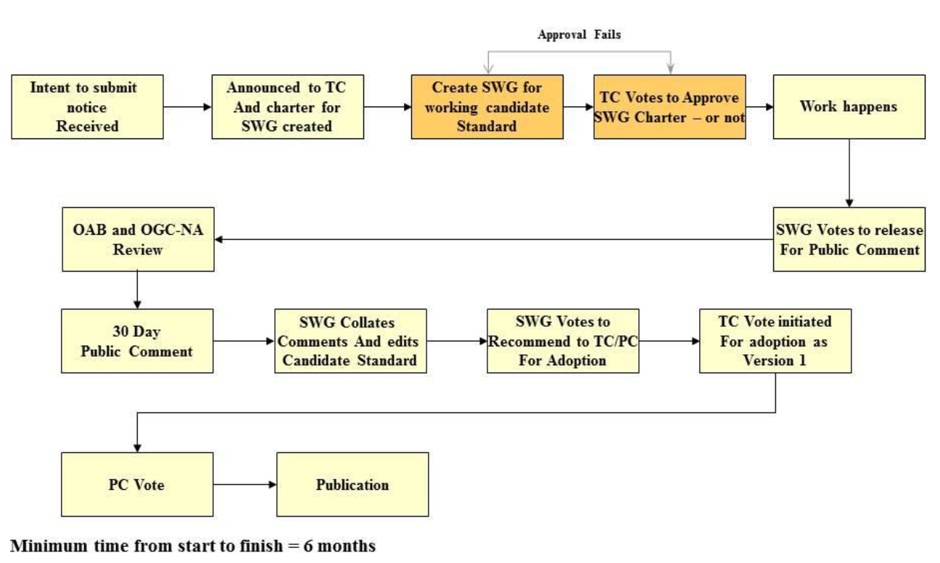
Standards Working Group (SWG): Process
http://portal.opengeospatial.org/files/?artifact_id=17592

Slide 20
"Open Standards” (like OGC Standards)
Is created in an open, international, participatory industry process […]. The standard is thus non-proprietary, that is, owned in common. It will continue to be revised in that open process, in which any company, agency or organization can participate.
Has free rights of distribution: An "open" license shall not restrict any party from selling or giving away the specification as part of a software distribution […] shall not require a royalty or other fee.
Has open specification access: An "open" environment must include free, public, and open access to all interface specifications. Developers are allowed to distribute the specifications.
Does not discriminate against persons or groups
Ensures that the specification and the license must be technology neutral: No provision of the license may be predicated on any individual technology or style of interface.
http://www.opengeospatial.org/ogc/faq/openness [2017-07-18]]
http://ggim.un.org/docs/Standards%20Guide%20for%20UNGGIM%20-%20Final.pdf, p. 7 [2017-07-18]]

Slide 21
However:
By this definition, a de facto standard established by one company or an exclusive group of companies or by a government is not an open standard, even if it is published and available for use by anyone at no charge. The Web, and the Spatial Web, cannot depend on proprietary standards.

Slide 22

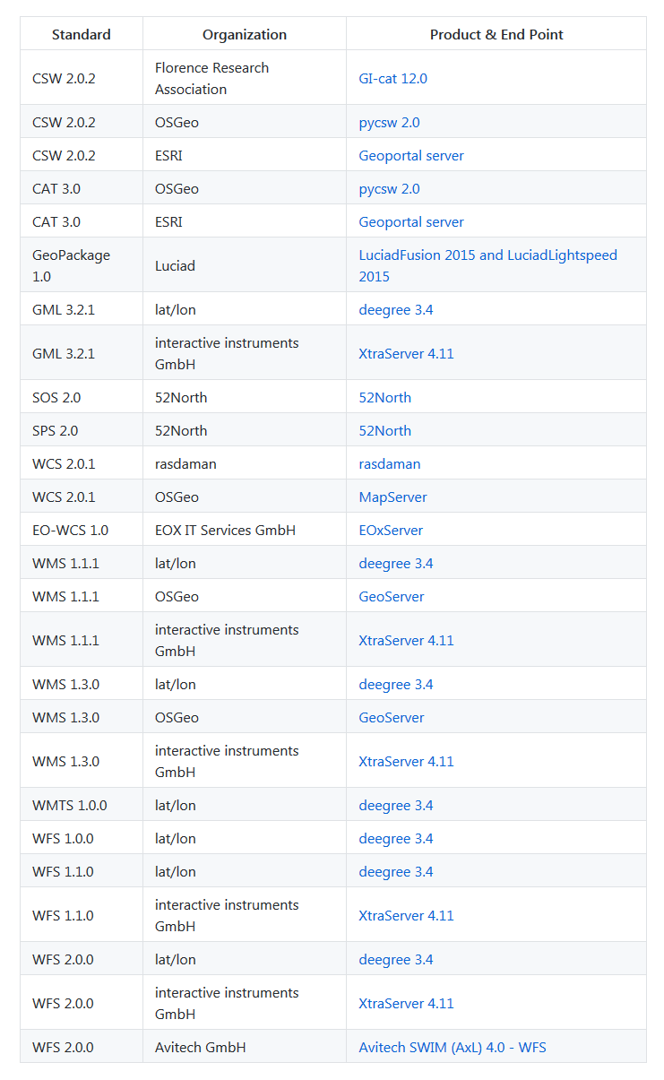
Reference Implementations
are fully functional, licensed copy of a tested, branded software that
have passed the test for an associated conformance class in a version of an Implementation Standard and that
are free and publicly available for testing via a web service or download
Are branded for one year - needs to be retested every year and pass the test to maintain its status as Reference Implementation
Can be found at https://github.com/opengeospatial/cite/wiki/Reference-Implementations
Source: http://cite.opengeospatial.org/reference

Slide 23
OGC Standards, evolving over years
… some of them became deprecated or
are replaced by newer versions
WCPS
WaterML
SensorML
OWS Contxt
OpenMI
IndoorGML
Filter Encoding
Geo Package ES
OpenSearch Geo
WCPS
WCPS
WaterML
PubSub
PubSub
GUFS
GUFS
Catalogue Service
Catalogue Service
Open GeoSMS
TSML
SensorThings
WaterML
I3S
GWML
GeoSciML
GeoPackage ES
3dP
CDB
GeoRSS
Moving Features
InfraGML
WSC
WPS
Symbology Encoding
SLD
SensorML
GML
Catalogue Service
SOS
OpenLS
GeoXACML extB
GeoXACML extA
CityGML
KML
Simple Features
Geo API
SPS
SPS
SWE Service Model
SWE Common Data Model
Observation & Measurement
NetCDF
WSC
WMT Service
Table Joining Service
Simple Feature SQL
Filter Encoding
Catalogue Service
Cat: ebRIM
SOS
PUCK
OSFE
NetCDF
GML
GeoSPARQL
CityGML
WKT CRS
WPS
KML
Geo Package ES
ARML
GeoPackage ES
SF OLE/COM
SF COBRA
WMS
GML in JPEG
CTS
WMC
WMC
1999
2001
2005
2006
2007
2008
2010
2011
2012
2014
2015
2016
2017
2018
2019

Slide 24
Mitgliedschaft/Membership

Slide 25
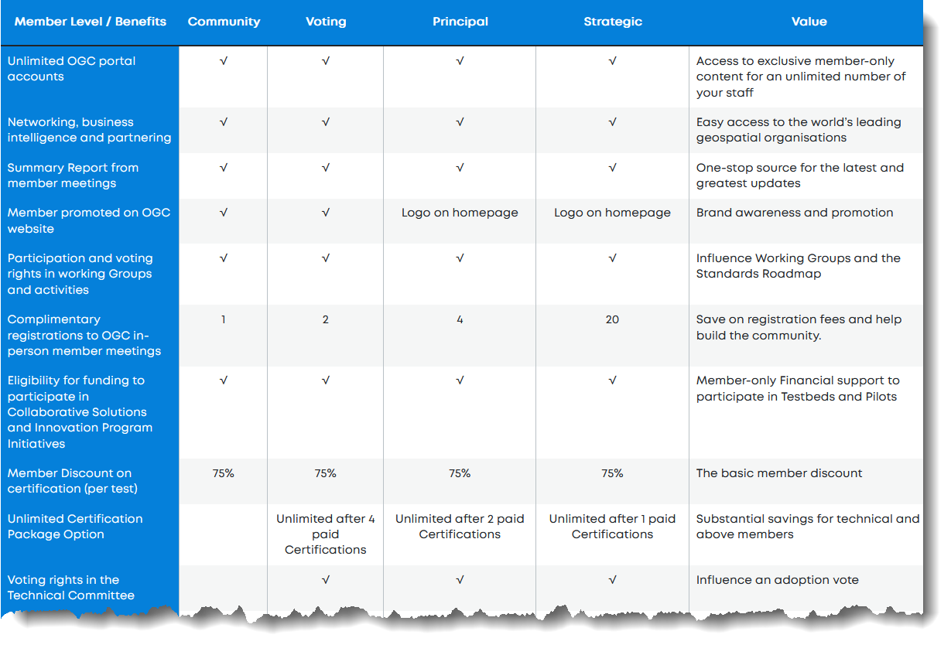
https://www.ogc.org/about-ogc/benefits/ [2023-05-01]

Slide 26

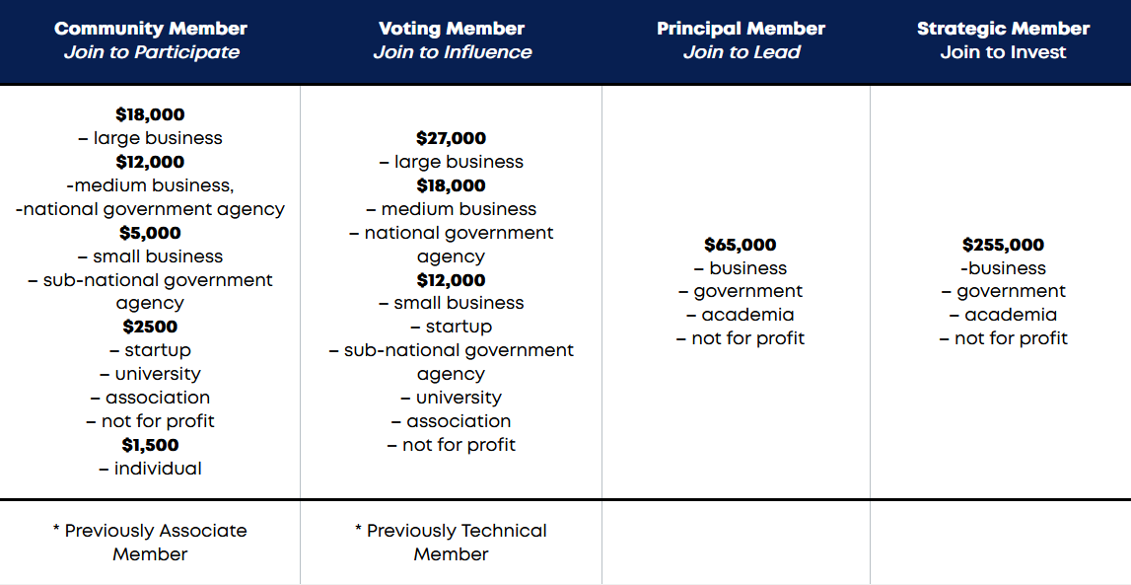
Mitglieder/Members
2020-11-11
https://www.ogc.org/join/ [2023-05-01]

Slide 27









































Commercial Mambers - Example
Hardware
Data
Public Agencies
Software
Universities
Research Institues
Industry

Slide 28
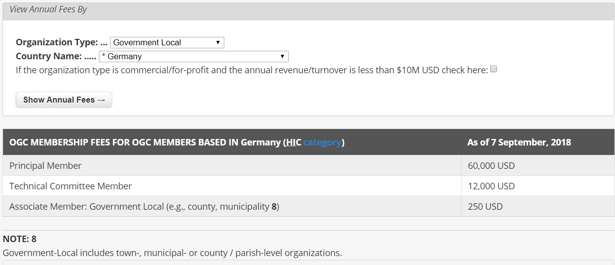
http://www.opengeospatial.org/ogc/join?orgtype=Government-Local&country=Germany#results [2018-09-07]

Slide 29
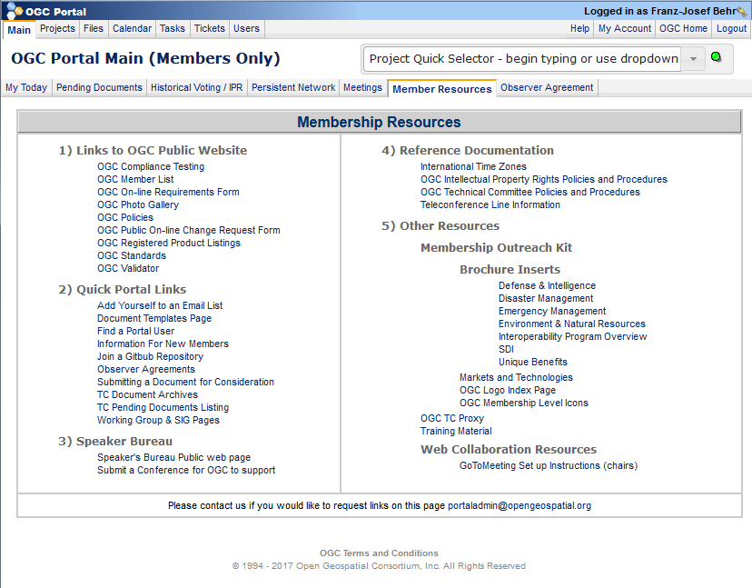

Slide 30
Organisational Structure

Slide 31
http://www.opengeospatial.org/projects/groups/smac
http://www.opengeospatial.org/ogc/organization/gac
Strategic Member Advisory Committee
Board of Directors
Global Advisory Council
Executive Director & Staff
Interoperability Program
Innovation
Program
Standards Program
Compliance Program
Communications and Outreach Program
IP Management Team
IP Management Team
Technical Committee
Planning Committee
Strategic Alliance
Working Group (WG)
Standards Liaison
Compliance Testing
Market and Regional Programs
Testbeds
Interoperability Initiative
Init. Mgnt. Team
Pilots
Certification and Branding
Education
Sponsors
Sub Committee
Plugfests
Plugfests
Member Services
Participants
OGC Architecture Board
Participants
Participants
http://www.opengeospatial.org/
ogc/programs/ip
https://cite.opengeospatial.org/
http://www.opengeospatial.org/
ogc/programs/ocap
http://www.opengeospatial.org/projects/groups/oab

Slide 32
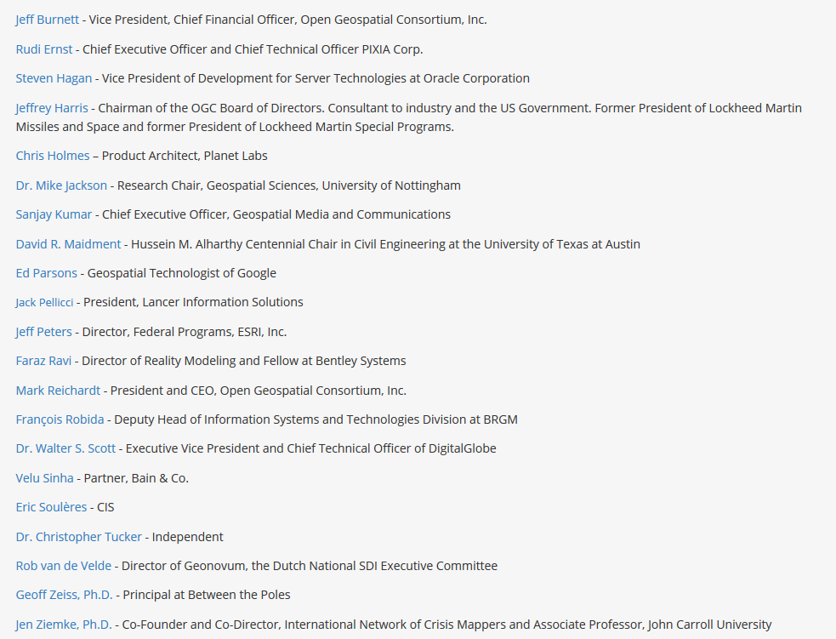
Board of Directors
wichtig/important

Slide 33

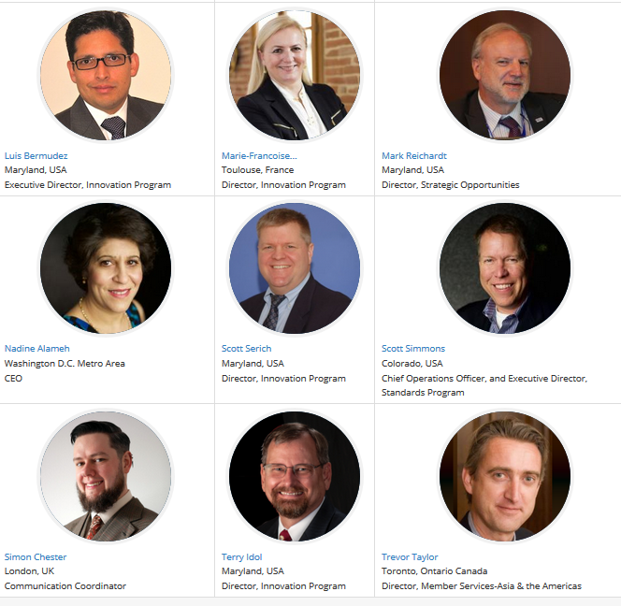
OGC Staff
"a virtual organisation" – "to ensure the best support for our global membership, our staff live and work in many different locations throughout the world."
http://www.opengeospatial.org/ogc/organization/staff [2019-07-08]

Slide 34
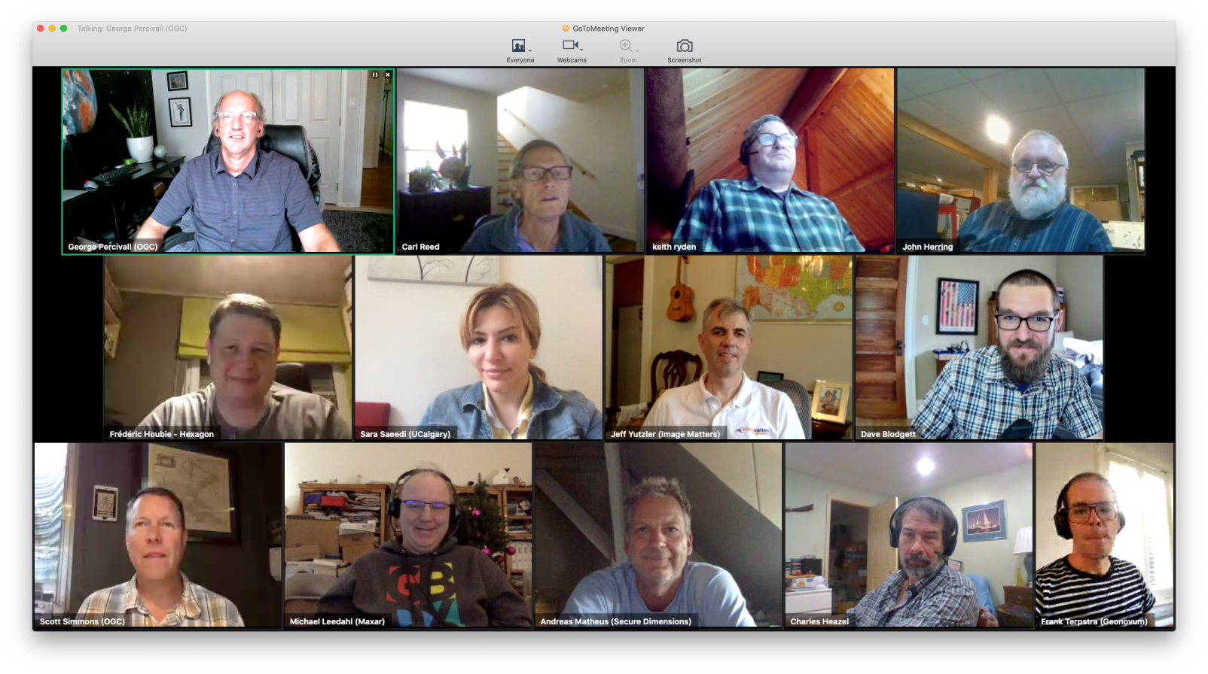
OGC Architecture Board - OAB
Meeting 2020 (Not all members present)
https://www.ogc.org/projects/groups/oab [2020-12-01]

Slide 35
Programs
https://www.ogc.org/ogc/programs

Slide 36
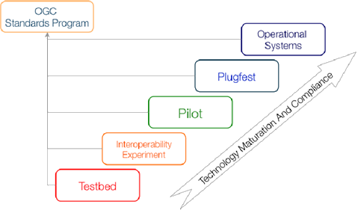
Innovation Program (IP)
"a collaborative agile process for solving geospatial challenges. Organizations (sponsors and technology implementers) come together to solve problems, produce prototypes, develop demonstrations, provide best practices, and advance the future of standards. "
Pilots
Plugfests
Testbeds
OGC Engineering Services
https://www.opengeospatial.org/docs/er
Interoperability Experiment
Concept Development studies
Increasing Technology Readiness in OGC-IP Initiatives . Percivall et al. (2015): Innovation in OGC: The Interoperability Program. https://www.researchgate.net/publication/283619801_Innovation_in_OGC_The_Interoperability_Program

Slide 37
Innovation Program (IP): Benefits
„a world recognized process for users of geospatial technology to collaborate and share the costs of advancing technologies for future enterprise architectures” [1]
Technological risk Reduction through accelerating development, testing and acceptance of interoperability standards with the refinement of standards and best practices
Market expansion and market availability of interoperable solutions
Experience of new technologiesand early adoption of standards
Cost effective methods for sponsors and participants to share expertise and development while gaining early marketplace insight and advantage
[1] https://www.opengeospatial.org/ogc/programs/ip?utm_source=phplist704&utm_medium=email&utm_content=HTML&utm_campaign=CORRECTION%3A+OGC+Pilot+Initiative+seeks+to+mature+standards-based+%E2%80%9CApplications+to+the+Data%E2%80%9D+architecture%3B+funding+available+for+participants

Slide 38
Strategic Member Advisory Committee (SMAC )
conceived to be a permanent committee within the OGC organization, designed specifically to provide Strategic Members the opportunity to participate in the strategic planning processes of the Consortium, and to support Consortium operations aimed at achieving the corporation's mission as defined in the bylaws.
The SMAC is a formal structure defined within the framework of OGC's bylaws, designed to operate in parallel with the formal technical decision-making process (Planning Committee and Technical Committee) of the Consortium. The SMAC is the approval body for the Interoperability Program Policy and Procedures.

Slide 39
Standards Program
The Technical Committee and the Planning Committee work in a formal consensus process to arrive at approved (or "adopted") OGC® standards.
Standards Program
Technical Committee
Planning Committee
Working Group (WG)
Standards Liaison
Sub Committee
OGC Architecture Board

Slide 40
Technical Committee (TC)
… where the formal standards development consensus discussion and approval process occurs. The many Domain Working Groups (DWGs) and Standards Working Groups (SWGs) comprise the TC. [OGC 2016]
responsible for all aspects of the formal consensus OGC specification process. This includes:
  Coordinate development of and modifications to the OGC Abstract Specification;
  Coordinate development and adoption of OGC Implementation Specifications;
  Act on specification change proposals (acceptance, rejection, and conditional acceptance);
  Many responsibilities concerning evaluation, approval and recommendations of various documents and proposals.

Slide 41
OGC Architecture Board - OAB
a forum to discuss the OGC-wide standards architecture.
considers architecture consistency and life cycle management of the OGC standards baseline.
evaluates current technology issues and identify gaps in the architecture that need to be responded to by the Membership.
provides guidance and recommendations to the TC and the PC.

Slide 42
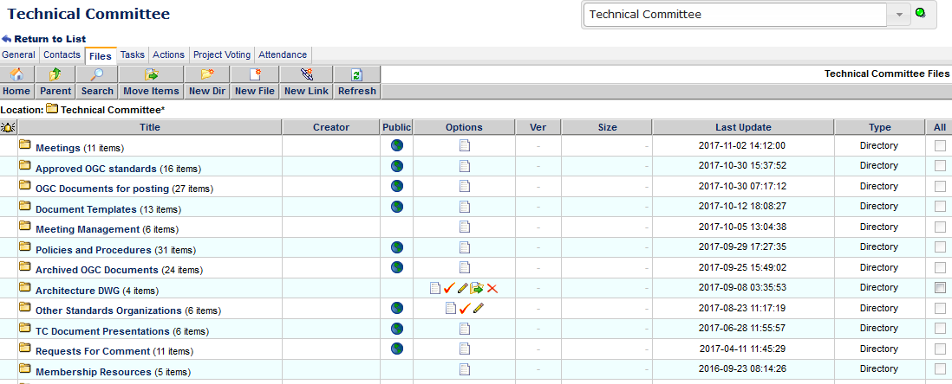
TC documents

Slide 43
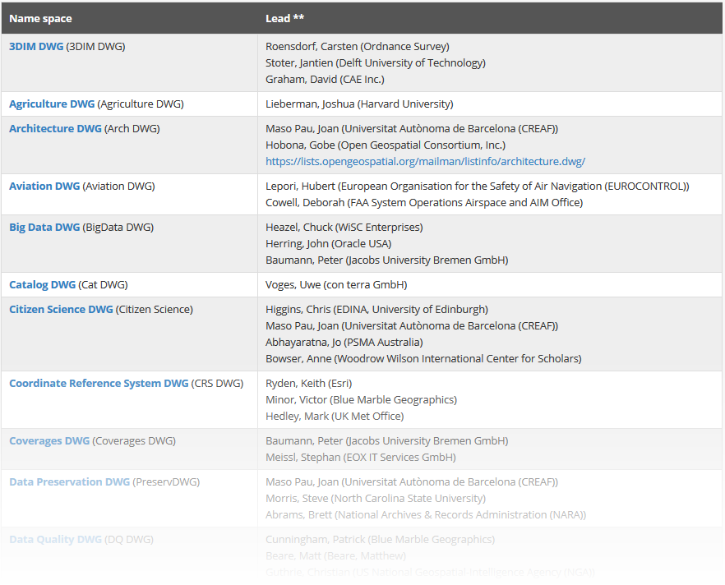
Domain Working Groups
“[…] members discuss technical requirements, use cases, and issues related to the development and revision of OGC standards. DWGs present and discuss the results of OGC interoperability projects.” (OGC 2016)
See the DWG listing at: http://www.opengeospatial.org/projects/groups/wg

Slide 44
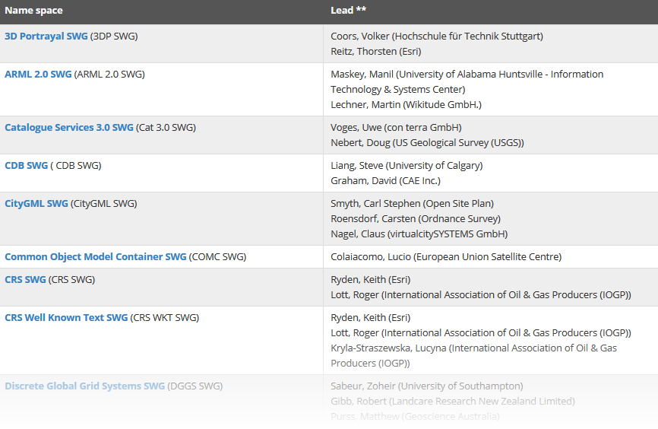
Standards Working Groups (SWGs)
“work on new (candidate) OGC standards or revisions to an existing OGC standard. Members and invited experts may participate. Each SWG initiative usually lasts from 6 months to 18 months. OGC Intellectual Property Rights policies, discussed above, are in full effect" (OGC 2016)
See http://www.opengeospatial.org/projects/groups/swg

Slide 45
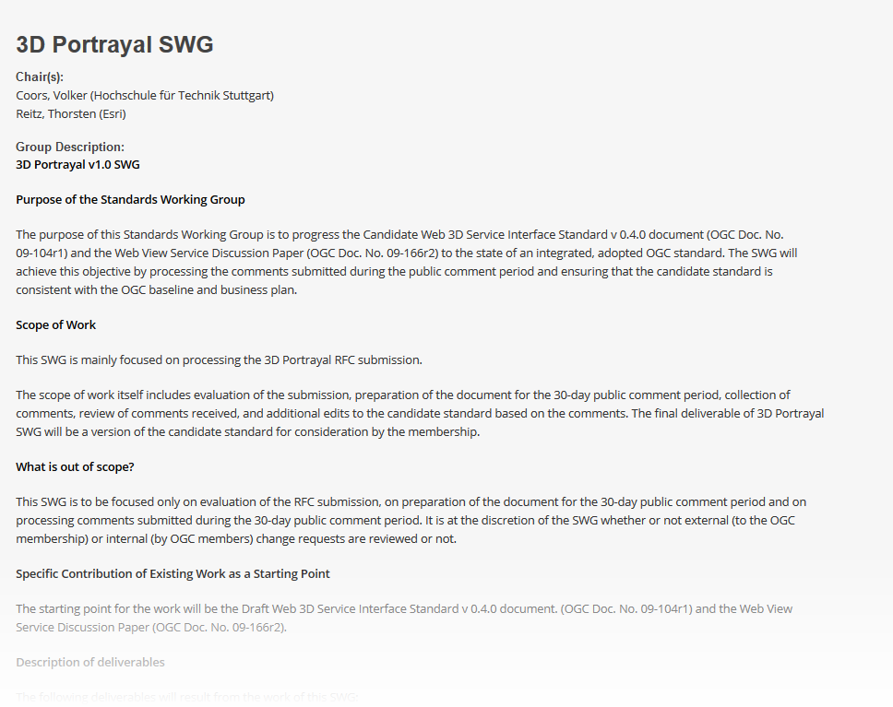

Slide 46
Outreach and Alliances

Slide 47
Communications and Outreach Program
„resources to help technology developers and users take advantage of the OGC's open standards. Technical documents, training materials, test suites, reference implementations and other interoperability resources developed in OGC Interoperability Initiatives”
available at http://wwwdev.opengeospatial.org/resources.
Outreach: OGC and its members support publications, workshops, seminars and conferences to help technology developers, integrators and procurement managers introduce OGC plug and play capabilities into their architectures.
Communications and Outreach Program
Strategic Alliance
Market and Regional Programs
Education
Member Services
http://www.opengeospatial.org/ogc/programs

Slide 48
Alliance Partners
OGC mission is aligned with the missions of many different organizations.
Collaboration on standards development, particularly when an interoperability solution depends on consistency between standards from different standards development organizations.
Standards organizations look to the OGC for advice on how to encode geolocation in their standards and OGC looks to them to learn what must be done to achieve harmonization across the standards stack.
Testing and validating standards through joint initiatives such as testbeds, interoperability experiments and pilot projects, and we collaborate on reference architectures to improve interoperability across communities of interest.

Slide 49
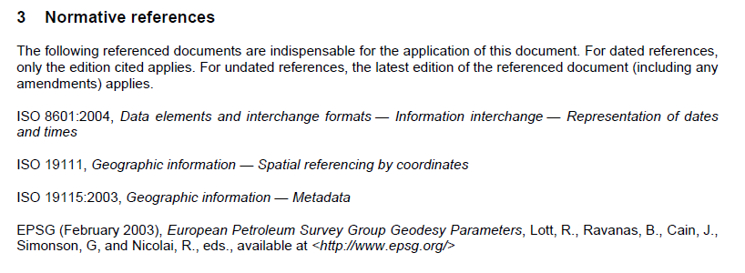
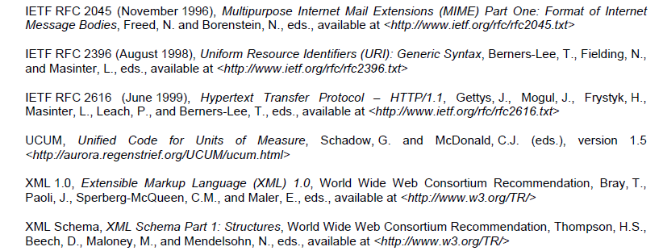
Example of referencing other standards

Slide 50
























OGC Alliance Partners
Notes:
2020: https://www.apachecon.com/acah2020/tracks/geospatial.html

Slide 51
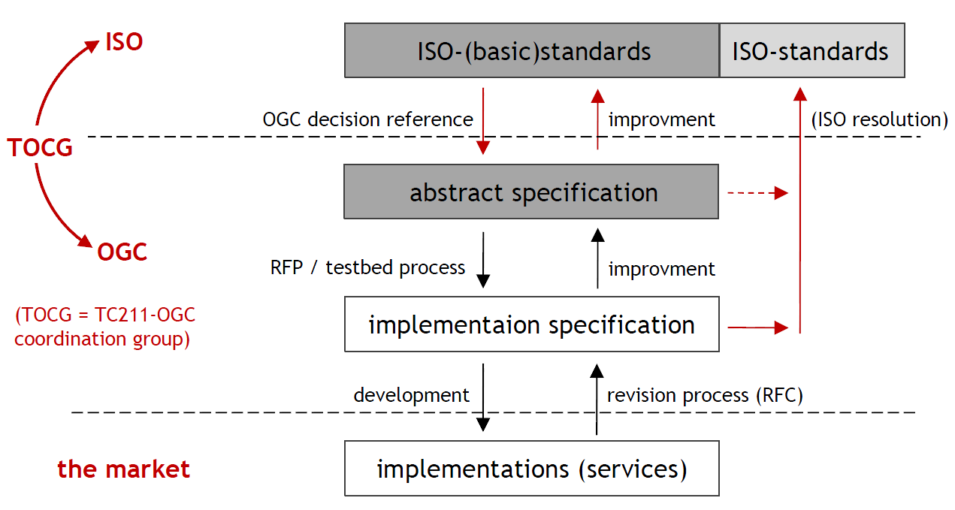
Alliance with ISO
Quelle:: Wolfgang Reinhart (2016). https://www.unibw.de/inf4/professuren/geoinformatik/lehre/skripten/herbsttrimester-2016/gi-kapitel-1-standards-intro.pdf/at_download/file

Slide 52
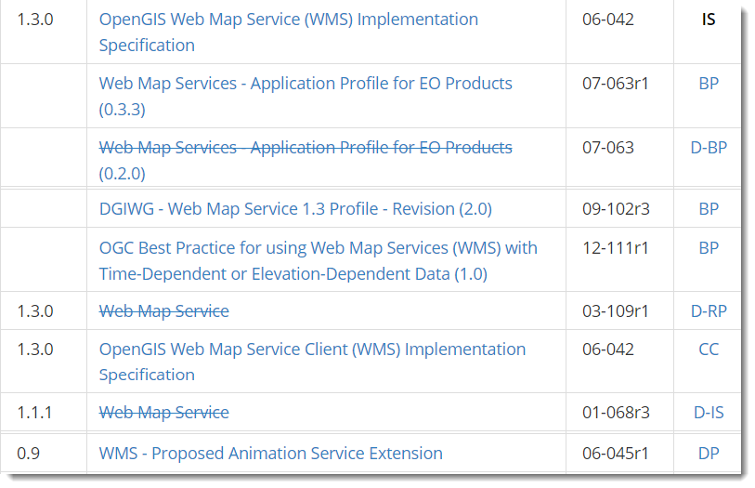
Documents

Slide 53
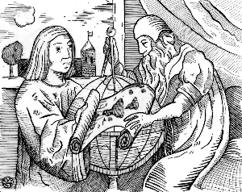
OGC Reference Model (ORM)
a framework for the ongoing work of the OGC.
describes the OGC Standards Baseline (SB) focusing on the relationships between the OGC standards.
The OGC SB consists of
  the approved OGC Abstract Specification and
  OGC standards as well as
  OGC Best Practices documents.
http://www.opengeospatial.org/standards/orm

Slide 54
OGC Abstract Specification
http://www.opengeospatial.org/docs/as
developed by the OGC Technical Committee (TC), an architecture in support of its vision of geospatial technology and data interoperability. [https://www.opengeospatial.org/standards 2019-07-10]
provides the conceptual foundation for most OGC standard development activities.
  OGC standards are built and referenced against the Abstract Specification, thus enabling interoperability between different brands and different kinds of spatial processing systems.

Slide 55
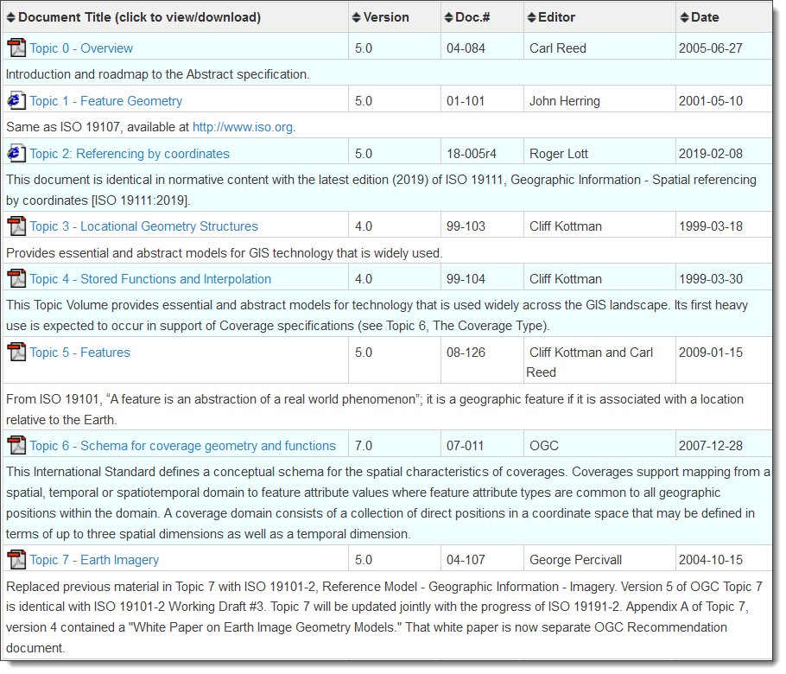
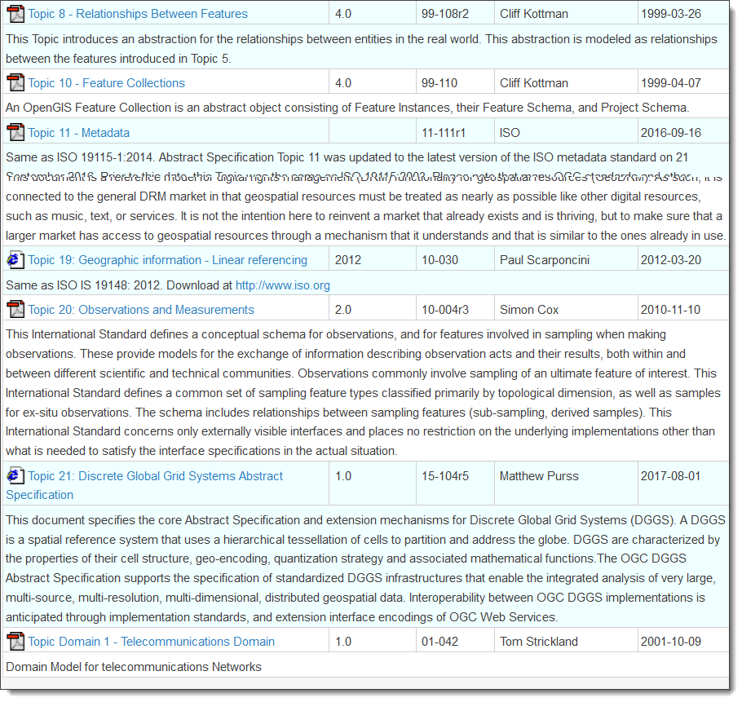

Slide 56
OGC Standards and Supporting Documents
"technical documents that detail interfaces or encodings" … "the main 'products' of the Open Geospatial Consortium and have been developed by the membership to address specific interoperability challenges" [http://www.opengeospatial.org/standards]
Two tracks of standards: [http://www.opengeospatial.org/standards]
  the Full standard track and
  the Community standard track, "a more lightweight process" since 2015, to enable standardization of “de facto” standards (like GeoJSON) [http://www.opengeospatial.org/blog/2543 2018-09-07]
OGC Implementation Standards: "more technical audience and detail the interface structure between software components"
Notes:
The focus of the OGC discussions was to define a more lightweight process by which outside (non-OGC) groups as well as OGC member organizations could feel comfortable submitting specifications developed outside the OGC into the formal OGC standards process.

Slide 57
Best Practices Documents http://www.opengeospatial.org/docs/bp
… contain recent discussion of best practices related to the use and/or implementation of an adopted OGC document and for release to the public.
… are an official position of the OGC and thus represent an endorsement of the content of the documents.
XML Schemas for some of these documents can be found at the Best Practices Schema Repository (http://bp.schemas.opengis.net/).

Slide 58
Engineering Reports http://www.opengeospatial.org/docs/er
Quite recent and primary output of OGC Innovation Program Initiatives (testbeds, pilot projects and interoperability experiments)
can address topics as needed by an initiative including:
  Requirements, Specifications which may become the basis for development of an OGC Standard.
  Testing Approach and Results (This includes experiment results), Compliance Test Design
  Next Steps and Lessons Learned
represent consensus positions of the initiative participants and sponsors only.
Do not represent the official position of the OGC nor of the OGC Technical Committee.

Slide 59
Further Documents
Discussion Papers: present technology issues being considered in the Working Groups of the TC in an unofficial way
  Purpose is to create discussion in the geospatial information industry on a specific topic.
  not intended to be targets of acquisition descriptions.
White Papers: present technology issues of interest to OGC members (http://www.opengeospatial.org/docs/whitepapers)
  are voted on by the membership to be approved for public release, but they do not represent official positions
Change Requests: are submitted by anyone for any existing or proposed OGC Standard.

Slide 60
Information Resources

Slide 61
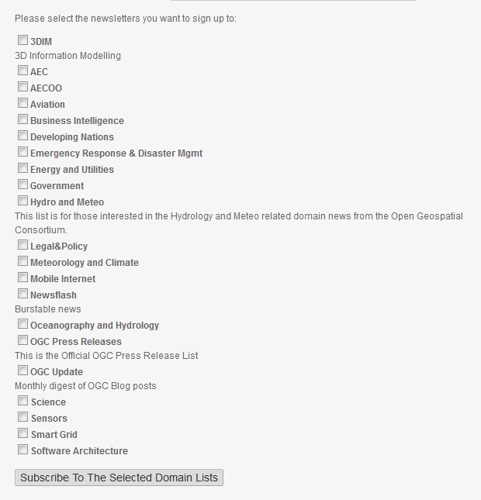

Mailing lists
https://mail.opengeospatial.org/lists/

Slide 62
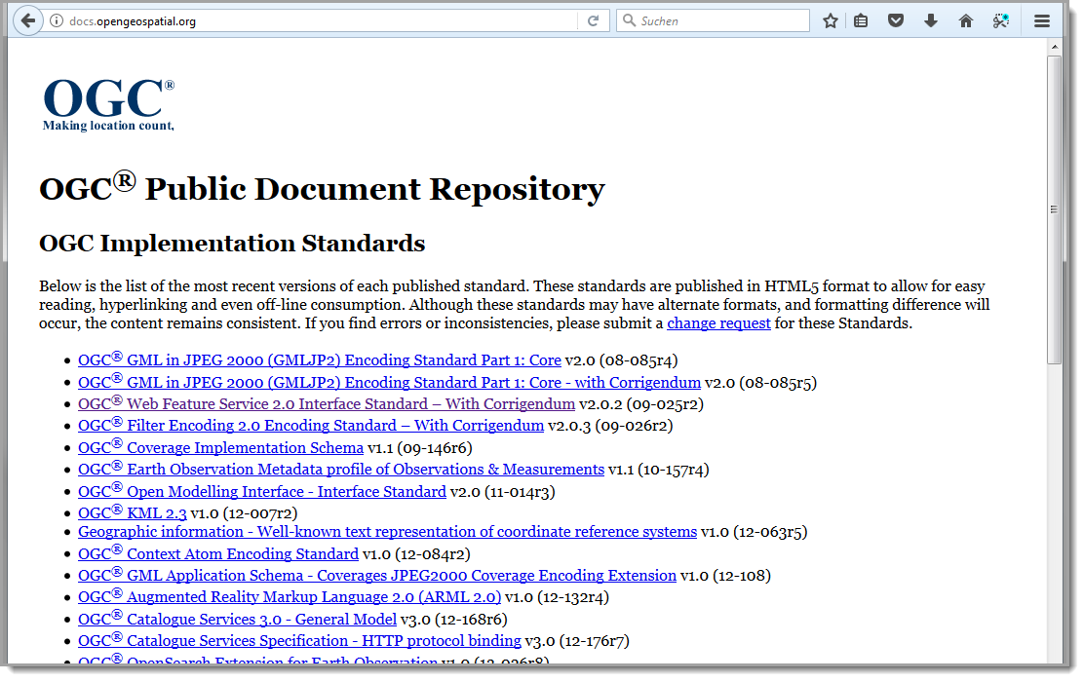
Public Document Repository
OGC Implementation Standards - OGC Community Standards - Abstract Specifications - Best Practice Documents - Test Suites - Policy Documents- White Papers – Other documents
http://docs.opengeospatial.org/ []2017-10-23

Slide 63
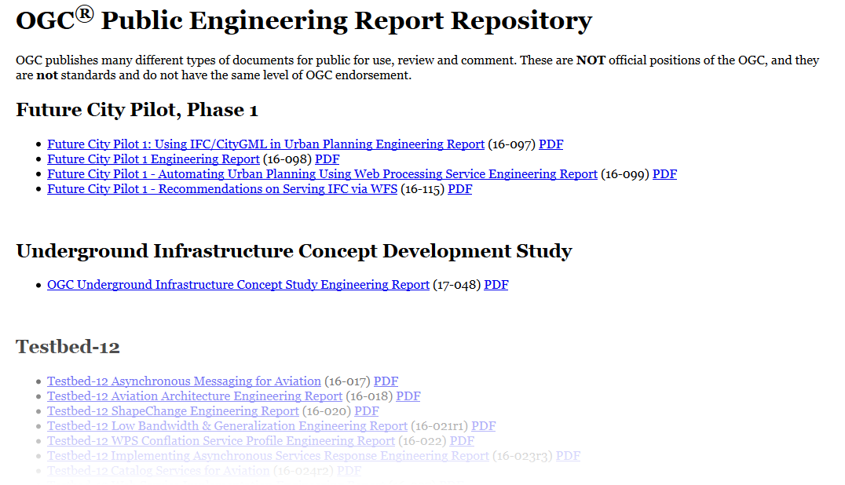
Public Engineering Reports – "latest developments in the standardization sector"
http://docs.opengeospatial.org/per/

Slide 64
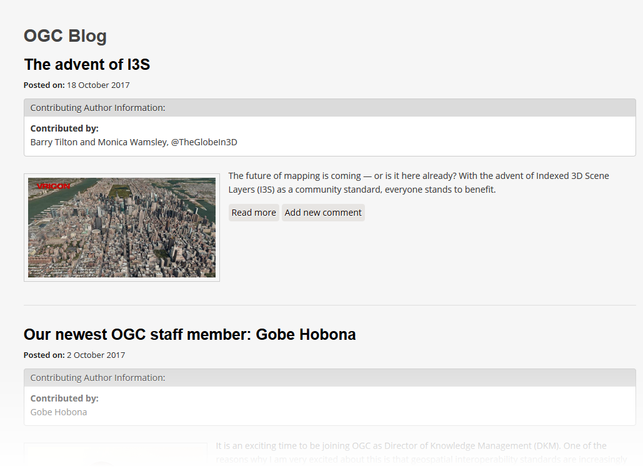
OGC Blog
http://www.opengeospatial.org/blog/

Slide 65
References
Dr. Ingo Simonis, Director of Innovation Programs & Science, Open Geospatial Consortium (2016): Geodata Integration & Standards & Interoperability.

